Slide 1
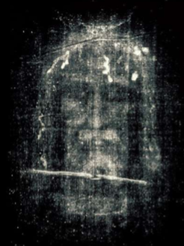
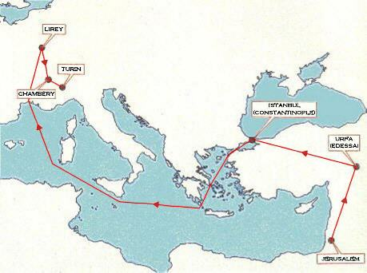
The Shroud of Turin an Enduring Mystery Part 3: History
Dr. Ray Schneider, P.E., Ph.D.
Associate Professor Emeritus
Bridgewater College, Virginia

Slide 2
Last Time
We didn't quite get through the slides so we'll continue from where we left off on the Science
The key point here is that emerging science that produces dating estimates based on other factors than C14 decay suggest that the shroud is indeed much much older than the interval the C14 labs produced
1250-1390 with 95% probability ? Really?

Slide 3
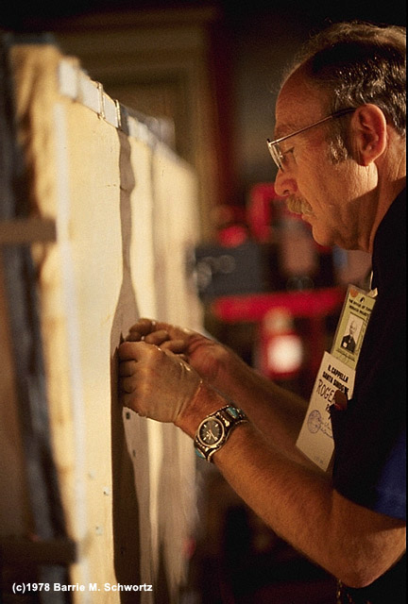
Introducing Raymond Rogers
UCLA / Los Alamos Science Fellow
Member of the 1978 STURP team
Cofounder of the Coalition for Excellence in Science Education.
Member of the Department of the Air Force Scientific Advisory Board
Published over 50 peer-reviewed papers in scientific journals.

Slide 4
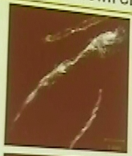
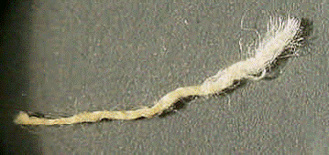
SURPRISINGLY He found splices dyed at one end in samples from the C14 region
under analysis at Los Alamos
the sample divided into three
parts one of which was
an adhesive resin

Slide 5
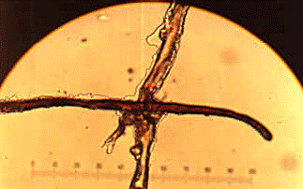
AND the fibers were encrusted
with dyestuff

Slide 6
AND
Madder root dye (Alizarin)
Alum
Gum Arabic
Vanillin
But only in the corner. Not anywhere else.

Slide 7
In 2002, Rogers and Anna Arnoldi of the University of Milan published preliminary findings suggesting mending.
Important Point: What was dated was chemically unlike the rest of the cloth.
Lloyd Curry in U.S. Government’s Journal of Research of the National Institute of Standards and Technology credited Rogers with significant findings.

Slide 8
In January 2005, Rogers’ findings were published in Thermochimica Acta
BBC: “Shroud Older Than Thought”
Philip Ball, writing in Nature Online, found the vanillin discovery particularly significant.

Slide 9
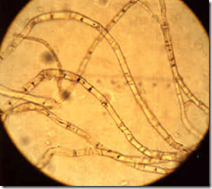
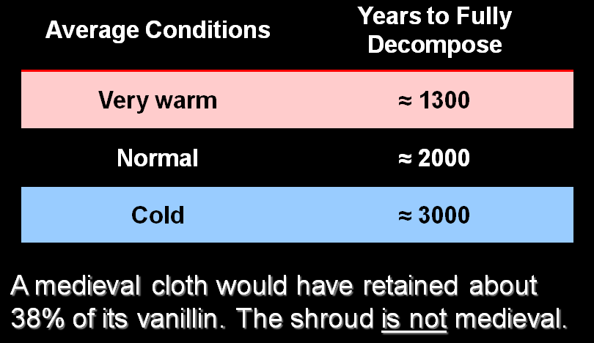
VANILLIN C₈H₈O₃

Slide 10
Three New
Dating Methods
Three Mechanical Tests Developed by Italian Researcher Giulio Fanti
nine ancient fabrics used in compiling the calibration curves: 3000 B.C. to 1000 A.D.
5 from Egypt, 3 from Israel, 1 from Peru
plus two modern fabrics of recent manufacture
Results: 300 BC ± 400; 200 BC ± 500; and 400 AD ± 400
Jointly: Statistically Combined 33 BC ± 250

Slide 11
Dating Status
Five independent dating methods now
C14
Vanillin Exhaustion
Fourier transform infrared spectroscopy
Raman spectroscopy
mechanical parameters of fibers under tension and breaking
Four agree only C14 is the outlier
Caveat: Fanti's methods require further confirmation

Slide 12
Next Time
So if we can't rule out authenticity then where exactly did the Shroud of Turin come from?
How can the burial cloth of Jesus Christ have been hidden in history only to turn up in the hands of a Christian knight around 1353?
Next time we'll look at that question
The History of the Shroud

Slide 13
Where We Are?
We've seen the correspondences between the shroud and the passion accounts in the gospels
We've seen the science which fails to show the shroud is not authentic and reveals many things that strongly argue for authenticity.
So where was this remarkable linen cloth before the 14th century?
RECONSTRUCTING THE HISTORY
A Mystifying Journey Through Possibilities

Slide 14
Where Do We Begin?
There are TWO Beginnings
The Shroud of Turin Is Displayed In Lirey, France sometime around 1353
Its History is a matter of public record to the present time with only small and scattered lacuna
The Primary Beginning If It Is Authentic
A Tomb in the region of Jerusalem
In the reign of Pontus Pilate
In either 30 A.D. or 33 A.D.

Slide 15
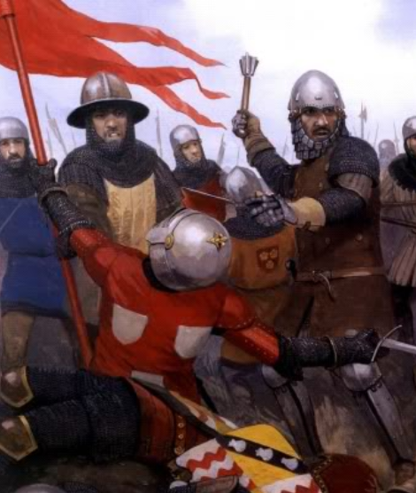
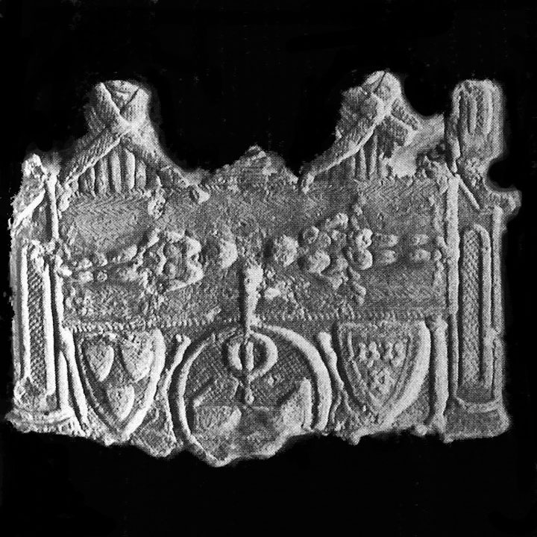
The Shroud Appears In Lirey, France
Exact date unknown c. 1349-1354
Owner: A Model Knight Geoffroy I de Charny who died 19 September 1356 defending his king at the battle of Poitiers
Bearer of the Oriflamme Battle Standard of the French King
Pilgrim's medallion
of the shroud showing
the arms of Geoffrey
de Charny and his wife
Jeanne de Vergy
6.2 cm x 4.5 cm
found in Seine river 1855

Slide 16
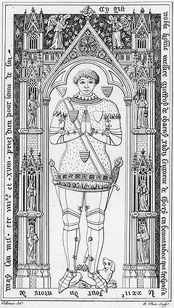
Geoffrey I de Charney Lord of Savoisy and Lirey
At Geoffrey's request a church to house relics was endowed by the king in June 1343 and July 1356, although no shroud is mentioned.
20 June 1353 the church is founded in honor of St. Mary of the Annunciation
On May 28, 1356 the church was eulogized by the local Bishop Henri de Poitiers bishop of Troyes
Geoffrey II de Charny

Slide 17
Bishop Pierre d'Arcis Bishop of Troyes (1378-1395)
1389/90 he writes a memo to the Avignon Pope Clement VII complaining of the exhibitions of the shroud as the authentic burial cloth of Jesus. He claimed: (he says)
his predecessor Bishop Henri de Poitiers had declared the shroud a forgery, and
had interviewed the painter (not identified)
pretended miracles were staged to promote belief
the bishop was ordered to perpetual silence on the matter by the pope who allowed the expositions on the condition that the shroud be presented as a representation and not the actual shroud of Christ

Slide 18
A Conspiracy?
Jack Marquardt blows up the d'Arcis memo in a 2001 paper, The Conspiracy Against the Shroud
it's concocted out of two other documents
probably never sent to the pope at all
Chevalier who created the document earns the admiration of his progressive colleagues, and a gold medal of 1,000 francs presented by the French Acadamie des Inscriptions in 1901.
The research subsequent to the 1898 photograph deflated the significance of the d'Arcis memo since the shroud is not a painting
https://www.shroud.com/pdfs/n55part3.pdf

Slide 19
A Great Many Documents *
1. Letter of Clement VII to Geoffroy II de Charny, dated 28 July 1389
2. Bull of Clement VII, 6 January 1390
3. Letter of Clement VII to Pierre d'Arcis, 6 January 1390
4. Letter of Clement VII to the ecclesiastical officials of Autun, Langres and Chalons-sur-Marne, 6 January 1390
5. Bull of Clement VII, dated 1 June 1390
6. The so-called Memorandum of Pierre d'Arcis (undated) which, in Chevalier's opinion, dates from the end of 1389.
* from Shroud Spectrum International #8 pg. 25, The Lirey Controversy, by Luigi Fossati
https://www.shroud.com/pdfs/ssi08part5.pdf

Slide 20
Observation
We have seen that the shroud is NOT a painting so to what is the good bishop referring? We'll come back to this point.
The bishop received no support from the pope or the king suggesting that they knew more about the shroud than they let on.

Slide 21
The de Charny/de Vergy Period
Son of Geoffrey I and Jeanne de Vergy, Geoffrey II de Charny displays shroud regularly at the church in Lirey, dies on 22 May 1398
1400 Margaret de Charny daughter of Geoffrey II marries Jean de Baufremont
June 1418 widowed Margaret marries Humbert of Villersexel, Count de la Roche, Lord of St.Hippolyte sur Doubs.
Following month the canons of Lirey convey the shroud to Humbert for safe-keeping. It is kept in various places and exhibited regularly.
http://www.shroud.com/history.htm

Slide 22
The Adventure Continues
1438 Humbert de la Roche, husband of Margaret de Charny dies and in 1443 the Lirey canons try to get her to return the shroud. She refuses.
1453 a widow with no children Margaret conveys the shroud to Duke Louis I of Savoy
1465 Duke Louis I dies and his son Duke Amadeus IX in 1502 instituted the cult of the Shroud in the Sainte Chapelle at Chambéry. The shroud is moved around a great deal by the Savoys.
1532 a fire damages the shroud in Chambéry

Slide 23
The Adventure Continues 2
1534 Chambéry's nuns the Poor Clares repair the shroud
1535 Savoy is invaded by French troops, the shroud is evacuated and displayed in Turin in May. It travels a good deal and is not brought back to Chambéry until 1561
1578 the shroud is taken to Turin ostensibly to save St. Charles Borromeo and his companions a trip on foot across the Alps. It remains in Turin until the present with only a couple of movements to protect it from war.

Slide 24
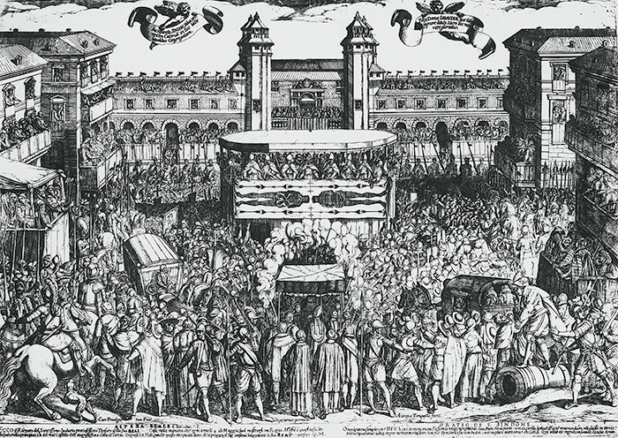
Expositions
Shroud is exhibited privately and publically for many years but does not leave Turin except to preserve it from the ravages of war.

Slide 25
1898 to the Present The Science We Looked At Last Time
The World Changes Suddenly. The Focus Is On Not Just A Cloth With A Faint Image On It …
Suddenly It Is A Prodigy, a Wonder
But It only appeared around 1355?
How Could It
Be Real

Slide 26
Backwards Or Forwards?
We can try to work backwards from 1355
Or we can try to work forwards from 30-33 A.D.
Or we can try to find a point In Media Res
The Timeline
70
544
944
1204
1355
the Present
?
EDESSA
?
KNOWN HISTORY
30-33 A.D.
CONSTANTINOPLE

Slide 27
Breaking It Down
The Timeline
70
544
944
1204
1355
the Present
?
EDESSA
?
KNOWN HISTORY
30-33 A.D.
CONSTANTINOPLE
The Known History Represents About A Third Of The Timeline
Based On Something I'll Call The Mandylion Conjecture We Can Fill In Another Third Roughly

Slide 28
What Is The Mandylion Conjecture?
The Mandylion Is An Image Of The Face Of The Lord Usually Depicted In Landscape Format
Ian Wilson In His 1978 Book asks the question:
"Could the Mandylion of the Eastern Orthodox Church have been one and the same as the cloth we know today as the Shroud of Turin?"
Correspondences That Point To The Answer
Coincidence of the Vignon markings
Description of the image as a "moist secretion"
the landscape display of the image
the "doubled in four" (tetradiplon) description
the deacon Gregory sermon

Slide 29
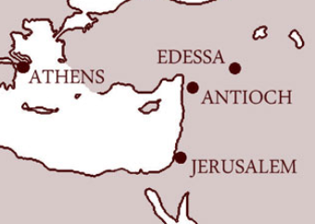
How Did The Shroud Get To Edessa?
Trying To Puzzle Out The Answer
The Timeline
70
544
944
1204
1355
the Present
?
EDESSA
?
KNOWN HISTORY
30-33 A.D.
CONSTANTINOPLE

Slide 30
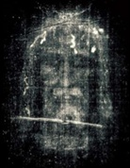
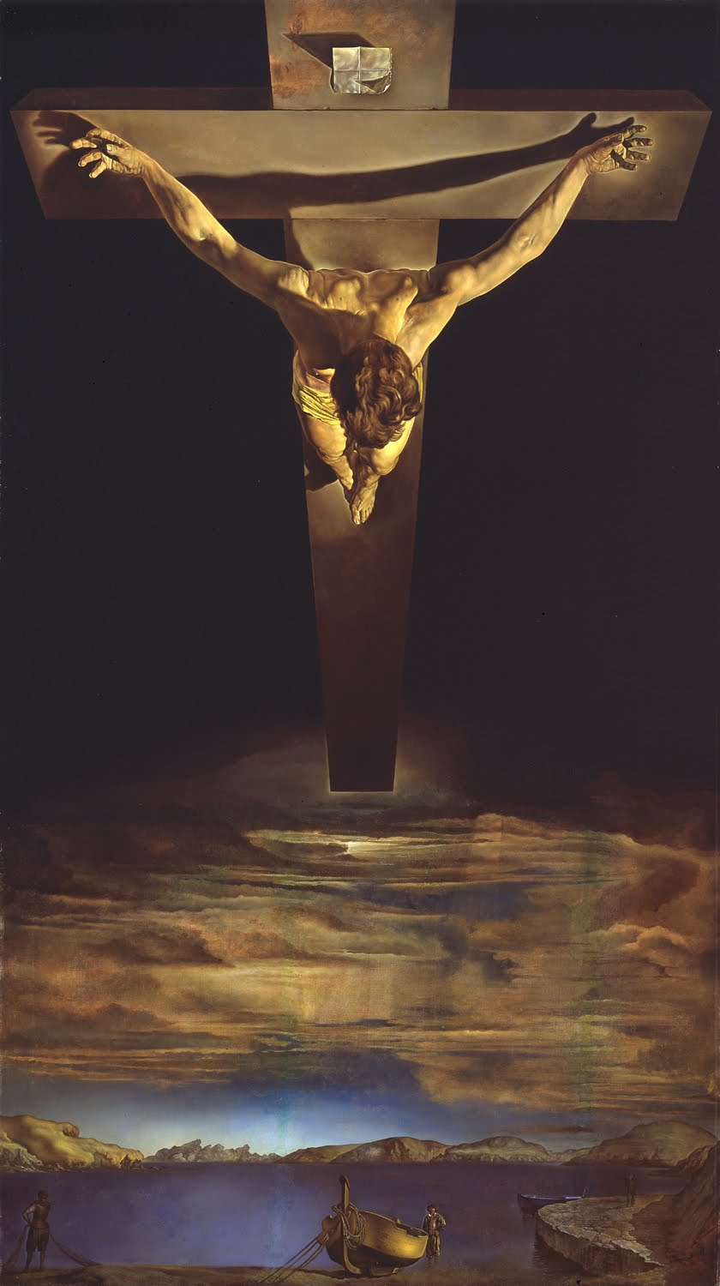
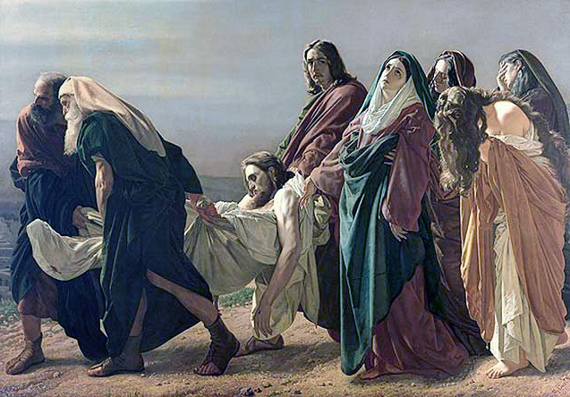
The Journey Begins
April 3, 33 A.D.
lunar eclipse at sundown
ACTS 2: 19-20
¹⁹ And I will show portents in the heaven above and signs on the earth below, blood, and fire, and smoky mist. ²⁰ The sun shall be turned to darkness and the moon to blood, before the coming of the Lord’s great and glorious day.

Slide 31
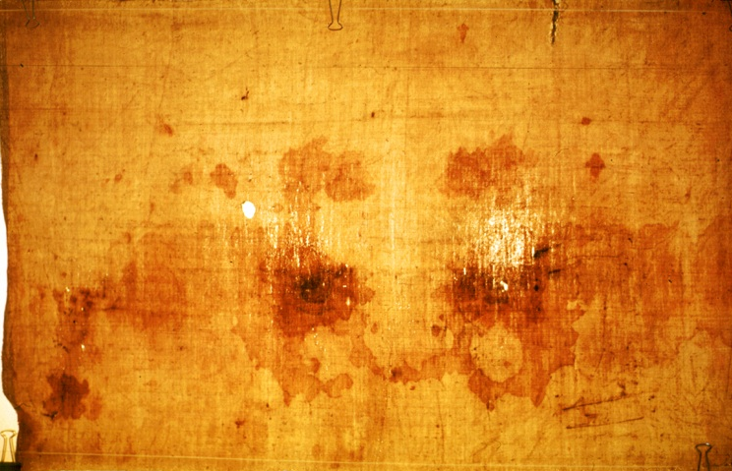
1. Scripture and the Shroud
30 to 33 A.D. The Public Ministry of Jesus of Nazareth
John 20:4-8
⁴ The two were running together, but the other disciple outran Peter and reached the tomb first. ⁵ He bent down to look in and saw the linen wrappings lying there, but he did not go in. ⁶ Then Simon Peter came, following him, and went into the tomb. He saw the linen wrappings lying there, ⁷ and the cloth that had been on Jesus’ head, not lying with the linen wrappings but rolled up in a place by itself. ⁸ Then the other disciple, who reached the tomb first, also went in, and he saw and believed; …

Slide 32
Missing Cloths?
A sindon (shroud) to carry the body to the tomb
A cloth to cover the top of the head of Christ in the tomb
Saint-Etienne Cathedral (located on the rue de Chantrerie in Cahors) is home to a museum of religious art. Its most interesting relic, called the “holy cap” or “cap of Christ,” was brought to Cahors by Bishop Géraud de Cardaillac. Having returned from the Holy Land in the 12th century, the cap is said to have covered Christ’s head in his tomb.
The "vera icon" Veronica image (Where does that fit into the picture?)
An image destroyed by the French Revolution at Besançon
http://gofrance.about.com/od/othercities/a/cahors-france.htm

Slide 33
So Who Got The Shroud?
Some Candidates
The Mother of Jesus
The Apostle John
The Apostle Peter
Joseph of Arimathea
Jude Thaddeus
We Don't Know

Slide 34
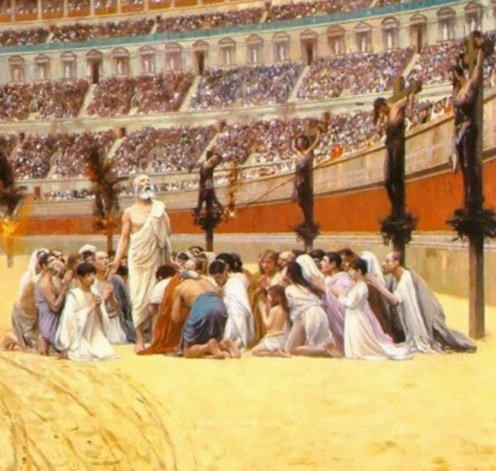
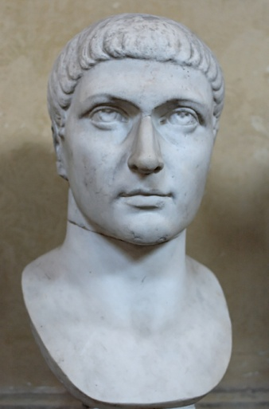
Why The Silence? From the Coliseum to Constantine
Coliseum
Small and Persecuted Community
Burial Cloths Were Ritually Unclean
The Shroud Contained an Image and Images Were Forbidden by Mosaic Law
Revealing Its Existence Would Encourage Enemies to Try to Seize and Destroy It
Constantine

Slide 35
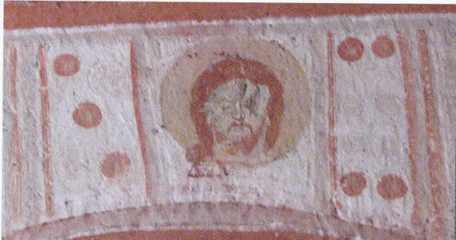
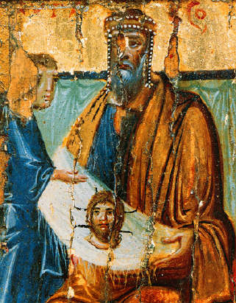
The Abgar V Legend
& Other Speculation
Linking the shroud to the Image of Edessa
The Only Major Image On Record
acheiropoietoe ("made without hands")
Getting to Edessa: Three Schemes (Stories)
Ian Wilson's Abgar V Legend
Jack Markwardt's Antioch Journey
Dan Scavone's Origin of the Grail

Slide 36
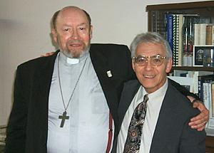
Spy-Clues ?
¹² Although I have much to write to you, I would rather not use paper and ink; instead I hope to come to you and talk with you face to face, so that our joy may be complete. (2 John 1:12)
Rev. Albert (Kim) Dreisbach and Dan Scavone
Could the early Christian community have exchanged information about the shroud through cryptic communications symbolic of the reality?
Early examples such as the Hymn of the Pearl (3rd c)
Cryptic meanings and hints in the canonical scriptures
Galatians 3:1, Luke 24:1-12, John 20:5-10
2 John 1:12 and 3 John 1:13-14

Slide 37
Galatians ?
http://youtu.be/eSHuJuo4k4Q?list=UUSv7BD9sKjIcA24ct1Hz_Aw
Dr. Frederick Baltz at St. Louis 2014
Offered an argument that this refers to the shroud being used in Paul's evangelization
Galatians 3:1
3 You foolish Galatians! Who has bewitched you? It was before your eyes that Jesus Christ was publicly exhibited as crucified!

Slide 38
Luke 24:1-12
Reading Between The Lines ? Maybe.
But on the first day of the week, at early dawn, they came to the tomb, taking the spices that they had prepared. ² They found the stone rolled away from the tomb, ³ but when they went in, they did not find the body. ⁴ While they were perplexed about this, suddenly two men in dazzling clothes stood beside them. ⁵ The women were terrified and bowed their faces to the ground, but the men said to them, “Why do you look for the living among the dead? He is not here, but has risen. ⁶ Remember how he told you, while he was still in Galilee, ⁷ that the Son of Man must be handed over to sinners, and be crucified, and on the third day rise again.” ⁸ Then they remembered his words, ⁹ and returning from the tomb, they told all this to the eleven and to all the rest. ¹⁰ Now it was Mary Magdalene, Joanna, Mary the mother of James, and the other women with them who told this to the apostles. ¹¹ But these words seemed to them an idle tale, and they did not believe them. ¹² But Peter got up and ran to the tomb; stooping and looking in, he saw the linen cloths by themselves; then he went home, amazed at what had happened.

Slide 39
John 20:5-10
What Did John See And Believe?
⁵ He bent down to look in and saw the linen wrappings lying there, but he did not go in. ⁶ Then Simon Peter came, following him, and went into the tomb. He saw the linen wrappings lying there, ⁷ and the cloth that had been on Jesus’ head, not lying with the linen wrappings but rolled up in a place by itself. ⁸ Then the other disciple, who reached the tomb first, also went in, and he saw and believed; ⁹ for as yet they did not understand the scripture, that he must rise from the dead. ¹⁰ Then the disciples returned to their homes.

Slide 40
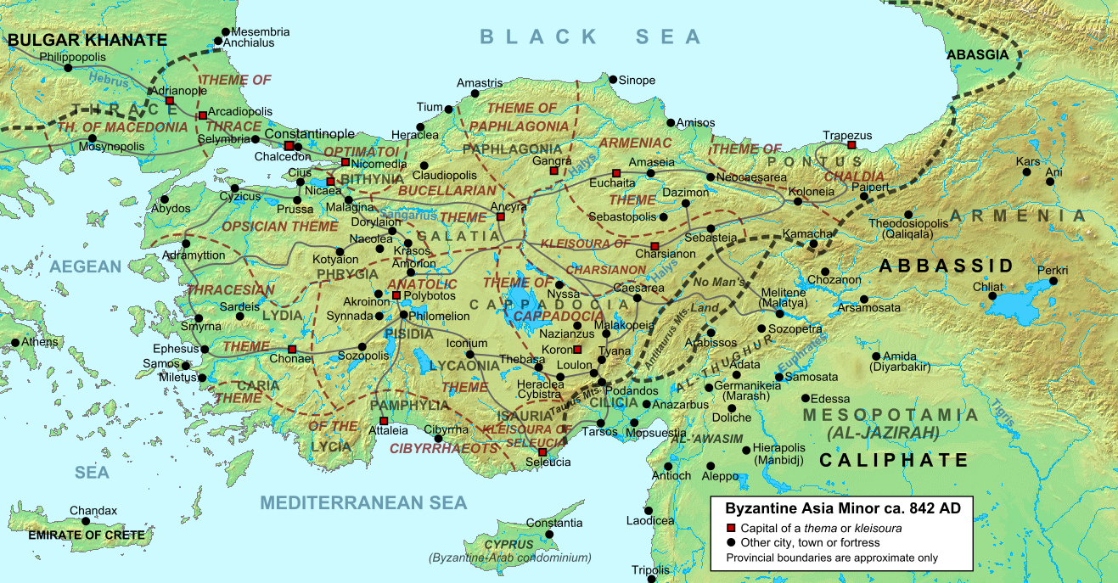
The Travels of the Shroud
"Asia Minor ca 842 AD" by Cplakidas - Own work. Licensed under CC BY-SA 3.0 via Wikimedia Commons - http://commons.wikimedia.org/wiki/File:Asia_Minor_ca_842_AD.svg#mediaviewer/File:Asia_Minor_ca_842_AD.svg

Slide 41
The Hymn of the Pearl
http://www.one-episcopalian-on-faith.com/2008/09/hymn-of-the-pea.html
The Hymn of the Pearl is an early Syriac poem of about the beginning of the third century (possibly as early as 216 A.D.) which seems to exhibit knowledge of the shroud.
The poem is embedded in the Acts of Thomas. a gnostic New Testament apocrypha about the acts of the apostle Thomas Judas Didymus and his mission to India. Thomas is supposed to have sent Thaddeus to Edessa to heal Abgar V.
Suddenly, I saw my image on my [burial] garment like in a mirror
Myself and myself through myself [or myself facing outward and inward]
As though divided, yet one likeness
Two images: but one likeness of the King [of kings]

Slide 42
Some Ancient Witnesses
NO IMAGE MENTIONED
4th Century — Eusebius (c. 260-340 AD)
relates the story of Abgar V's message to Jesus but makes no mention of an image
Late 4th or Early 5th Century (c. 400 AD) — Doctrine of Addai
When Hannan, the keeper of the archives, saw that Jesus spake thus to him, by virtue of being the king's painter, he took and painted a likeness of Jesus with choice paints, and brought with him to Abgar the king, his master. And when Abgar the king saw the likeness, he received it with great joy, …
The Acts of Thaddaeus (Surviving Greek Text from 6th Century)
… Ananias, having gone and given the letter, was carefully looking at Christ, but was unable to fix Him in his mind. And He knew as knowing the heart, and asked to wash Himself; and a towel was given Him; and when He had washed Himself, He wiped His face with it. And His image having been imprinted upon the linen, He gave it to Ananias …
6th Century — Mozarabic Rite (Preface for Saturday of Holy Week
Peter ran with John to the tomb and saw the recent imprints of the dead and risen man on the linens.
6th Century — Evagrius (c. 535- ?) History published about 593 AD
gives an account of how the image sent to Abgar saved the city during the siege of Chosroes the Persian in 544 AD
Painted Image with Choice Paints
acheiropoietoe ("made without hands")

Slide 43
Iconoclasm Down The Centuries
Silences in the matter of images is necessary to protect them in times of iconoclasm
Jewish Iconoclasm (esp. King Hezekiah c. 715 and 686 BC purged Solomon's Temple and caused the Nehushtan to be destroyed)
Synod of Elvira (305/6 AD) pre-ecumentical council forbade images in churches
Destruction of Pagan Images post Constantine
Threats of Destruction From Muslim Conquests
Byzantine Iconoclasm (726-787 AD) and (814-842 AD)
Protestant Reformation (desecrated many churches)
French Revolution (destroyed Besancon Image)
bronze serpent

Slide 44
Ian Wilson's Chronology
30-33 A.D. Shroud Carried to Edessa to Abgar V by Thaddeus, one of the 72, disappears temporarily from history (http://www.newadvent.org/cathen/01042c.htm)
525 A.D. Rediscovered hidden over the gate of Edessa
944 A.D. Transferred from Edessa to Constantinople
1204 A.D. Disappearance from Constantinople After The Sack of the City
1355 A.D. Reappears in Lirey, France
1453 A.D. Transferred to the House of Savoy
1578 A.D. Move to Turin
1983 A.D. Transferred to the Catholic Church on Death of Umberto II
MANDYLION
SHROUD
* derived from Ian Wilson's presentation "Discovering More of the Shroud's Early History".

Slide 45
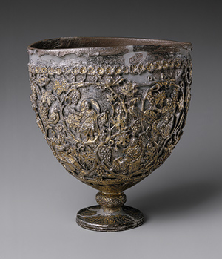
Jack Markwardt's Chronology
30-33 A.D. Crucifixion, Burial, and Resurrection of Christ
c. 40 A.D. Persecution drives Peter to Antioch with Passion relics
30 – 324 A.D. Passion Relics Concealed, church persecuted
324-337 A.D. Constantinian Era and early Eastern Iconoclasm
and imperial relic collection motivates continued silence
337-540 A.D. Post-Constantinian Era
357 A.D. Antioch becomes a stronghold of Arianism
362 A.D. Julian the Apostate attempts to seize Antioch's relics
Theodoretus hides them, including shroud, and is martyred
370-410 A.D. In the Theodosian era the Abgar legend begins
to speak of images and shroud like representations
of the face of Christ appear in the West
528 Earthquake destroys cathedral and shroud is discovered when
rubble is cleared away
540 Shroud is evacuated to Edessa in advance of the Persian attack

Slide 46
Dan Scavone's Chronology
The Mysterious Role of Joseph of Arimathea leading to the Grail legends
Could the Grail be the Shroud?
contained Jesus' body
captured Jesus' blood
displayed rarely in gradual manifestations
Similarity of an Edessan Easter Ritual & What Robert de Clari Saw In Constantinople
Rev. Albert (Kim) Dreisbach and Dan Scavone two "spy clue" detectives
Note: Grail legends emerge in the 12th and 13th century presumably from tales told by the returning crusaders

Slide 47
An Edessan Easter Ritual
Quoted from Scavone below cited. Compare this to what Robert de Clari saw in Constantinople in 1203
In Edessa, it was kept in a gold chest (scrinium) and on Easter it used to change its appearance according to different ages: it showed itself in infancy at the first hour of the day (7 a.m.), childhood at the third hour, adolescence at the sixth hour, and the fullness of age at the ninth hour, when the Son of God came to His Passion and cross. * * source a 10th c. Latin Abgar text believed to be a copy of an 8th/9th c. Syriac text
https://www.shroud.com/pdfs/scavone.pdf
https://www.shroud.com/pdfs/n56part3.pdf
http://www.bastabalkana.com/2015/01/mandylion-acheiropoietos-jesus-images-constantinople-vi-xii/

Slide 48
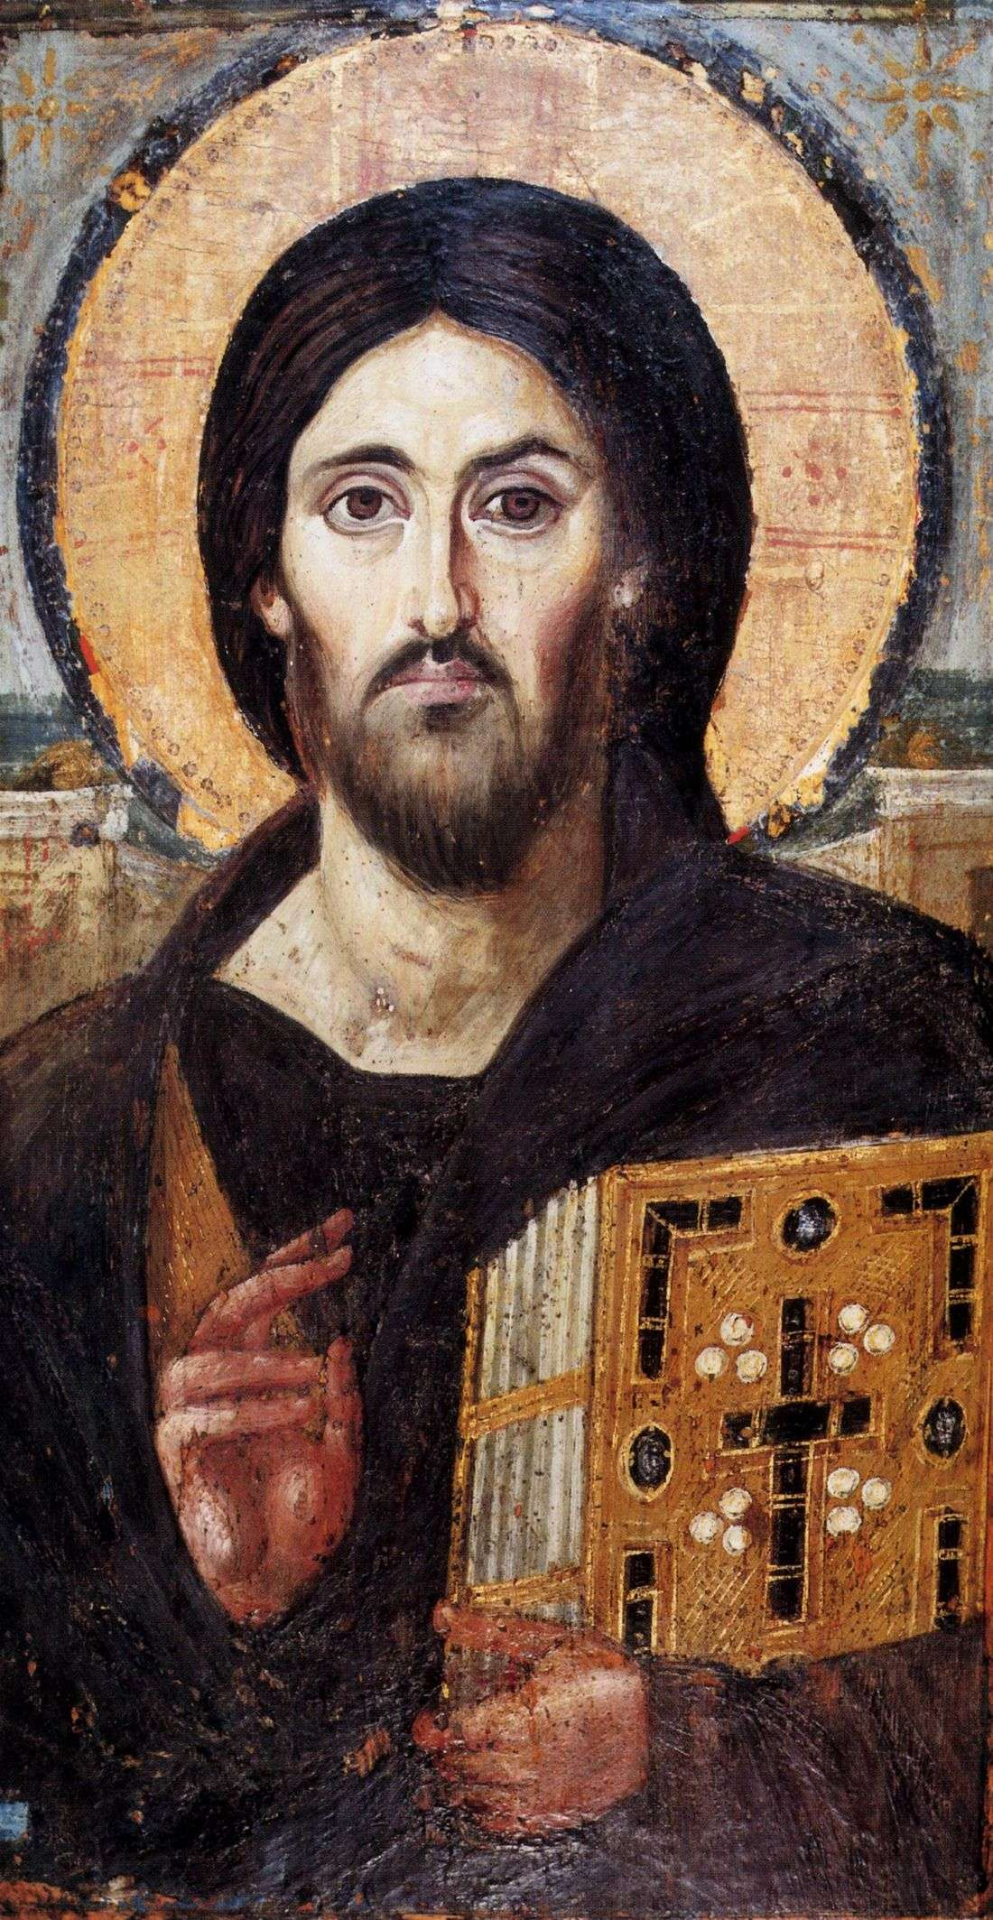
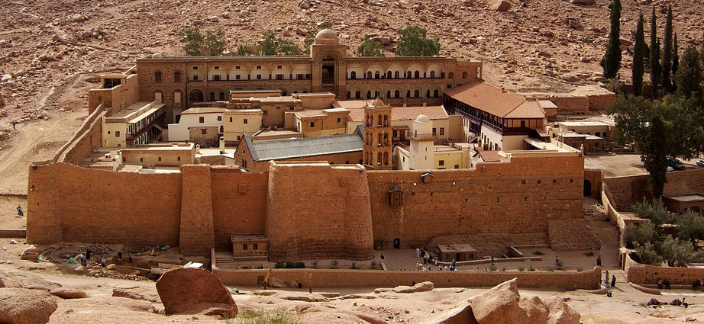
Now We're In Edessa
It's the 6th Century And Suddenly There's A Shift In The Art Representing Christ
Large eyes, long nose, and many other shared features
Earliest Preserved Pantocrator
Image (6th Century) From
St. Catherine's In The Sinai

Slide 49
Let's Take A Short Intermission
Ten Minutes To Stretch Etc.

Slide 50
Now We're In Edessa
It's the 6th Century And Suddenly There's A Shift In The Art Representing Christ
Large eyes, long nose, and many other shared features
Earliest Preserved Pantocrator
Image (6th Century) From
St. Catherine's In The Sinai

Slide 51
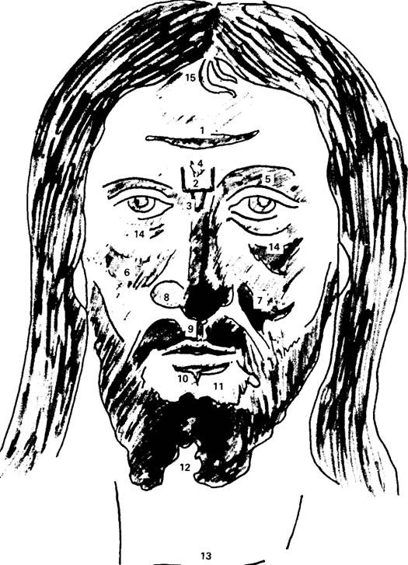
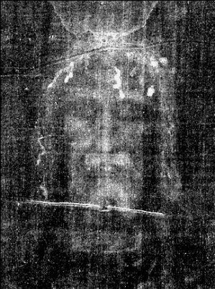
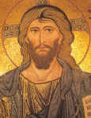
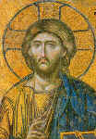
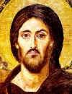
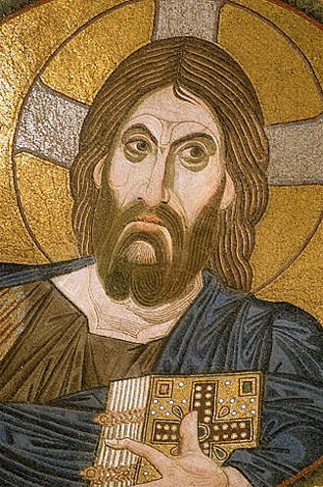
Vignon Markings
15 Characteristic Traits of Shroud in Artistic Depictions of Christ starting about the 6th century.
The Vignon markings - how Byzantine artists created a living likeness from the Shroud image. (1) Transverse streak across forehead, (2) three-sided "square" between brows, (3) V shape at bridge of nose, (4) second V within marking 2, (5) raised right eyebrow, (6) accentuated left cheek, (7) accentuated right cheek, (8) enlarged left nostril, (9) accentuated line between nose and upper lip, (10) heavy line under lower lip, (11) hairless area between lower lip and beard, (12) forked beard, (13) trans­verse line across throat, (14) heavily accentuated owlish eyes, (15) two strands of hair
ca. 1148
ca. 1260-1289
ca. 590
ca. 1050-1100

Slide 52
* image used by Ian Wilson in presentation "Discovering More Of The Shroud's Early History"

Slide 53
544 A.D. Mandylion Saves Edessa From The Persian Attack
Reported in The Ecclesiastical History of Evagrius — A History of the Church from AD 431 to AD 594 in Chapter XXVII describes how the image of Edessa was invoked to cause a Persian siege engine to be set on fire thus repulsing the Persian attack.

Slide 54
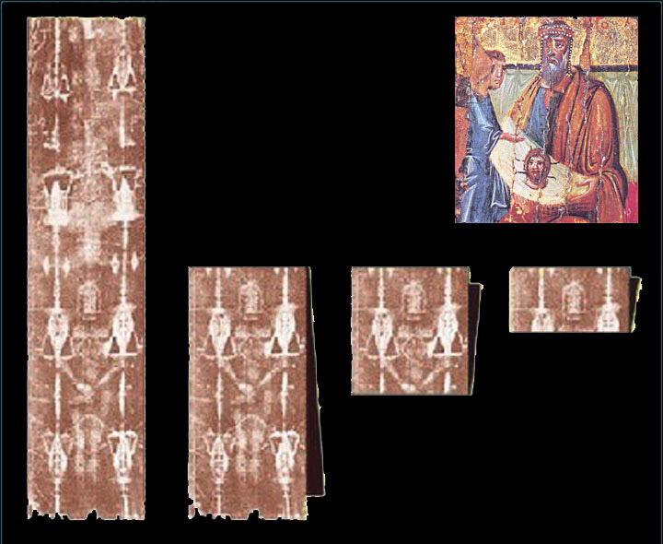
Tetradiplon (doubled in four)
Acts of the Holy Apostle Thaddeus describes the Manylion using the word
10th century painting
depicting Abgar receiving the Mandylion

Slide 55
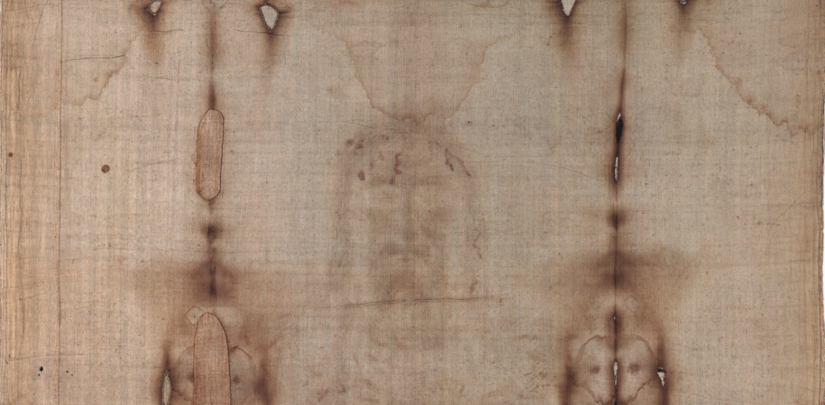
Shroud Folded As The Mandylion Tetradiplon

Slide 56
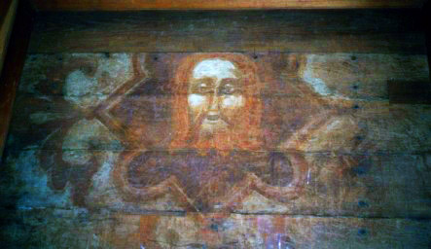
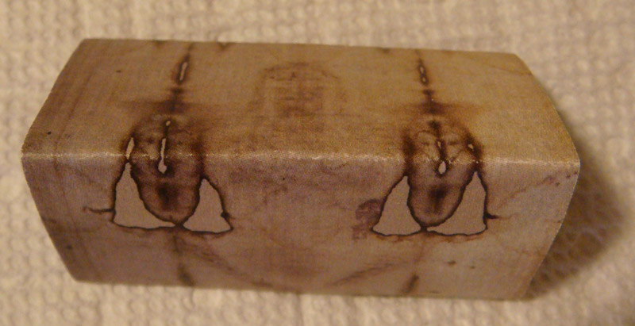
Tetradiplon
See also http://shroud3d.com/findings/the-halo-around-the-head

Slide 57
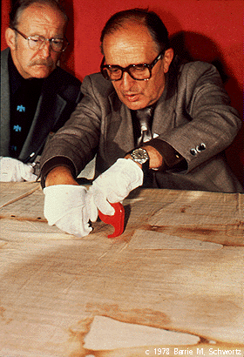
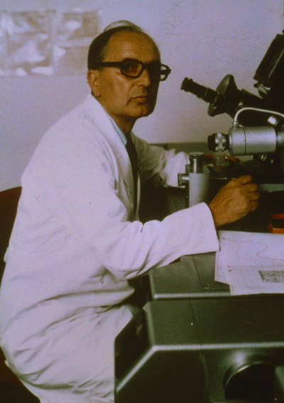
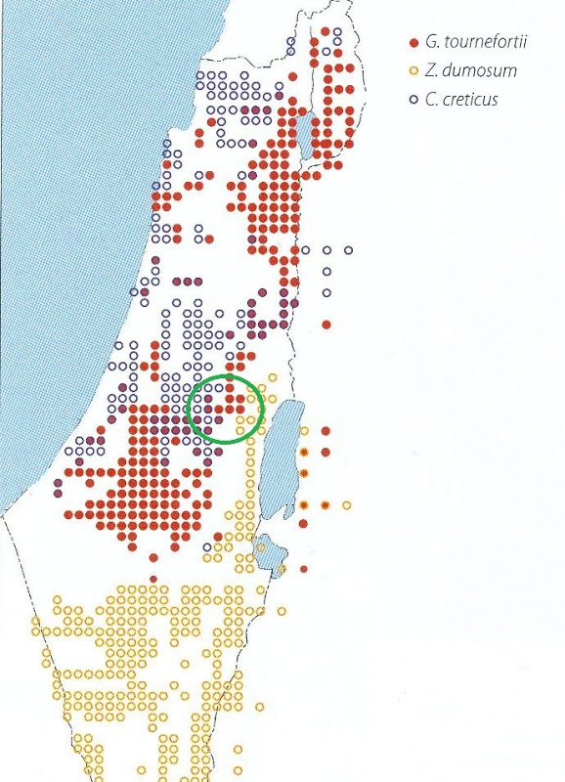
Max Frei Pollen Data
Identified 49 species of plants represented in the dust of the shroud *
Half did not grow in Europe
29 were plants of the Near East
21 grow in the desert or the steppes
13 characteristic of the Negev and the Dead Sea
"I leave the possibility open that a part of the pollen comes from the manufacture of the cloth and perhaps also from aromatic substances such as aloe used for the burial processes or from the wet skin of the body which was wrapped in the cloth."
* Shroud Spectrum International #3 (1982)

Slide 58
From Edessa To Constantinople
The Timeline
70
544
944
1204
1355
the Present
?
EDESSA
?
KNOWN HISTORY
30-33 A.D.
CONSTANTINOPLE
"Earlier in the year of 944 the Byzantine Emperor, Romanos I, had managed to reach an agreement with the Muslim authorities that they would be willing to hand it over in exchange for 200 Muslim prisoners and 12,000 pieces of silver."
http://www.jaas.org/edocs/v18n1/Sebastian%20Brock-mandili-Final.pdf

Slide 59
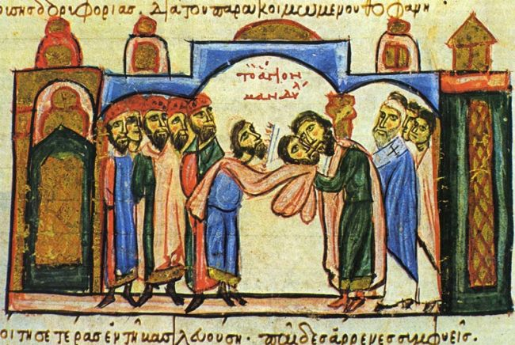
The Discovery The Mandylion Is More Than A Face
August 15, 944 the Mandylion arrives in Constantinople to a popular welcome
Initially shown to emperor Constantine VII and his two brother in laws. The image described as a "moist secretion" and difficult to make out. Blood is mentioned.
August 16, 944 the archdeacon Gregory gives a homily and says …

Slide 60
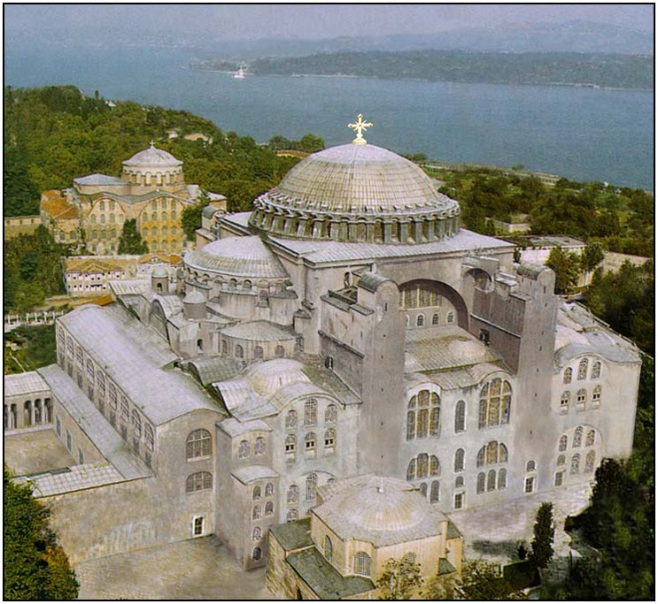
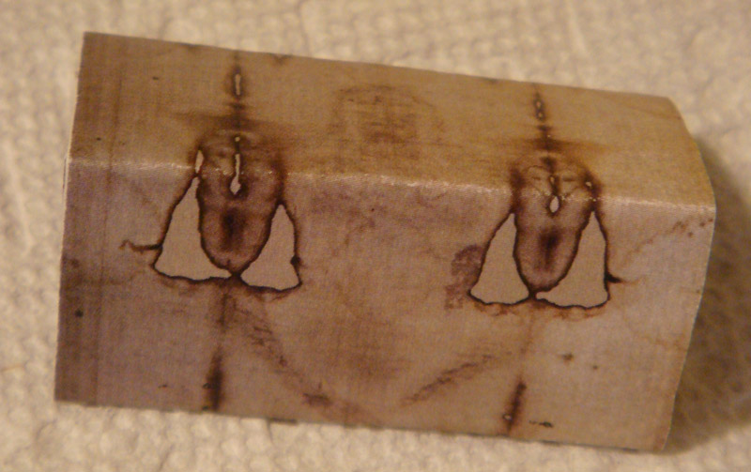
7. Saving The Shroud In 943-944
8. The Gregory Sermon August 944 A.D. at Hagia Sophia
“The splendor has been impressed uniquely by the drops of agony sweat sprinkled from the face…These are truly the beauties that produced the coloring of Christ’s imprint, which has been embellished further by the drops of blood sprinkled from his own side…blood and water there, sweat and image here.”
The Mandylion Revealed
to Be More Than
Just The Face of Christ

Slide 61
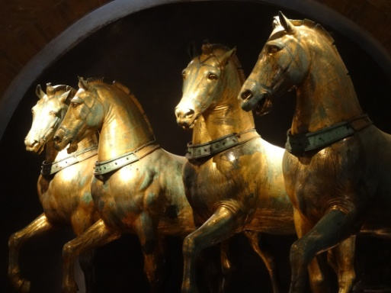
9. A Witness At Constantinople
Robert de Clari, chronicler of the 4th crusade described the shroud he saw in 1203 with these words:
"… there was another church [lit. another of the churches] which was called My Lady Saint Mary of Blachernae , where there was the SYDOINES in which, [lit. where] Our Lord had been wrapped, which every Friday, raised itself upright, so that one could see the form of our Lord on it [lit. there], and no one, either Greek or French, ever knew what became of this SYNDOINES when the city was taken." *
* translation from Old French by Peter F. Dembowski http://www.shroud.com/pdfs/ssi02part5.pdf

Slide 62
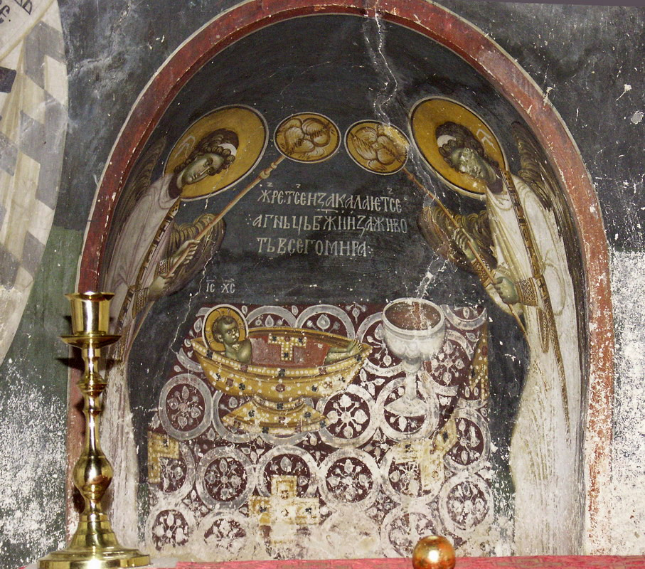
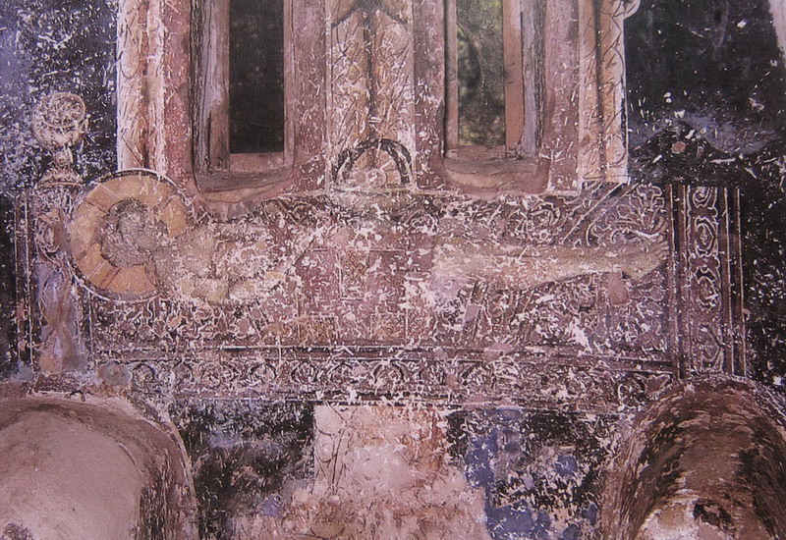
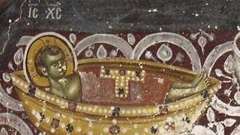
10.1 Melismos, Threnos, Epitaphioi
Traditions motivated by the shroud?
Later A Memory In The East after the shroud was lost?
c. 1192 Earliest Preserved Melismos (μελισμος ) Mural at Kurbinovo, Monastery of St. George in Macedonia

Slide 63
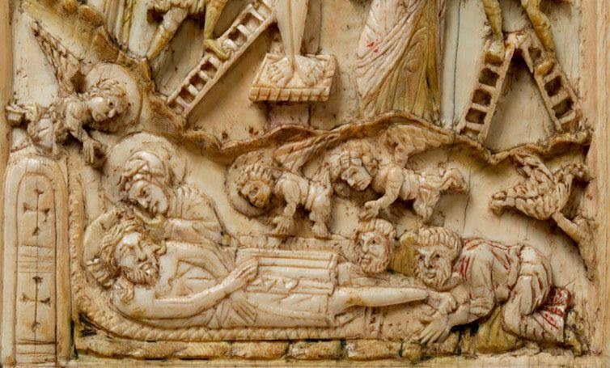
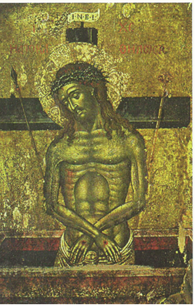
10.2 Threnos, Epitaphioi, and the Man of Sorrows
An Echo Of The Shroud And A Religious Ritual?
Citation from oldest Latin
Abgar legend account
likely 10th century *
JOSEPH OF ARIMATHEA, THE HOLY GRAIL, AND
THE EDESSA ICON by Dr. Dan Scavone
http://www.shroud.com/pdfs/n56part3.pdf
detail from early 12th century ivory carving
. . . on Easter it used to change its appearance according to different ages: it showed itself in infancy at the first hour of the day, childhood at the third hour, adolescence at the sixth hour, and the fullness of age at the ninth hour, when the Son of God came to His Passion . . . and . . . cross
Man of Sorrows

Slide 64
Nicholas Soemundarson
In 1157 Nicholas Soemundarson an Icelandic abbot upon returning home from a pilgrimage to Constantinople put together a catalogue
The abbot mentioned:”… a shroud with the blood and body of Christ on it”
pg. 73 Heller, Report on the Shroud of Turin

Slide 65
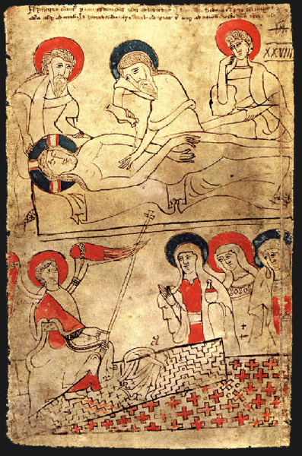
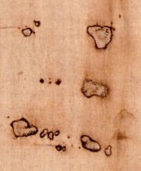
11. Pray Codex 1192-1195 A.D.
Pray Codex contains crossed
thumb-less hands, a pattern like
a herring bone twill and markings
that look like the burns on the shroud
the pre-1532
shroud burns

Slide 66
STURP Transmitted Light Images
Observed the horizontal discolorations in the transmitted light image marked by arrows
John Jackson inferred from these the structure of a likely device which explains what Robert de Clari saw in 1203
We'll call it the Constantinople Device

Slide 67
The Constantinople Device
Robert de Clari, chronicler of the 4th Crusade said that at the church of St. Mary of Blachernae "… where there was the shroud in which Our Lord had been wrapped, which every Friday raised itself upright, so that one could see the figure of Our Lord on it. … no one, either Greek or French, ever knew what became of this shroud when the city was taken."
Stills from BBC video posted to YouTube "Shroud of Turin - BBC - New Evidence"

Slide 68
The Sack of Constantinople In April 1204
The shroud disappears from Constantinople apparently part of the "spoils of war" as Margaret de Charny later characterized the shroud.
Where did it go? How did it get to Lirey?
The Timeline
70
544
944
1204
1355
the Present
?
EDESSA
?
KNOWN HISTORY
30-33 A.D.
CONSTANTINOPLE

Slide 69
Constantinople To Europe
Othon de la Roache and the Knights Templar
Two narratives each with its recommendations
Othon de la Roche
Knights Templar
Arms of Geoffrey de Charny
and Jeanne de Vergy
the Templecombe portrait

Slide 70
The Simple Story
Othon de la Roche captures the shroud during the sack and takes it to Athens where he has been awarded the fief of Athens
August 1, 1205 Theodore Angelos, brother of Michael, Despot of Epirus wrote pope Innocent III complaining that the shroud had been taken to Athens
Sometime (unknown) Othon ships the shroud back to Bergundy where it ends up finally in the cathedral at Besançon from which Jeanne de Vergy, descendent of Othon, conveys it to her husband Geoffrey I de Charny (reconstruction)

Slide 71
Complications
In 1349 the cathedral in Besançon burns down and the shroud there is said to be lost
In 1377 the missing Besançon shroud is "discovered" in a niche in the rebuilt church and is alleged to have rejuvenated a dead man. The presiding cleric is a de Vergy
Speculation is that the discovered shroud is a painting commissioned by Jeanne de Vergy
Note: This "Shroud" appears to meet the characteristics of Bishop D'Arcis's letter to the pope

Slide 72
The Shroud Appears In The West
17th Century Drawings Comparing Besançon Shroud to The Shroud of Turin
Detail of the Drawing
of the Besançon shroud

Slide 73
A More Complicated Story
For safekeeping and due to the fact that the pope has condemned the crusaders for stealing the relics from Constantinople demanding their return, Othon places the shroud in the hands of the Knights Templar
It becomes a secret holding of the Knights and they use it in their initiation rites

Slide 74
The Suppression of the Templars
The rumors that they worshipped a "head" and committed sexually obscene acts were used to initiate the suppression of the Templars in October of 1307
The testimony elicited under torture was contradictory but included claims that they had to kiss a two headed image with four feet (there were many other stories as well)

Slide 75
A Remarkable Coincidence
March 18, 1314 Templar leaders sentenced to perpetual imprisonment. Jacques de Molay and Geoffroi de Charney, Master of Normandy, proclaim their innocence and are burnt to death in front of the Cathedral of Nôtre Dame. *
The Templar Geoffroi de Charney bears a name very familiar to us. It has not been established that he is related to Geoffrey I de Charny but it has also not been disproved.
*
http://freemasonry.bcy.ca/anti-masonry/suppression.html first bullet paraphrased slightly.

Slide 76
What Was The Templar Ritual?
We only have textual evidence about a head or an image (cloth) with two heads and four feet
images are frame captures from Ray Downing's "The Real Face of Jesus" slightly image enhanced

Slide 77
The Question Of The Sudarium
There are multiple relics of Christ's passion which are distributed among the churches of Europe. Many are no doubt pious frauds but some are no doubt genuine.
We need to return to the second linen which was in the Jerusalem tomb in 33 A.D. It is a cloth said to have wrapped Jesus's head.

Slide 78
Cloth of Oviedo
(The Other Cloth)
Left Palestine in 614 A.D. to escape Persian Army Arrived in Spain about 618? Cataloged 14 March 1075
http://www.freerepublic.com/focus/f-chat/3054879/posts

Slide 79
Match With
The Sudarium
Blood matches the configuration of the face and bloodstains on the back of the head match stains on the sudarium.
The Sudarium and the Shroud Were In Contact With The Same Body

Slide 80
5. The Movements of the Shroud
Travels of the Shroud and Sudarium
CONSTANTINOPLE
Sudarium of Oviedo
Shroud of Turin
ALEXANDRIA

Slide 81
6th Century Liturgy
to Europe to the Present
1260 to 1390!?
C14 Interval
6th Century liturgy used in Spain called the Mozarabic Rite. During the preface the priest says:
“Peter went with John to the tomb and saw the recent imprints of the dead and risen man on the linens.”
1208
Athens
Robert de Clari
Constantinople Device
1203
1192-1195
Pray Codex
1157
Soemundarson
944
Constantinople Gregory Sermon
500’s
Edessa &
An Art
Revolution
Spy Clues
An Empty Tomb

Slide 82
Plausibility Map
Jerusalem
- Antioch
Edessa
Constantinople
- Athens
- Othon de la Roche
- Knights Templar
- Besancon
Lirey
Chambery
Turin
Sudarium
Shroud
Pollen
Correspondences
SILENCE
Constantine
Mandylion
- tetradiplon
Shroud
ART
Vignon Markings
UNIQUE FEATURES
Negative
Three Dimensional
Superficial Image
Medical Fidelity
Areal Density Image
Historical/Crucifixion Fidelity
DATING METHODOLOGIES
- Carbon Dating
- Vanillin Extinction
- FTIR
- Raman Spectroscopy
- Breaking Strength

Slide 83
A Plausible Prehistory Exists But What Is It?
What is the image?
How did it get on the shroud?
Can we make one ourselves?
Next Time
The Image & The Skeptics

