Slide 1
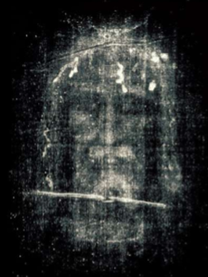
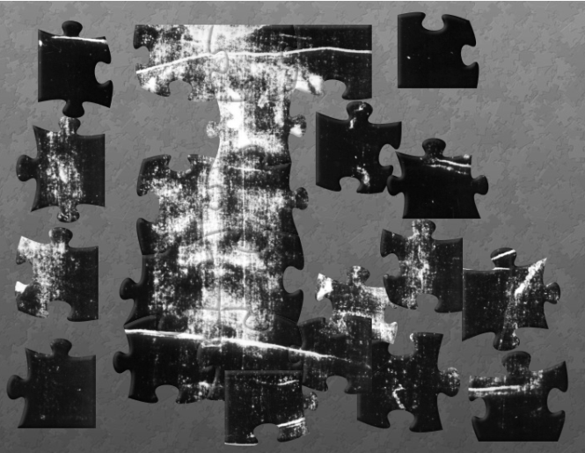
The Shroud of Turin an Enduring Mystery Part 1: Introduction
Dr. Ray Schneider, P.E., Ph.D.
Associate Professor Emeritus
Bridgewater College, Virginia

Slide 2
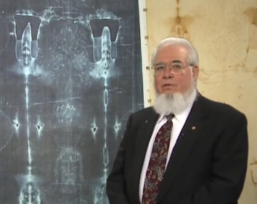
Introductions
Dr. Ray Schneider, P.E., Ph.D. (retired)
B.S. Physics, St. Joseph's College, Philadelphia, Pa.
Most of an M.S. in Physics from Drexel
M.S. in Engineering Technology, Penn State
Ph.D. Information Technology , George Mason
Research Scientist Naval Air Development Center, PA.
Senior Scientist to Technology Center Leader at Sperry Defense Systems, Eagan, MN
Engineering Director at ComSonics, Harrisonburg, Va.
Adjunct Faculty (≈ 10 years) James Madison University
Professor of Math and Computer Science, Bridgewater College, Bridgewater, Va. (2002-2012)

Slide 3
Encounter With The Shroud
About 1962 At A Religious Retreat At A Lecture Using Glass Slides From The 1931 Enrie Pictures
Showed people the image if they were interested
1976 Eric Jumper & John Jackson Dramatically Demonstrate the 3D Characteristic
They showed you could do more science on the shroud and that hooked me.
Researched & Lectured On The Shroud Ever Since

Slide 4
Why Are You Here?
Please Introduce Yourselves Briefly
Share With Us The Questions You Have?
Do You Have A Conviction About the Shroud?
What Would You Most Like To Know?
Where Are You Now On The Balance?
Burial Cloth
or Icon?
Just Don't Know!

Slide 5
An Enduring Mystery
The Shroud Of Turin Continues To Mystify
We Will Explore The Mystery Taking A Journey Through The Many Stories That Attempt To Capture The Reality Of The Shroud Of Turin
A Journey
Through Stories

Slide 6
The Primacy of Story
Eyewitness Stories
A Story By Someone Who Was There
Religious Stories
A Story About The Acts of God
Science Stories
A Story With Mathematics/Analytics
History Stories
A Story With Documents
Art Stories
A Story Told In Pictures and Artifacts
Notes:
Each of our guides has a unique perspective. Whether science, history, archeology, art, personal witness, or religion, each seeks to illuminate the truth.

Slide 7
Truth: The Test of Story
Science Stories
History Stories
Eyewitness Stories
Religious Stories
The Test
of a story is whether
It Is TRUE?
Notes:
For the ultimate test of story is whether it is true.

Slide 8
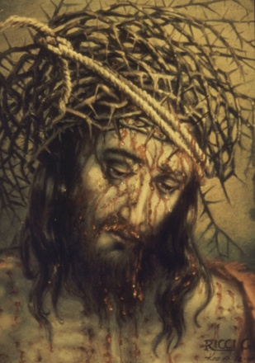
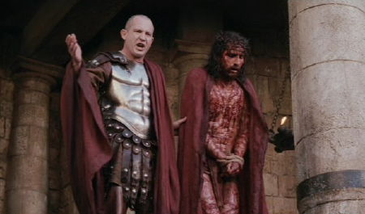
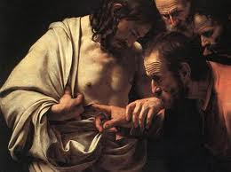
What Is Truth?
Ecce Homo!
Unless I See I Will Not Believe
Truth is the Correspondence Between Story and Reality
Notes:
But "What is truth?" Pontius Pilate asked Jesus.

Slide 9
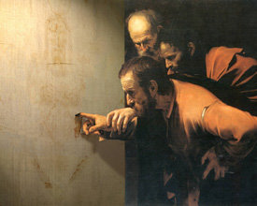
What Is Truth?
Ecce Homo!
Unless I See I Will Not Believe
Truth is the Correspondence Between Story and Reality
Notes:
Truth is the correspondence between story and reality.

Slide 10
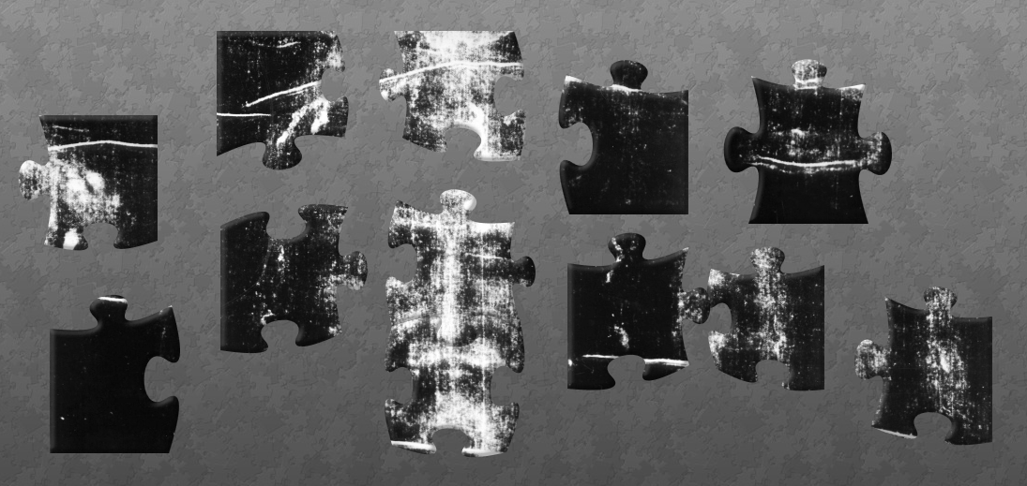
How Do You Know The Truth?
Direct Observation
Witnesses
Correct Interpretation
Understanding
Correspondences With Other Known Truths
Correlation and Explanatory Principles
Coherence
It All Fits Together
Notes:
The apostle Thomas, declared "Unless I see I will not believe." Direct witness, correct interpretation, correspondences among known truths, and coherence are the tests of truth.

Slide 11
What Is The Shroud?
The Shroud is a linen cloth 2 x 8 cubits (14' 3" long and 3' 7" wide)
Above: the Shroud From The Back Side

Slide 12
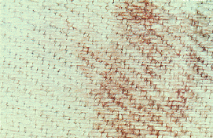
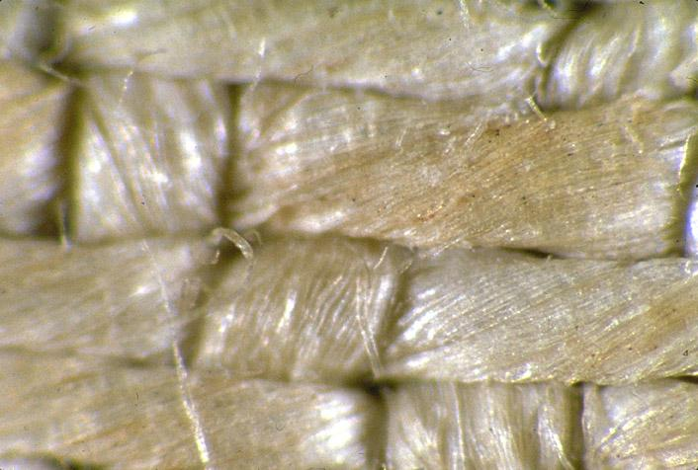
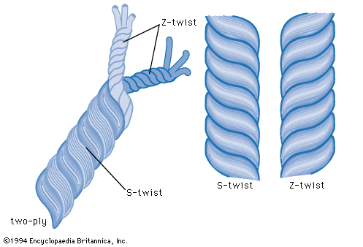
LinenTextile
Weave
a three-to-one herringbone twill — each weft thread passing alternately under three warp threads and over one, producing diagonal lines, which reverse direction at regular intervals to create a herringbone pattern.
Shroud Threads are Z-twist (clockwise)
Egyptian Linen is predominantly S-twist
Weave Density
Warp 38.6, Weft 25.7 threads per cm. Z-twist

Slide 13
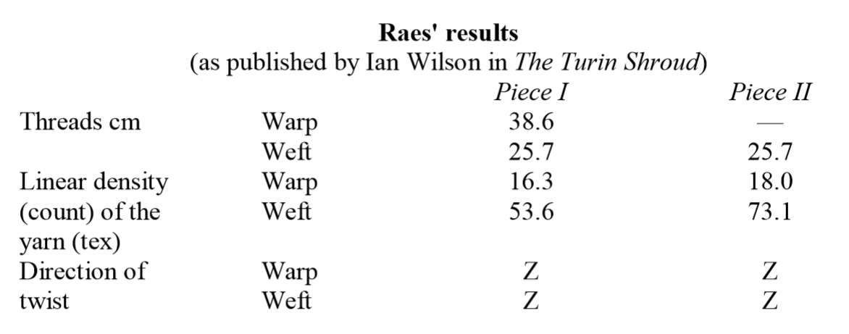
Fineness of Weave
Raes Results from 1973 Sampling as reported by Ian Wilson

Slide 14
Many Markings
Burn Holes
Scorches
Water Stains
Patches
A Complex Weave
3 and 1 Twill Weave

Slide 15
And On The Other Side The Faint Image Of The Front And Back Of A Man
Lower Image Equalized

Slide 16
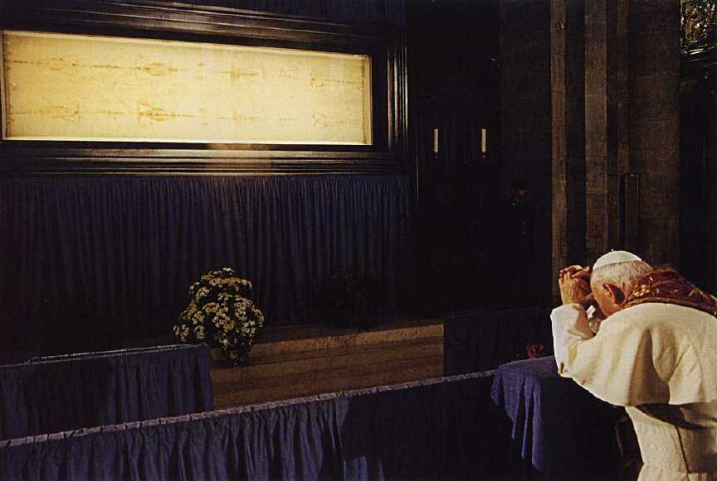
Visibility of the Image
the image is only visible at a distance
when you are close to the shroud you can no longer discern the image

Slide 17
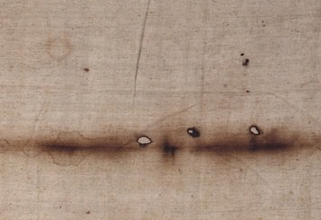
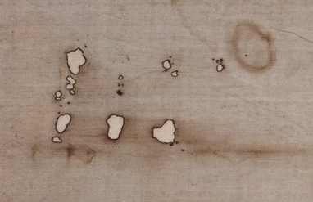
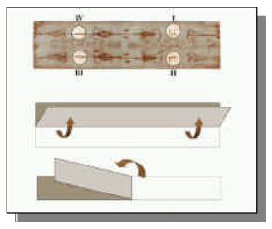
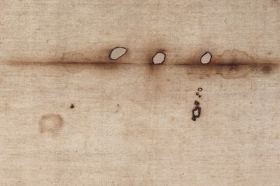
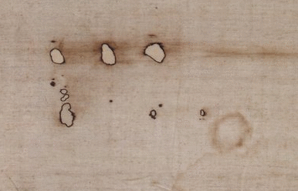
Pray "Poker" Holes
Four sets of holes often called the "Poker " holes or the Pray holes from the illustration in the Pray codex indicate that at the time of the damage the shroud was folded in four.

Slide 18
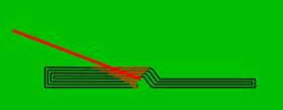
Burn Holes From 1532 Fire
Burn holes from a fire in Chambery in 1532 run the length of the shroud on both sides of the image
Pray Holes, shroud folded in 4
Burns from 1532 fire, shroud folded in 32
Folding image from FURTHER STUDIES ON THE SCORCHES AND THE
WATERMARKS by Aldo Guerreschi and Michele Salcito, © 2005 Dallas

Slide 19
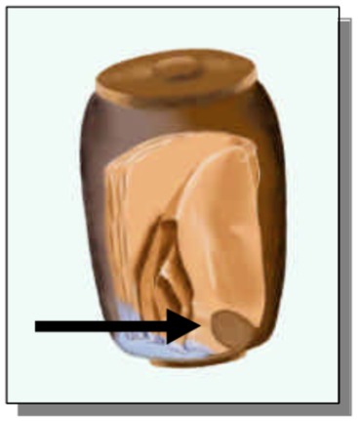
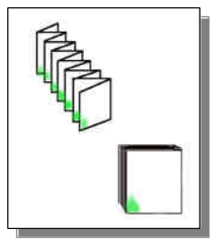
Waterstains
Folding work by Aldo Guerreschi and Michele Salcito reported in their paper PHOTOGRAPHIC AND COMPUTER STUDIES CONCERNING THE BURN AND WATER STAINS VISIBLE ON THE SHROUD AND THEIR HISTORICAL CONSEQUENCES at Paris 2002

Slide 20
Sindonology.org's Shroud Scope

Slide 21
A Survey Of The Markings
We Will Use Mario Latendresse's Website http://sindonology.org/ and particularly the Shroud Scope to capture examples of markings. If they are too faint we'll enhance their contrast or otherwise manipulate them to make them clearer.
Let's Start A Survey Of The Markings On The Shroud. We'll Call Each Feature By The Commonly Used Names

Slide 22
A Quick Survey Of Markings
Clean Linen (i.e. places free of dirt and marks)
Burn and Scorch Marks
Water Stains
Blood Stains
Banding Phenomenon
Various Dots and Dirt
Wrinkles and Fold
Patches and Stitching

Slide 23
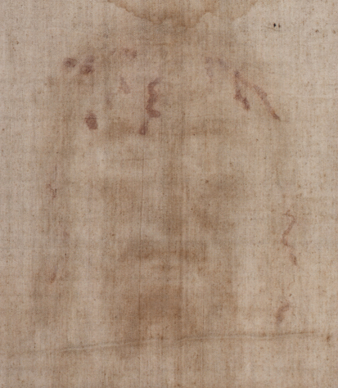
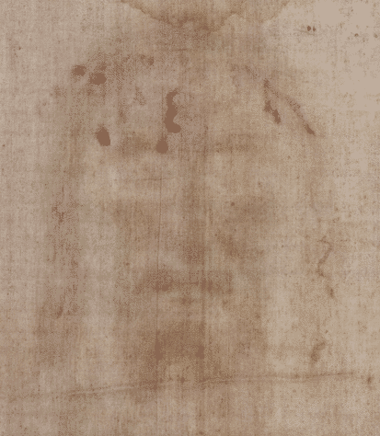
Face From Sindonology.org
RGB .png image from clipping
same image converted to 16 colors

Slide 24
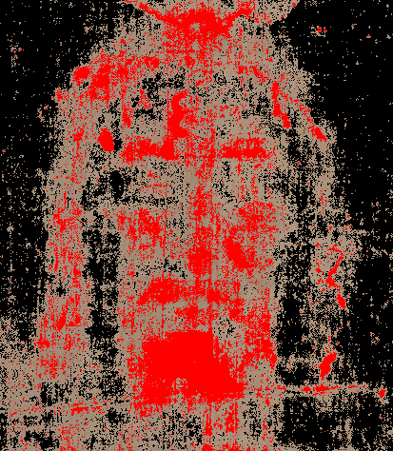
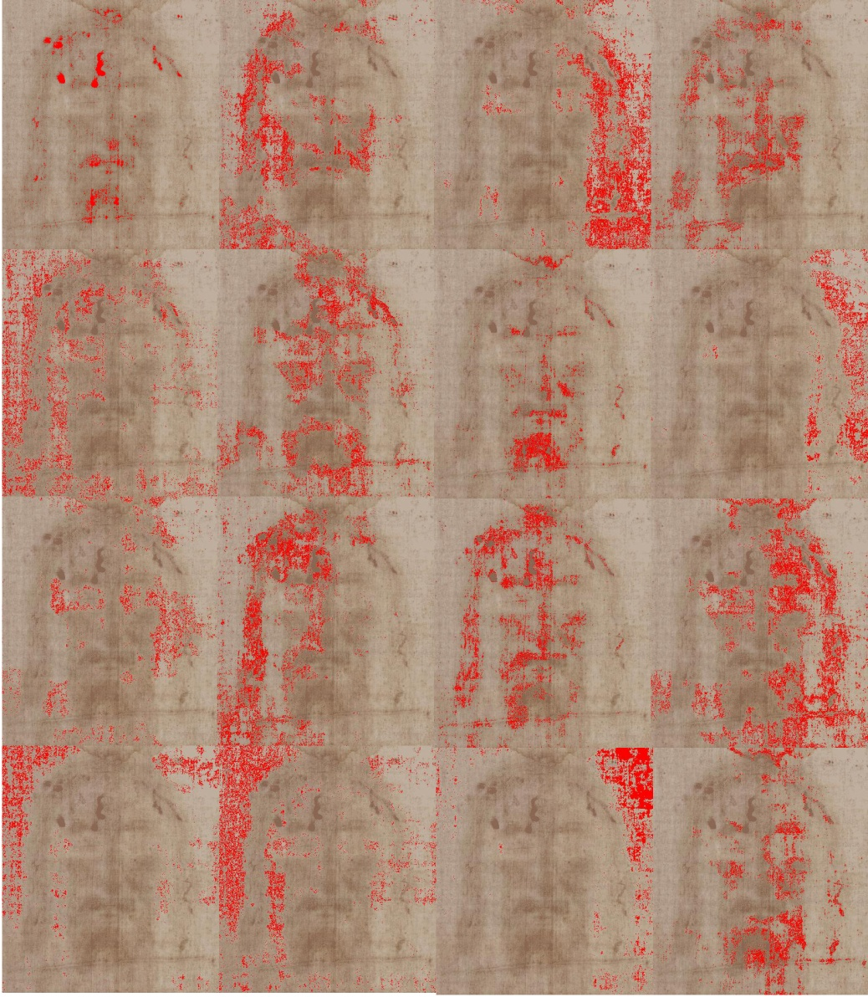
The 16 Colors With RED Injected And A False Color Combination
BLOOD = RED, CLOTH = BLACK
IMAGE = no-change
BLOOD= 1,7,11,16 IMAGE=2,4,6,9,10,12
CLOTH = 3,5,8,13,14,15

Slide 25
A Forensic Test
We have multiple gospel accounts of the passion and death of Jesus Christ
If the shroud is authentically the burial shroud of Jesus Christ it must corroborate those accounts at least is substance
Preferably it should, if authentic, enlarge our understanding is some ways

Slide 26
Gospel Event Chronology
Beaten
Scourged
Crowned With Thorns
Carried His Cross
Nailed to the Cross
Died
Pierced

Slide 27
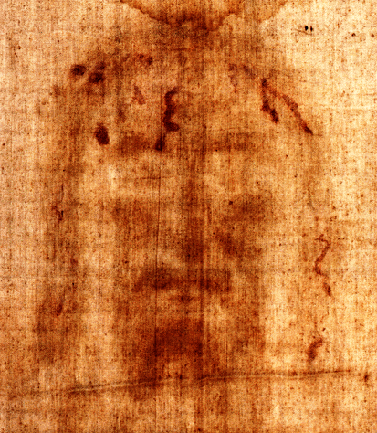
Beaten
Luke 22:63-65
The men who were guarding Jesus made fun of him and beat him. They blindfolded him and asked him, “Who hit you? Guess!” And they said many other insulting things to him.

Slide 28
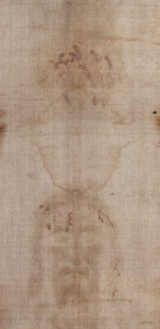
Crowned With Thorns
Then Pilate’s soldiers took Jesus into the governor’s palace and the whole company gathered around him. They stripped off his clothes and put a scarlet robe on him. Then they made a crown out of thorny branches and placed it on his head, and put a stick in his right hand; then they knelt before him and made fun of him. “Long live the King of the Jews!” they said. They spat on him, and took the stick and hit him over the head. When they had finished making fun of him, they took the robe off and put his own clothes back on him. Then they led him out to crucify him.

Slide 29
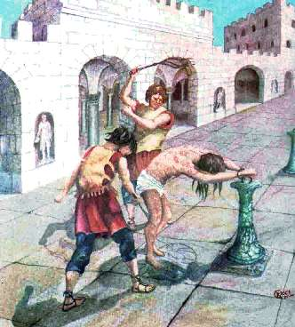
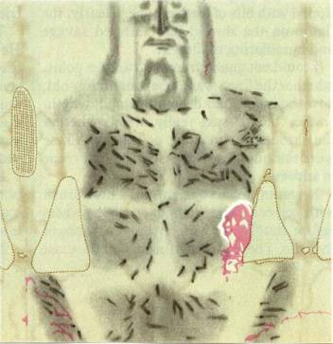
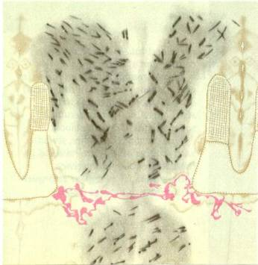
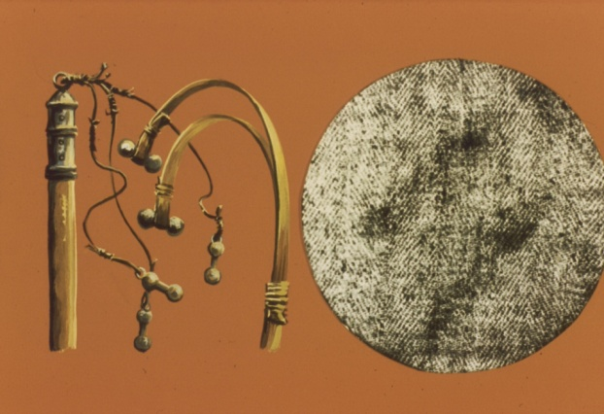
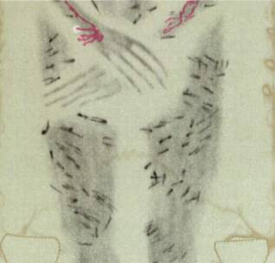
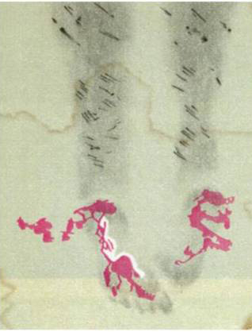
Scourged
120 strokes or more from an instrument of torture that appears to match a pair of Roman flagrums

Slide 30
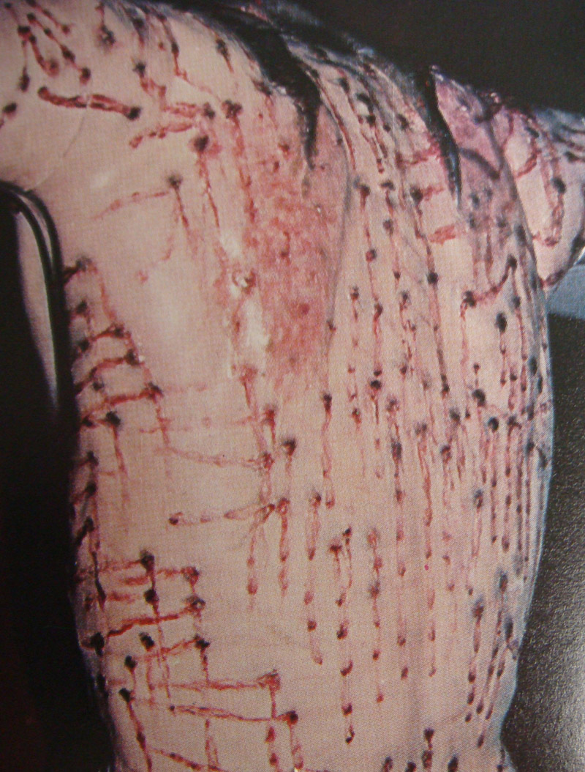
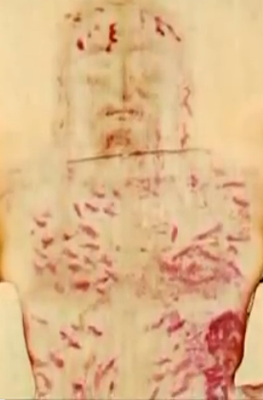
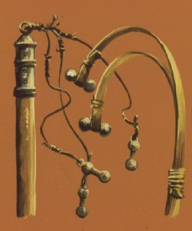
The Scourging and Crucifixion
Scourging Depiction Derived From The Shroud by
Giulio Ricci
Area of Abrasion from Carrying the Patibulum (Crossbeam)
Blood on frontal image (enhanced)
from "The Real Face of Jesus" documentary
by Ray Downing

Slide 31
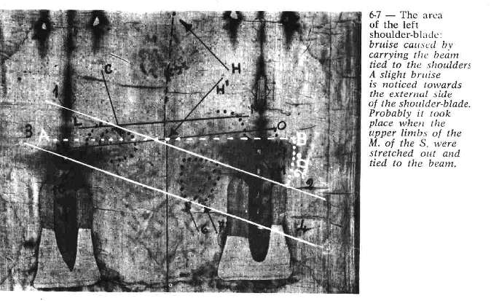
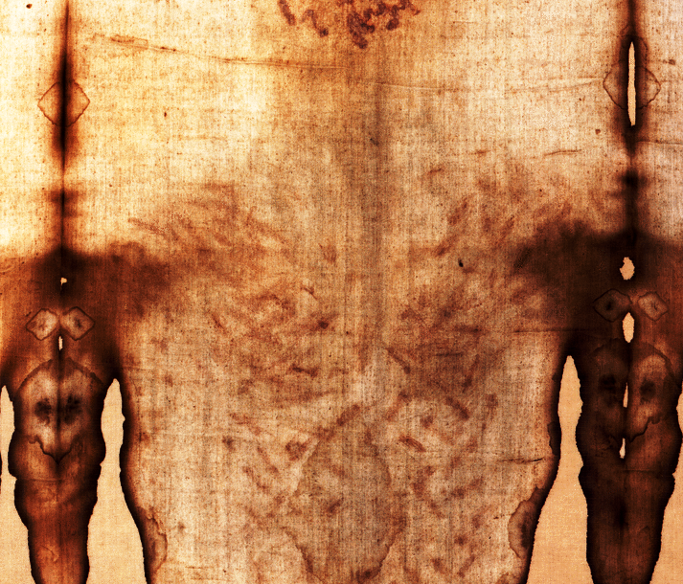
Carried His Cross The Patibulum

Slide 32
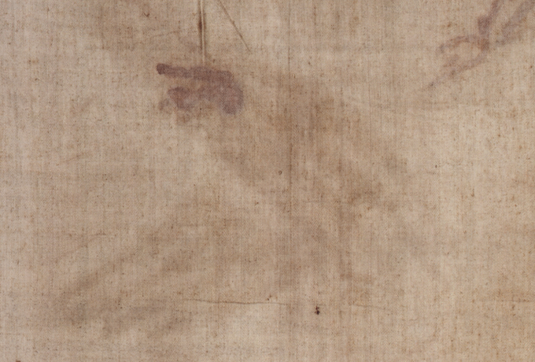
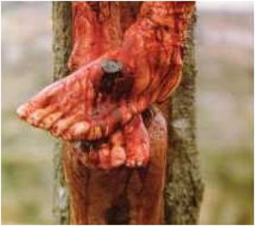
Nailed To The Cross
No Thumbs Visible
Nailed Through Wrist

Slide 33
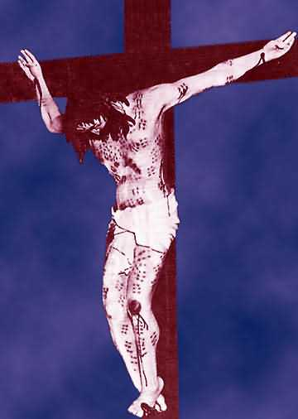
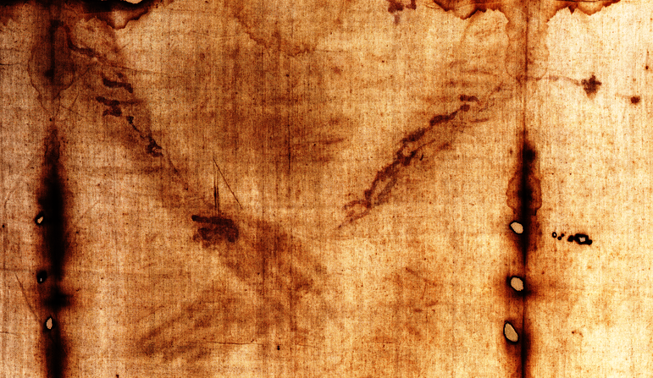
Jesus Dies On The Cross
Two directions of blood flow along the arms

Slide 34
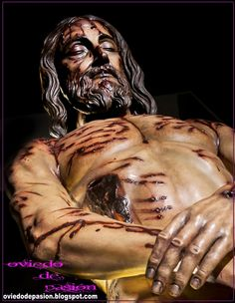
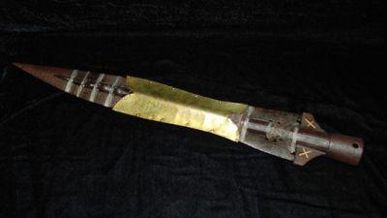
Pierced
John 19:34 “But one of the soldiers opened his side with a lance, and immediately there came out blood and water.”

Slide 35
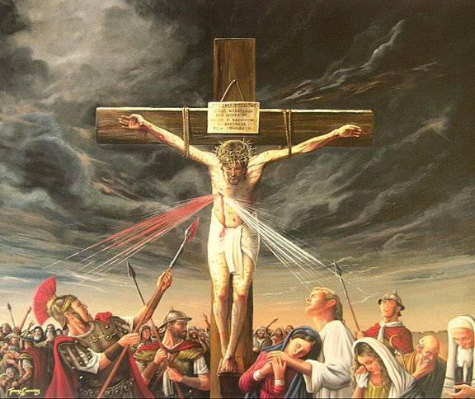
A Flow of Blood and Water
John 19:34 “But one of the soldiers opened his side with a lance, and immediately there came out blood and water.”

Slide 36
A Short Intermission
Let's Take Ten Minutes Or So

Slide 37
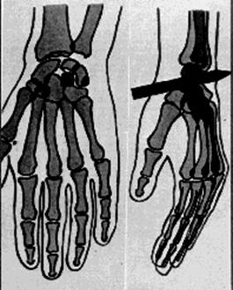
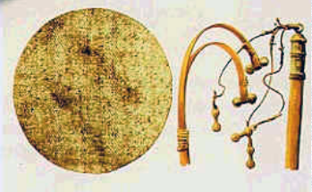
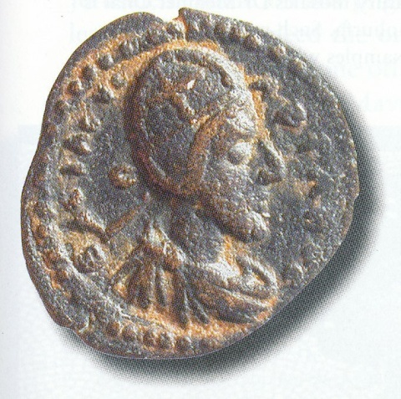
Discussion
The image on the shroud is consistent with the accounts of the Passion
Information gleaned from the shroud is actually more detailed than the gospel accounts
Nails through the wrists
Details of the scourge
A crown of thorns that covers the head

Slide 38
Resources: People
The number of people who have and continue to study the shroud is very large. These include people from many different disciplines.
We're going to skim through some of the people who we'll see later in our course
Then we'll look at some of the on-line resources that are available

Slide 39
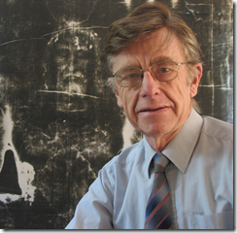
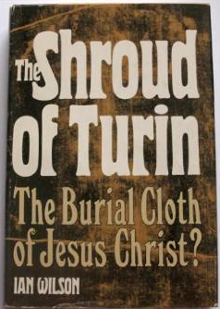
Resources: People
Some Individuals And Their Expertise
Ian Wilson: Historian
One of the most prolific writers on the shroud, author of the seminal book:
The Shroud of Turin: The Burial Cloth of Jesus Christ
Author of Many More Books
Originator of the Mandylion Hypothesis

Slide 40
Ian Wilson
More Books By Ian Wilson (many more)

Slide 41
Resources: People
John Jackson, Ph.D. Physicist and his wife Rebecca
Turin Shroud Center of Colorado
Leader of the 1978 Shroud of Turin Research Project (STURP) which did definitive science on the shroud
http://www.shroudofturin.com/

Slide 42
Resources: People
Barrie Schwortz, Documenting Photographer of the 1978 STURP Team and founder of the web side: www.shroud.com
Best website on the shroud
Founder of STERA
Shroud of Turin Education and Research Association, Inc.

Slide 43
Resources: People
Monsr. Giulio Ricci, early shroud researcher. Pioneered realistic crucifixion depictions.

Slide 44
Resources: People
Paul Vignon (1865-1943) was a French Professor of Biology and an artist. He was a science pioneer studying the shroud after 1898. His work is still significant.
- studied marks on ancient paintings that had features similar to the shroud
- first to attempt an explanation of the 3D aspects of the image
Paul Vignon
Yves Delage

Slide 45
Resources: People
Russ Breault, shroud researcher, lecturer, and author
Shroud Encounter website http://shroudencounter.com/
Shroud University http://www.shrouduniversity.com/

Slide 46
Resources: People
Aldo Guerreschi, professional photographer who did work on water stains and photo-relief
Barrie
Aldo

Slide 47
Resources: People
John Heller, Biophysicist and Alan Adler, blood chemist
Friends in life major & contributors
John Heller

Slide 48
Resources: People
Alan Whanger and his wife Mary and the Council for Study of the Shroud of Turin
Pioneered polarizer comparison methods
Focuses on faint suggestive images

Slide 49
Resources: People
Fr. Francis Filas, S.J. explored the idea that coins are on the eyes of the man of the shroud
Speculative Finding of a Pontus Pilate lepton

Slide 50
Resources: People
Max Frei, Swiss Criminologist, pioneer of tape sampling, discovered pollens on shroud

Slide 51
Resources: People
Ray Rogers (1927-2005), Los Alamos Chemist, member of the STURP team and author of important ideas about the image formation process
http://www.shroud.com/pdfs/rogers10.pdf

Slide 52
Resources: People
Dorothy Crispino (1916-2014), founder and editor of Shroud Spectrum International, peer reviewed journal (issues available on shroud.com)

Slide 53
Resources: People
Petrus Soons and Pete Schumacher the two masters of shroud 3D
http://vimeo.com/40036132 3D animation

Slide 54
Resources: People
Fred Zugibe, M.D., Ph.D. (1928 – 2013) forensic scientist studied crucifixion

Slide 55
Resources: People
Joe Marino and Sue Benford pioneered theories about problems with C14 samples

Slide 56
Resources: People
Roger Basset, artist, works to try to discover the image of Jesus within the shroud "noise" without distorting the information

Slide 57
Resources: People
Fr Peter Rinaldi (1911-1993) and Fr. Adam Otterbein (1916-1998) founders of the Holy Shroud Guild were largely responsible for the success of the 1978 STURP work

Slide 58
Resources: People
Fr. Adam Otterbein (1915-1998) with Al Adler
Fr. Otterbein was the "go-to" guy at the Holy Shroud Guild for many many years
I met him at a shroud conference at Elizabethtown College in 1985
I had corresponded with him before that, just missing the STURP window

Slide 59
Resources: People
Dan Porter, web-master at shroudstory.com one of the most active discussion blogs on the Shroud of Turin
Met Dan in 2008 at the Columbus, Ohio shroud conference
http://shroudstory.com/

Slide 60
Resources: People
Mario Latendresse is a computer scientist and the author of the excellent shroud site sindonology.org which include the application: Shroud Scope
The Shroud Scope application lets you make measurements on the shroud and pan over some of the most high resolution images of the shroud that are available. Just for illustration I clipped a good many of the images used in this presentation from Shroud Scope

Slide 61
Resources: People
Dan Scavone, historian whose theories about the shroud's history have greatly informed my own understanding

Slide 62
Resources: People
Jack Markwardt, attorney, historian, and author especially focused on the early history of the shroud
http://www.shroud.com/pdfs/Markwardt-refl.pdf

Slide 63
Resources: People
Paul Maloney, archeologist and General Projects Director of the Association of Scientists and Scholars International for the Shroud of Turin (ASSIST)
he was instrumental, together with others, in bringing the Max Frei Collection of Shroud sticky tapes to the United States in 1988

Slide 64
Resources: People
Dr. Pierre Barbet (1884-1961) was a French physician, chief surgeon at Saint Joseph's Hospital in Paris. He was a pioneer in the medical study of the shroud.

Slide 65
Resources: People
Walter McCrone (1916-2002) microscopist worked with STURP tapes, skeptic, believed shroud was some kind of painting
http://www.holyshroudguild.org/drmccrone5.html

Slide 66
Resources: People
Joe Nickell (1944 - ) prominent shroud skeptic. Has tried to duplicate shroud using bas-reliefs and rubbings with mixed success

Slide 67
Resources: People
Isabel Piczek, artist and physicist

Slide 68
Resources: People
William Meacham, archeologist and critic of the 1988 Carbon Dating and subsequent "restoration" fiasco
William Meacham and Stephen Mattingly

Slide 69
Resources: People
Nicholas Allen, is the shroud an early photograph? Made one, you decide.

Slide 70
Resources: People
Gilbert Lavoie, blood expert
blood mysteries solved
timing critical

Slide 71
Resources: People
Giulio Fanti, Associate Professor, Department of Mechanical. Engineering, Padua University, Italy
a very active researcher
interesting image theories
working to pioneer alternative dating methods

Slide 72
Next Time
SCIENCE MEETS THE SHROUD
Let's look at a few resources
Websites www.shroud.com
Books www.amazon.com
Blogs www.shroudstory.com
Any Last Minute Questions?

