Slide 1
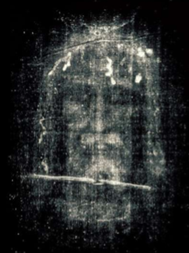
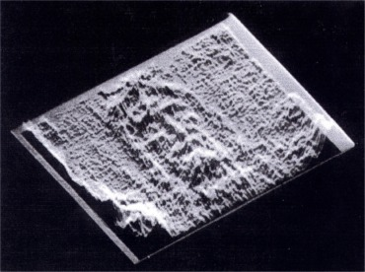
The Shroud of Turin an Enduring Mystery Part 2: Science Encounters the Shroud
Dr. Ray Schneider, P.E., Ph.D.
Associate Professor Emeritus
Bridgewater College, Virginia

Slide 2
Last Week We Looked At Characteristic Markings
Except for incidental markings of burns, water stains and other small markings what we saw was:
Image of a Crucified Man
Blood Stains
Flow from the wrists and feet
A large wound in the chest
Large blood and serum separated flow across back
Blood stains from smaller flows about the head
Numerous small doublet blood stains on the back, thighs, calves, and buttocks characteristic of a severe scourging
Science and the Shroud of Turin © 2014 R. Schneider
2

Slide 3
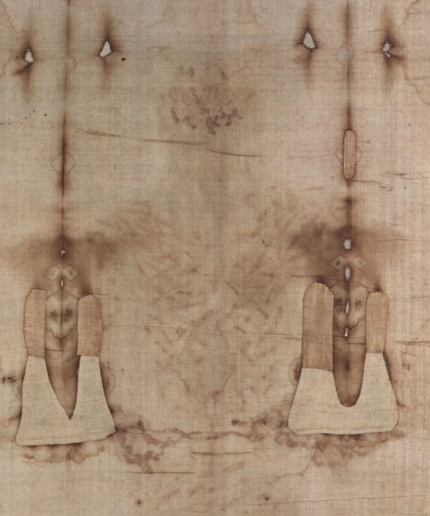
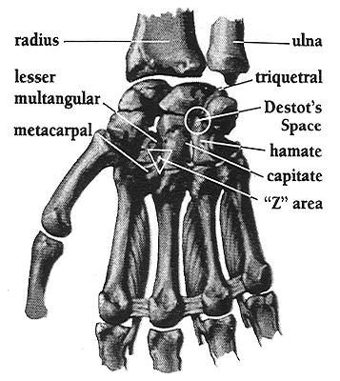
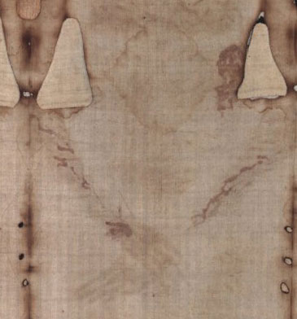
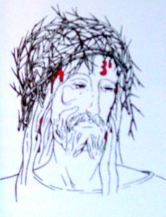
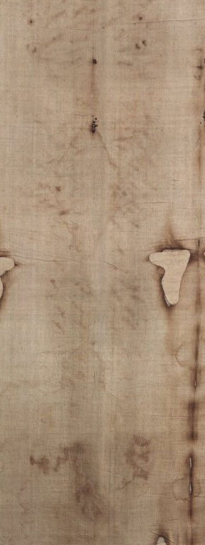
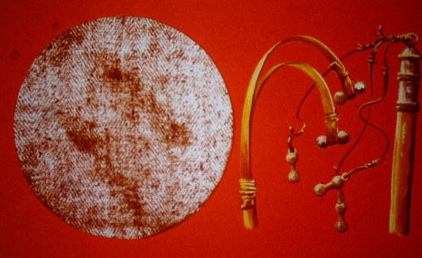
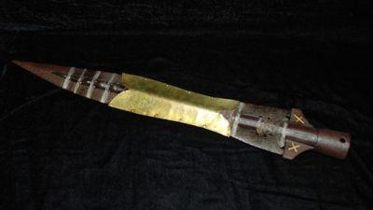
Blood Stains
chest wound
consistent with
spear thrust
head wounds
Crown or Cap of Thorns
numerous scourge wounds
wrist wound
consistent with nails
Scourge Wounds
consistent with a
Roman flagrum
foot wounds
consistent with nails
blood and serum flow across the back
3

Slide 4
Today Our Focus Is On
SCIENCE
Science is partly responsible for the increased interest in the shroud, especially photography
There Are Many Other Perspectives on The Shroud of Turin
History
Archeology
Religion
Textile Technology
Today Though We'll Look At The Science
Science and the Shroud of Turin © 2014 R. Schneider
4

Slide 5
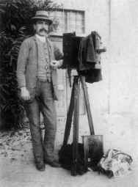
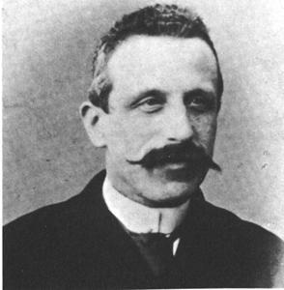
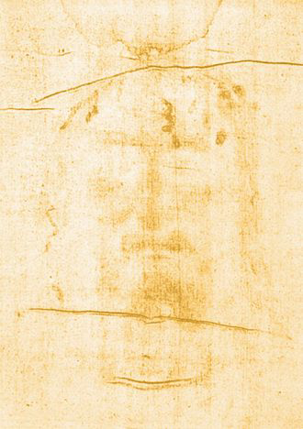
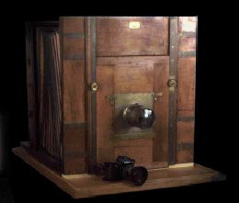
Science Discovers the Shroud
Secundo Pia
Science paid no attention to the shroud and then …
On May 28, 1898 Secundo Pia photographs the Shroud of Turin for the First Time
and was amazed to see a face emerge from the darkroom developer
Science and the Shroud of Turin © 2014 R. Schneider
negative
5

Slide 6
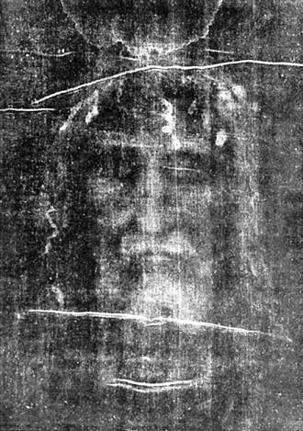
Science Discovers the Shroud
Secundo Pia
The Shroud
behaved like a
photographic
negative!
positive
Science and the Shroud of Turin © 2014 R. Schneider
6

Slide 7
A Sensation!
Pia's photographs create a sensation!
A group of scientists at the Sorbonne in Paris become interested
On the advice of Yves Delage a member of the French Academy of Sciences and a scientist of international reputation,
Paul Vignon an instructor of Science and associates take up the study of the Shroud
Science and the Shroud of Turin © 2014 R. Schneider
7

Slide 8
Paul Vignon
For almost three years Vignon and his associates conducted an intense study of the Shroud
He concluded:
"The impressions on the Holy Shroud are produced by chemical action, largely without absolute contact between the body and the cloth. Of this we have no doubt."
― The Shroud of Christ by Paul Vignon
© 1902 pg. 154 English Version

Slide 9
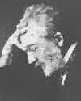
April 21, 1902
Yves Delage presented their findings to the French Academy of Sciences
the Shroud is not a painting regardless of historical documents that say it is.
negative image and fidelity beyond the ability of Renaissance artists
no pigments present nor signs of artistic preparation
conclude image is an imprint of a human corpse produced by the action of natural forces
presented a physical theory of image formation called the vaporograph theory

Slide 10
The First Scientific Image Theory
Vignon's Vaporograph Theory
Febrile sweat covering the unwashed body contains urea which changes to ammonia and releases an ammoniac vapor
A mixture of spices containing aloes on the body react to produce staining vapors
The vapors rise vertically in the humid air trapped between the body and the Shroud
The stain is graduated on the receptive surface according to the contours of the body
― paraphrased from an account of Edward Wuenschel summarizing Vignon's theory

Slide 11
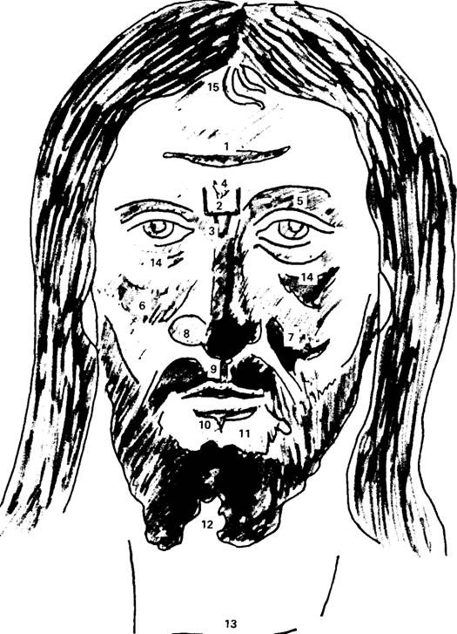
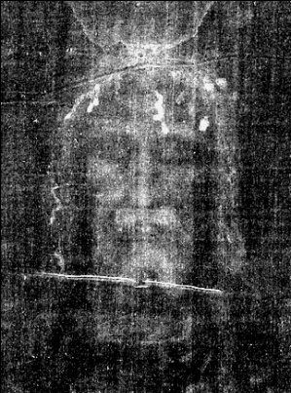
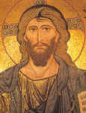
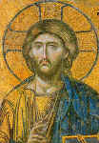
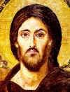
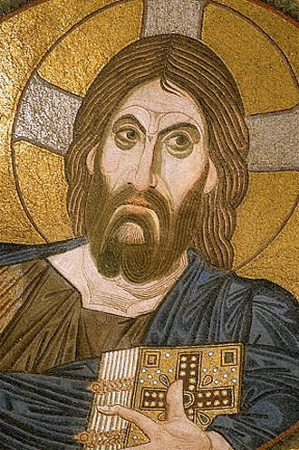
Vignon Markings
15 Characteristic Traits of Shroud in Artistic Depictions of Christ starting about the 6th century.
The Vignon markings - how Byzantine artists created a living likeness from the Shroud image. (1) Transverse streak across forehead, (2) three-sided "square" between brows, (3) V shape at bridge of nose, (4) second V within marking 2, (5) raised right eyebrow, (6) accentuated left cheek, (7) accentuated right cheek, (8) enlarged left nostril, (9) accentuated line between nose and upper lip, (10) heavy line under lower lip, (11) hairless area between lower lip and beard, (12) forked beard, (13) trans­verse line across throat, (14) heavily accentuated owlish eyes, (15) two strands of hair
ca. 1148
ca. 1260-1289
ca. 590
ca. 1050-1100

Slide 12
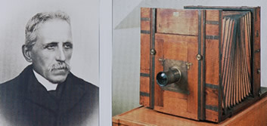
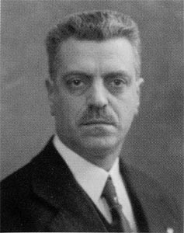
1931 Giuseppe Enrie Photographs
an elderly Secundo Pia attended
May 4-24, 1931 on the occasion of the marriage of Umberto, Crown Prince of Italy, and Princess Maria Jose of Belgium
Twelve photographs were taken on large glass plates by professional photographer Giuseppe Enrie
4 of the entire Shroud
The entire Shroud in 3 sections on 3 plates
Complete dorsal
the face
the bust
the face in 2/3rds of original dimensions
the face in original dimensions
the wound on the wrist enlarged seven times
Giuseppe Enrie

Slide 13
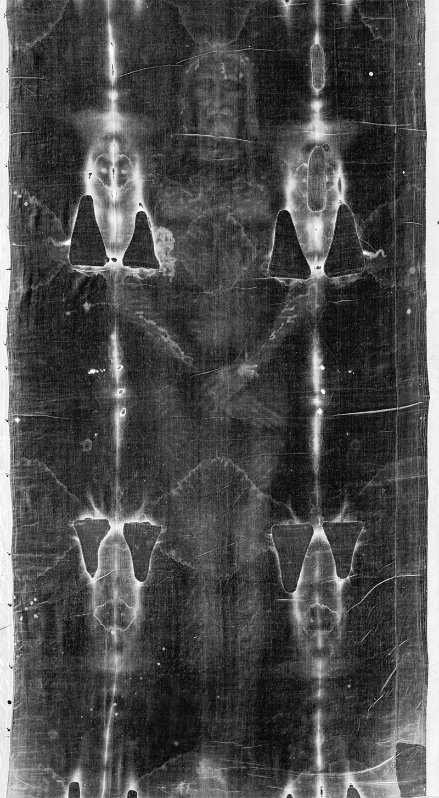
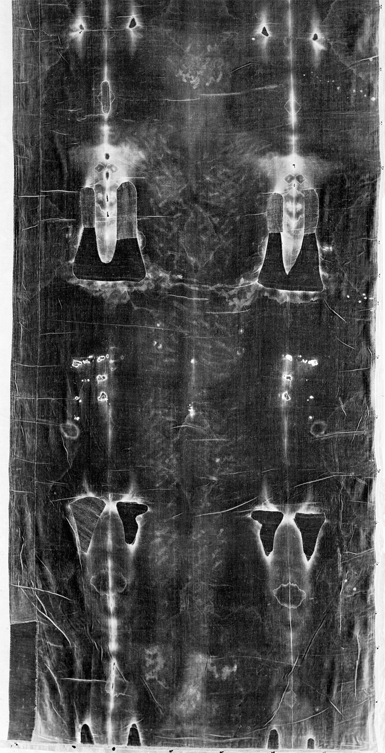
1931 Enrie Photos [negative]
Much Superior
to Pia's Photos
due to the
More Mature
Technology
in 1931

Slide 14
Beyond Visual Examination
A Commission formed by Cardinal Pellegrino to advise him on scientific investigation of the Shroud met on June 16-17,1969
Four years of diplomatic activity and preparation followed until in January 1973 approval to conduct the first scientific studies of the Shroud was received from Count Umberto the exiled king of Italy and owner of the Shroud

Slide 15
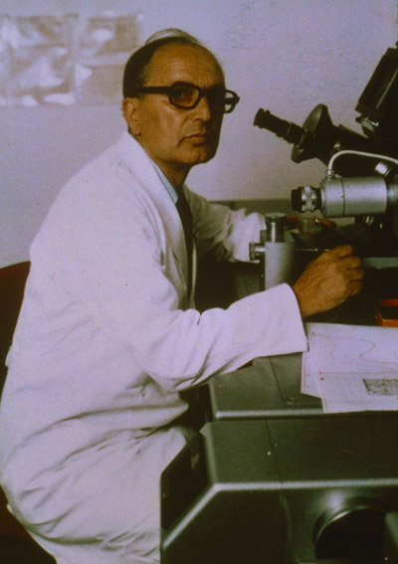
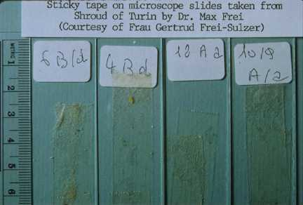
November 23, 1973
Swiss Criminologist Dr. Max Frei takes 12 tape samples of the dusts on the Shroud from non-image areas
He subsequently discovered
in the dusts the pollens of
species of specifically
Palestinian plants
The adhesive tape technique
was subsequently used by
Frei again and by STURP in
1978

Slide 16
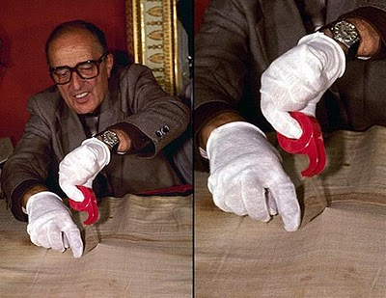
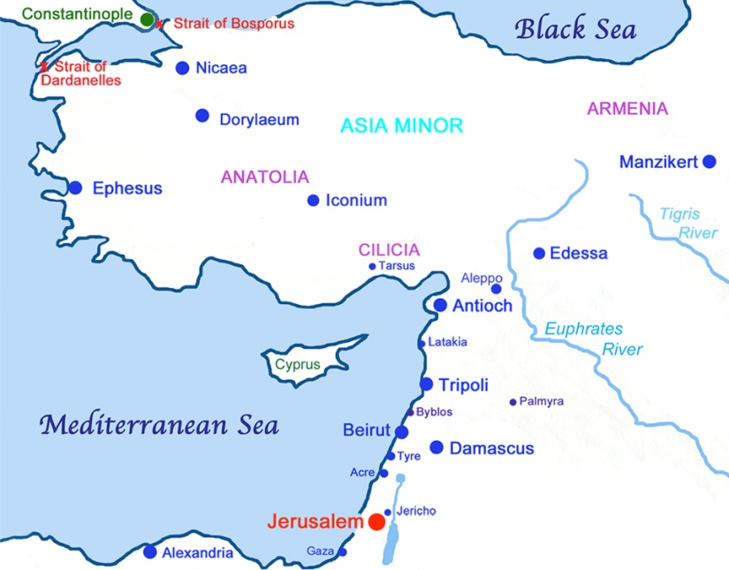
Pollens
The conclusions of the Swiss botanist are interesting:
"The presence on the Shroud of pollen of 29 plants of the Near East, and especially of 21 plants that grow in the desert or the steppes, directly leads to the hypothesis that the Shroud, now preserved in Turin, in the past was exposed to open air in countries where these plants are part of the normal vegetation. (...) Three-quarters of the species found on the Shroud grow in Palestine, of which 13 species are very characteristic or unique of the Negev and the Dead Sea area (halophyte plants). The palynology thus allows us to say that during its history (including manufacturing) the Shroud resided in Palestine. This result does not explain the presence of pollen of steppe plants that are missing in Palestine or are extremely rare there. According to palynology, the Shroud must have been exposed to open air in Turkey because 20 of the found species are abundant in Anatolia (Urfa, etc..) and four around Constantinople, and are completely lacking in the Central and Western Europe.”
Quoted by Emanuela Marinelli in https://www.shroud.com/pdfs/marinelli2veng.pdf

Slide 17
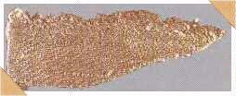
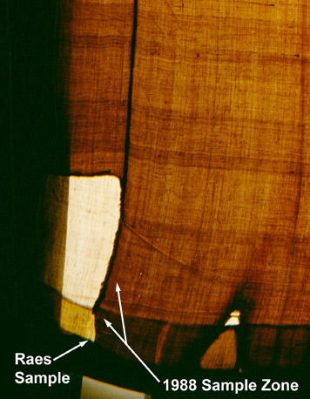
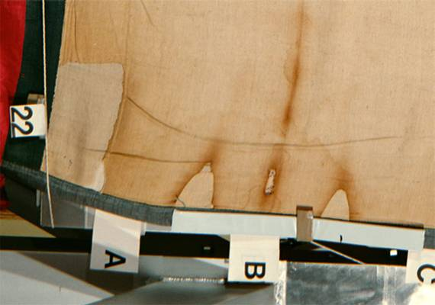
1973 Raes Sample
November 24, 1973 Gilbert Raes was permitted to take small samples of the Shroud:
2 threads 12mm weft and 13 mm warp, and
2 larger samples
40 mm x 10 mm from side strip
40 mm x 13 mm from corner
Warp Weft
Threads/cm 38.6 25.7
Size of thread 16.3 53.6*
Twist Z Z
tex = gm/Km
cotton intrusions
gossipium herbaceum
normal lighting
transmitted lighting

Slide 18
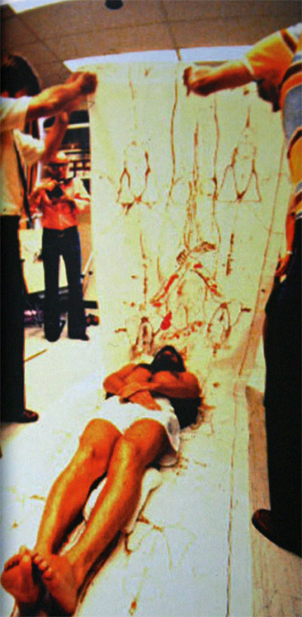
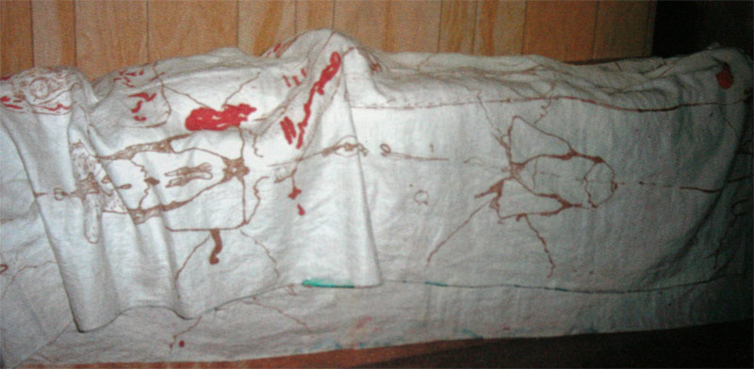
Topology of the Shroud work done c. 1974 to 1976
John Jackson and Eric Jumper, two young Air Force Captains investigate the Shroud.
They concluded that the image is consistent with a cloth wrapped body. Jumper says,"There is only one way to correctly wrap the body."

Slide 19
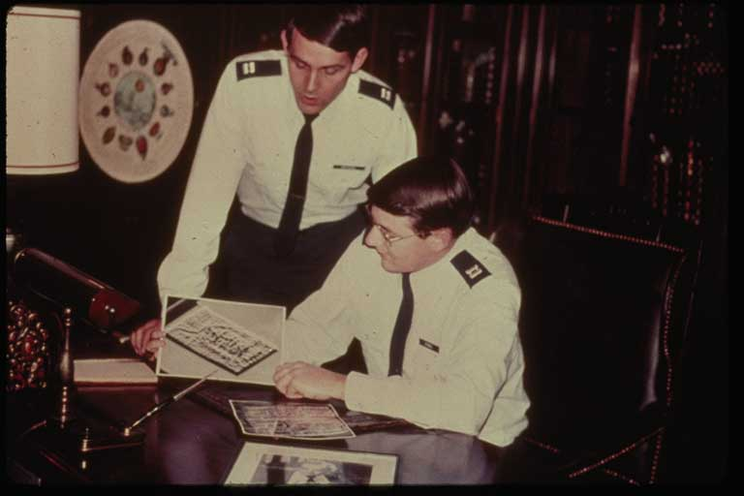
1976 the Discovery Made the News
John Jackson
John Jackson
Eric Jumper
Eric Jumper

Slide 20
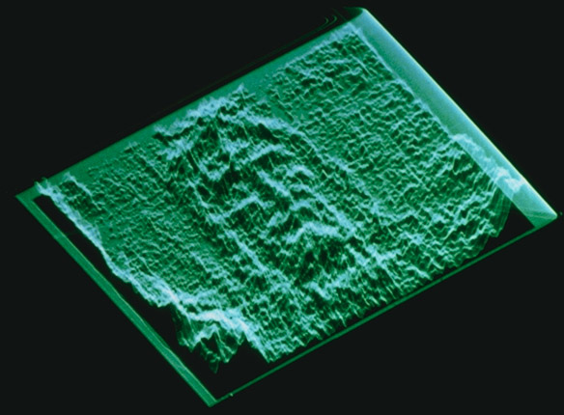
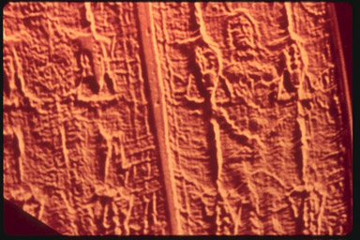
February 19, 1976 VP-8 Analyzer Reveals 3D Character of Shroud Image
Light and Dark translate into
vertical relief using the VP-8
This 3D property of the
shroud image further revealed
when at John Jackson's prompting, Bob Mottern of Sandia Laboratories put an Enrie photograph in the VP-8
image analyzer on February 19, 1976

Slide 21
More VP-8 Examples
Vertical Relief Gain
Rotation

Slide 22
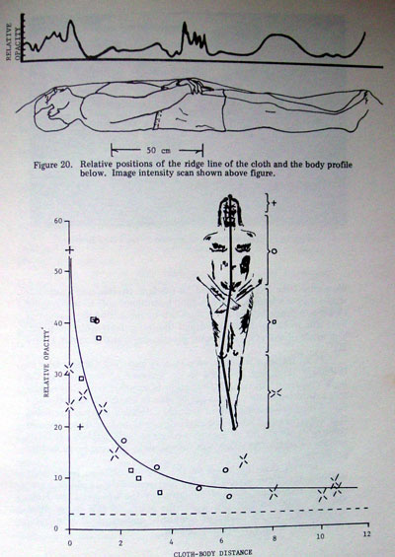
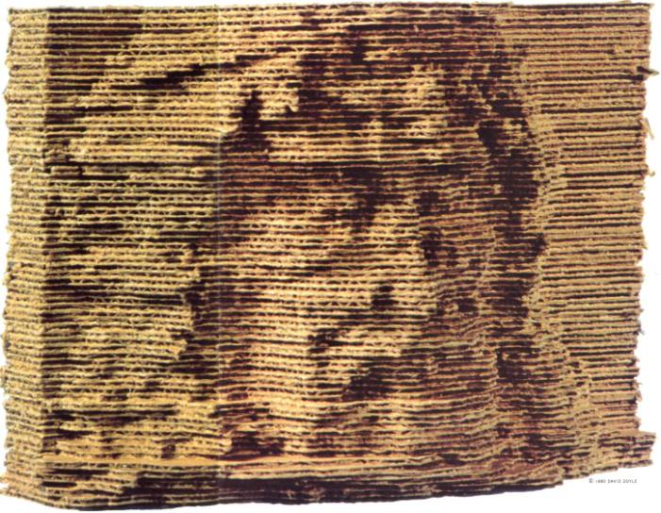
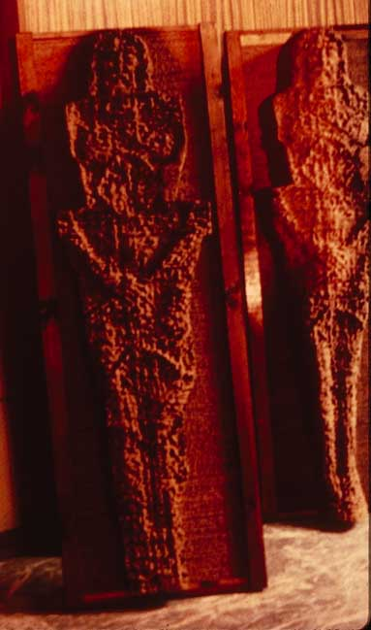
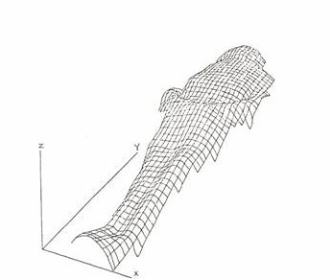
Microdensitometer Readings Confirmed a Cloth to Body Distance Intensity Relationship
Line Scan Models were
methodically cut out of corrugated cardboard by volunteers and a three-dimensional figure emerged from the background noise.

Slide 23
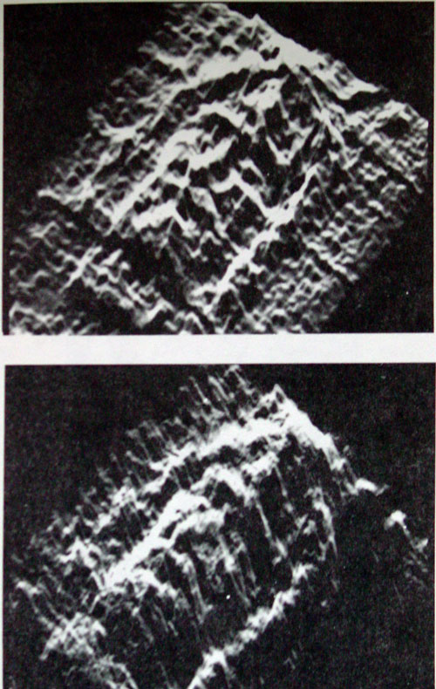
Three Dimensional Image
VP-8 Image
Transfer
Function at left
applied to Shroud

Slide 24
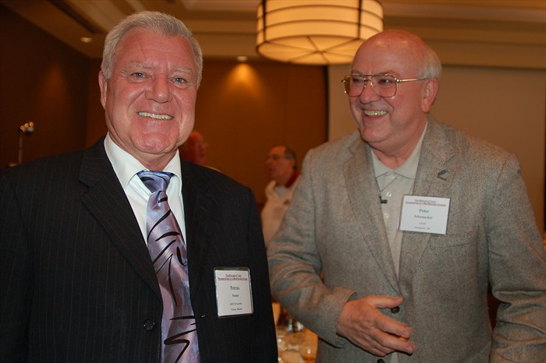
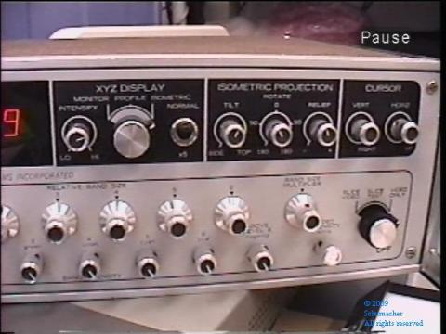
A Later Result
Petrus Soons
Pete Schumacher
http://shroud3d.com/
VP-8 Image Analyzer
Video taken at 2008 Shroud Conference in Columbus, Ohio

Slide 25
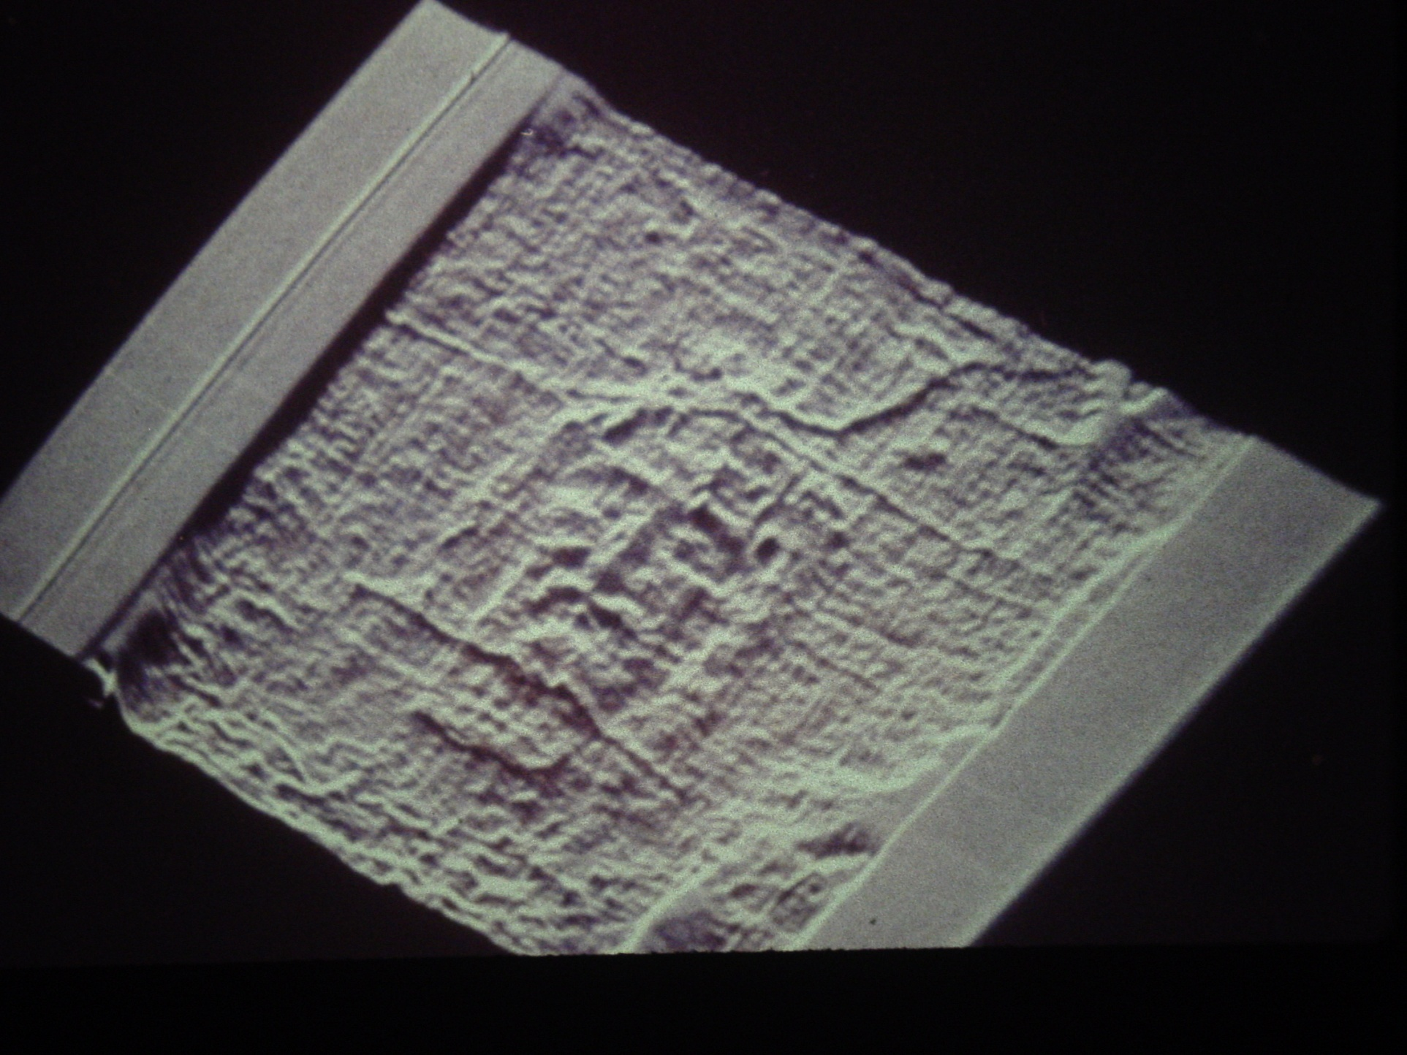
Button-like objects over eyes
created speculation about coins
or potshards

Slide 26
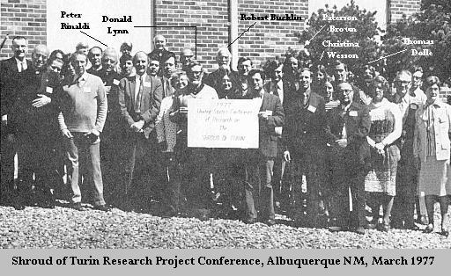
March 23-24,1977 United States Conference of Research on The Shroud of Turin, Albuquerque, New Mexico
Jumper and Jackson Put U.S. Science on the Shroud Map
Encouraged the prospect of a serious scientific study of the Shroud
In September 8 STURP members go to Turin and distribute copies of the proceedings of the March 1977 meeting. The authorities are impressed.

Slide 27
May 1978 Planning Conference Colorado Springs
No Money, No Organization, No Plan, No Equipment and No Firm Commitment from Turin to even have access to the Shroud
Eric Jumper suggested planning in fixed time 12 hour blocks: 12, 24, 36, 48, 96 hours
Tom D'Muhala of Nuclear Technology Corp. stepped up to the plate to help with organization and funding
Organized STURP as tax exempt corporation
Designed a complex table to support the Shroud during tests
Solicited equipment donations from manufacturers
Organized a Dry Run on Labor Day Weekend 1978 to rehearse the scientific tests to be performed
Arranged for a mock-Shroud to be created to help with the tests
And it happened in less than five months

Slide 28
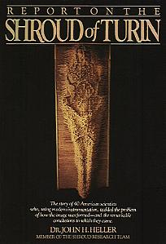
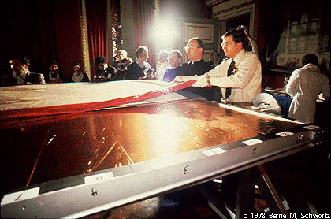
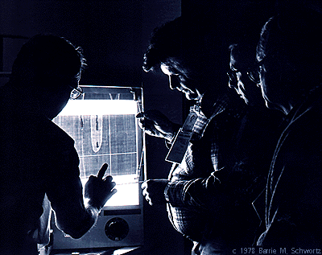
STURP 1978
http://www.shroud.com/history.htm
for more on the history of the Shroud

Slide 29
Intermission
Let's take 10 minutes to stretch

Slide 30
Before We Go On
Did anyone find some interesting things since last time they'd like to share with the group?
Do you have any questions that you'd like to see addressed in this session or future sessions?
How do you think the course is going so far?

Slide 31
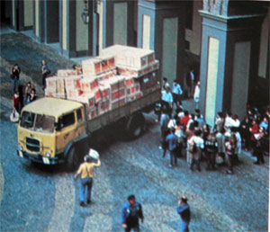
1978 STURP The Shroud of Turin Research Project
$2.5 M of donated scientific equipment
arrives in Turin only to be held up by customs at the last minute it is released and the most intense scientific investigation of the Shroud ever performed begins.

Slide 32
Extraordinary Battery of Tests
High Resolution Visible Light Photography
Photo Microscopy
X-Ray Radiography
Infrared Reflectance Spectroscopy
Ultraviolet Reflectance, Fluorescence Photography
Visible Narrowband and Wideband Photography
Adhesive Tape Sampling
Optical Transmission Photography

Slide 33
STURP carefully blocked out tests …
Test Group # Personnel Time Allocated
Hour Required [hours] Remarks
—————————————————————————————————————————————————————————————
1 4 1/2 hours
2 photomosaic
3 Photography 8 6
4 (block 1) 1 1/2 hours
5 spectral
coverage
—————————————————————————————————————————————————————————————
7 X-Ray Radiography 7 2 Preliminary
test exposures
—————————————————————————————————————————————————————————————
9
X-Ray Fluorescence 6 4 Foot blood
11 (block 1)
12
—————————————————————————————————————————————————————————————
Infrared (block 1) 6 1 I/R photo test exp.
—————————————————————————————————————————————————————————————
14 Spectroscopy (block 1) ...

Slide 34
Photomicrosophy
blood stains dorsal image
microscopic view of an image fiber
burn detail

Slide 35
STURP Team Examines X-Ray Radiography
STURP detects spectral
responses of dirt on the Feet, Nose, and Knee of the man of the Shroud

Slide 36
Rare Travertine Aragonite
Dirt Found on Nose, Left Knee, and Heel. Rare Calcium Carbonate Form Found On Heel Matches Samples from Jerusalem
Dr Ricardo Levi-Setti (University of Chicago) compared shroud sample with samples collected in Jerusalem using high resolution scanning ion microprobe observing an excellent match

Slide 37
Frei and Rogers take Tape Samples of Shroud
Frei: 25 samples in non-image areas
STURP: 37 samples
19 dorsal, 17 ventral, 1 of Holland cloth

Slide 38
Back of the Shroud Seen for 1st time in 400 years

Slide 39
The Shroud in Transmitted Light
The blood stains are dense and the image markings are ephemeral (note horz. bands)

Slide 40
A Banding Example
http://shroud3d.com/making-of-the-holograms/making-holo-expertise-barrie-schwortz
In the apparently blank "band" by the left side of the face there is attenuated image information

Slide 41
Blood Work
Fr. Adam Otterbein of
the Holy Shroud Guild
porphyrin ring
Alan Adler, an expert porphyrin chemist, and his associate John Heller confirmed through a range of chemical testing that the blood markings on the Shroud were human blood.
florescence of the porphyrin
ring
Alan Adler

Slide 42
Confirmation of Whole Blood
High Fe in Blood Areas by X-ray fluorescence
Indicative reflection spectra
Indicative microspectrophotometric transmission spectra
Chemical generation of characteristic porphyrin fluorescence
Positive hemochromagen tests
Positive cyanmethemoglobin tests
Positive detection of bile pigments
Positive demonstration of protein
Positive indication of albumin specifically
Protease tests, leaving no residues
Microscopic appearance as compared with appropriate controls
Forensic judgment of the appearance of the various wound and blood marks

Slide 43
Some Mark Evans Micrographs
ME-5 small of
back blood x32
ME-6 Dense blood
small of back x32
ME-29 nose image
location D13 x64
ME-15 clear cloth
location C13 x32
ME-17 dorsal foot
blood x6.3
ME-20 image eye
loc D13 x32
There are 32 micrographs
ME-19 blood and
image foot x32
ME-24 blood small
of back C8 x54
ME-12 wax
loc F11 x6.3
https://shroudofturin.files.wordpress.com/2013/11/mark-evans.pdf

Slide 44
Dorsal Microphotography Map
http://www.sindonology.org/photomicrographs.shtml#locations
https://www.shroud.com/mapping.htm

Slide 45
Ventral Microphotography Map
http://www.sindonology.org/photomicrographs.shtml#locations
https://www.shroud.com/mapping.htm

Slide 46
A Blood Mystery
Why does blood that should be on the face appear to be in the hair?
Cloth shift between blood and image transfer
46

Slide 47
Blood Transport
A Cloth-Wrapped Body
Blood runs down the arm and drips off the elbow onto the enfolding cloth

Slide 48
STURP Findings
the shroud is not a painting, no pigment, no directionality, not an albedo image
the image encodes cloth to body distance
the image is ephemeral no more than 15 to 30 microns thick (one or two fibrils)
the chromophore is straw-yellow, oxidized linen
fluorescent halos surround blood
blood went on before image (no image beneath blood)
the blood is human blood, work by others has shown it is type AB and male (DNA testing)
calcium and strontium and iron are uniformly present on the shroud in small quantities consistent with ancient manufacture of linen

Slide 49
Further Findings
the image is medically accurate
venous and arterial blood flows are accurate
distortions are consistent with a cloth wrapped body
forensic medical examiners have no problem interpreting the image
wounds are entirely consistent with 1st century practices
faint and incomplete images of flowers and coins and others (speculative)

Slide 50
1978 STURP Conclusions
“The Shroud image is that of a real human form of a scourged, crucified man. It is not the product of an artist.”
“The bloodstains are composed of hemoglobin and also give a positive test for serum albumin.”
“The image is an ongoing mystery and until further chemical studies are made . . . the problem remains unsolved.”

Slide 51
May 1977 The Carbon Dating Chase Begins
Dr. Harry Gove
Harry Gove, Ted Litherland, and Kenneth Purser develop Accelerator Mass Spectrometry (AMS) ― 100 to 1000 times more sensitive than previous Libby counter Carbon-14 dating method.
David Sox, an English cleric sends Gove a letter in June saying that at last this makes Carbon Dating of the Shroud feasible.
In 1978 Gove visited Turin to explore the possibility of Carbon Dating the Shroud

Slide 52
Planning a Test
Competition Developed to Control the Carbon Dating of the Shroud
March 1979 Gove attends a STURP meeting
Initially Brookhaven and Rochester proposed making measurements with STURP involvement
The issue becomes a tug of war among factions. Gove does not want STURP involved.

Slide 53
1982 A Bootleg Carbon Date
Alan Adler and John Heller get a thread from the Raes sample informally C14 tested
the Thread is divided in two
One ends tests 200 a.d. while the other end tests 1000-1200 A.D.

Slide 54
1983
Six Carbon Dating Labs receive test samples #1 Ancient Egyptian Linen and #2 a more recent cotton from Peru
Labs are Arizona, Bern/Switzerland, Brookhaven, Harwell, Oxford, and Rochester
The Shroud is given to the Vatican by the House of Savoy
In 1984 STURP gives Turin a plan to test the Shroud. 26 tests. #6 Carbon Dating

Slide 55
1986
After nothing short of Byzantine complications a meeting is held to plan the Carbon 14 testing
A protocol was developed for seven labs and mutiple sample sites, at least three and preferably five or more

Slide 56
Carbon Dating 1988
Three labs supervised by the British Museum
Arizona
Zurich
Oxford

Slide 57
The Dating of the Shroud
Round 1
British scientists Professor Edward Hall, Dr. Michael Tite, and Dr. Robert Hedges announcing the results of the carbon-dating at a press conference held at the British Museum
13 October 1988

Slide 58
1260 to 1390!
Too Much C14
Nominally 92% versus 79%
i.e. 13% too much

Slide 59
Predictable
Results
The publicity and controversy surrounding the 1988 Carbon 14 date brought shroud
research to a standstill.
But one bad result in the midst of universal good results calls for an explanation not dismissal.

Slide 60
The Carbon-14 Data
χ²=6.4 for Shroud, anomalously high
χ² >
6.4 5
0.1 90
1.3 50
2.4 30
Shroud of Turin
Linen from tomb in Nubia
11th to 12th century A.D.
Egyptian Mummy carbon dated earlier to 2010 ±80
-110 B.C. to 75 A.D.
Cope of St. Louis d’Anjou
dated 1290-1310 A.D.
IS IT REALLY A VALID TEST?

Slide 61
The Aftermath
Speculation ensued on why the Shroud could be so convincing in other respects and yet date Medieval?
Many Unsatisfactory Accounts were advanced:
the 1532 fire contaminated it
biological contamination (bioplastic coatings)
biofractionalization
isotope enrichment
radiation induced enhancement due to "the physics of the Resurrection"
Many Just Accepted the Date
Support and Interest in Shroud research declined

Slide 62
Problems with the C14 Test
UV Florescence
Only a Single Sample Site
High Probability of Contamination at Selected Site — contamination found (ex. cotton and dyes) in the sample area
History of Shroud Makes It a Difficult Subject
Fire of 1532 Subjected It to Extreme Opportunities for Contamination
Textiles Often Date Unreliably
biofractionalization, ion-exchange, and build up of contamination (ex. "bioplastic") are examples of possible skewing mechanisms
possible site of repair and reweaving and evidence from UV and Blue Mosaic show that the region is anomalous.
Blue Mosaic
Sample Site

Slide 63
1999 A Clue
Brian Walsh points out an interesting fact
The Carbon Dates exhibit a systematic shift with distance from cloth edge
Chance or Evidence of a Problem

Slide 64
What's Wrong With Carbon Dating?
To Be Valid The Samples Must Be Uncontaminated and Representative of the Whole
Blue Quad Mosaic
UV-Fluorescence
False Color Depiction of
1st Component of PCA
χ² = 6.4
Samples were contaminated and dating correlated strongly with the contamination
64
©1978 Barrie M. Schwortz Collection, STERA, Inc. , ©1978 Vernon Miller, © 2012 J.M. Morgan, III

Slide 65
Benford and Marino
Propose the Mediaeval Patch Theory

Slide 66
Introducing Raymond Rogers
UCLA / Los Alamos Science Fellow
Member of the 1978 STURP team
Cofounder of the Coalition for Excellence in Science Education.
Member of the Department of the Air Force Scientific Advisory Board
Published over 50 peer-reviewed papers in scientific journals.

Slide 67
SURPRISINGLY He found splices dyed at one end
under analysis at Los Alamos
the sample divided into three
parts one of which was
an adhesive resin

Slide 68
AND the fibers were encrusted
with dyestuff

Slide 69
AND
Madder root dye (Alizarin)
Alum
Gum Arabic
Vanillin
But only in the corner. Not anywhere else.

Slide 70
In 2002, Rogers and Anna Arnoldi of the University of Milan published preliminary findings suggesting mending.
Important Point: What was dated was chemically unlike the rest of the cloth.
Lloyd Curry in U.S. Government’s Journal of Research of the National Institute of Standards and Technology credited Rogers with significant findings.

Slide 71
In January 2005, Rogers’ findings were published in Thermochimica Acta
BBC: “Shroud Older Than Thought”
Philip Ball, writing in Nature Online, found the vanillin discovery particularly significant.

Slide 72
VANILLIN

Slide 73
Three New
Dating Methods
Three Mechanical Tests Developed by Italian Researcher Giulio Fanti
nine ancient fabrics used in compiling the calibration curves: 3000 B.C. to 1000 A.D.
5 from Egypt, 3 from Israel, 1 from Peru
plus two modern fabrics of recent manufacture
Results: 300 BC ± 400; 200 BC ± 500; and 400 AD ± 400
Jointly: Averaged 33 BC ± 250

Slide 74
Dating Status
Five independent dating methods now
C14
Vanillin
Fourier transform infrared spectroscopy
Raman spectroscopy
mechanical parameters of fibers under tension and breaking
Four agree only C14 is the outlier
Fanti's methods require further confirmation

Slide 75
Next Time
So if we can't rule out authenticity then where exactly did the Shroud of Turin come from?
How can the burial cloth of Jesus Christ have been hidden in history only to turn up in the hands of a Christian knight around 1353?
Next time we'll look at that question
The History of the Shroud

