Slide 1
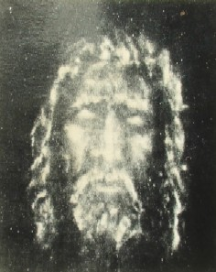
The Shroud of Turin an Enduring Mystery Part 4: Skeptics & Image Formation
Dr. Ray Schneider, P.E., Ph.D.
Associate Professor Emeritus
Bridgewater College, Virginia

Slide 2
The Deeper Mystery
We've Looked At The Shroud From Three Perspectives
RELIGIOUS: We've seen that its markings blood and image faithfully depict the passion of Christ
SCIENCE: We've seen that the science demonstrates that it is not a painting or apparently a product of human artifice
HISTORY: While there are certainly holes, a plausible historical reconstruction is possible especially with the corroborative witness of the Sudarium of Oviedo

Slide 3
The Skeptics
The Skeptics Insist That The Shroud Is Too Good To Be True. It Must Be A Forgery.
they point to the C14 Date
Given The Work Done To Date It's Reasonable To Say: "Show Me!"
Show me how to make one?
Show me what makes it inauthentic?
How do I know how to make that distinction between a forger or an authentic relic of the tomb?

Slide 4
Characteristics of the Image
Any demonstration that the shroud is a forgery requires that we identify at least some way that a forger could duplicate all the characteristics of the shroud
Image Characteristics
Blood Flows
Forensic Fidelity
elements a forger would or could not know about
pollen, fluorescent serum rings, dirt from Jerusalem, details of crucifixion that differed from art tradition

Slide 5
Some Image Properties
Negative
STAR Features
Superficial
Three Dimensional
Areal Density
Resolution
Blood Before Image
Forensic Accuracy
Historical Crucifixion Accuracy

Slide 6
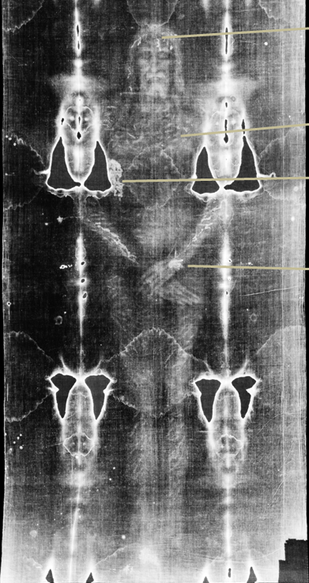
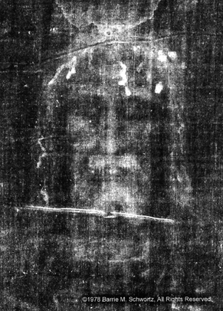
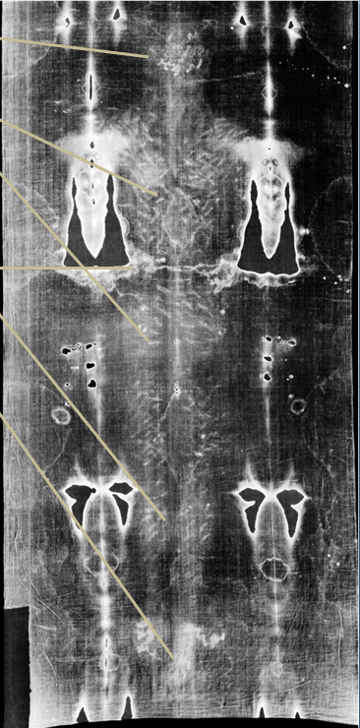
A Negative Image
A Negative That Is Not A Negative

Slide 7
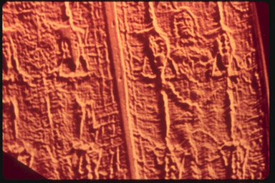
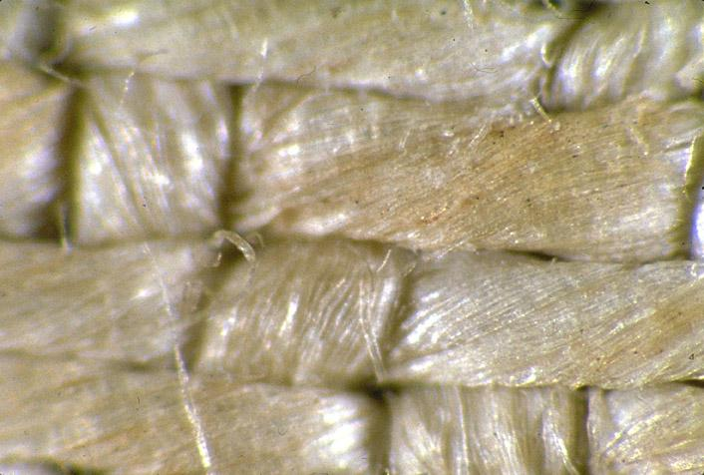
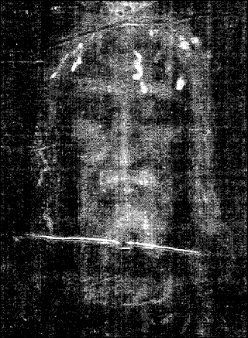
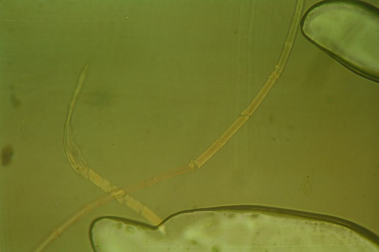
STAR Properties Four Most Challenging Image Properties
Superficial Image only on
top-most fibrils and only on
the surface, nominally < 600nm
thick.
Three Dimensional Image which
encodes cloth to body distance.
Areal Density, all image fibers
the same color to ≈2% and
density due to more colored
fibrils where color is darker
not darker
color.
Resolution D/d < 1/3 requires vertical anisotropy

Slide 8
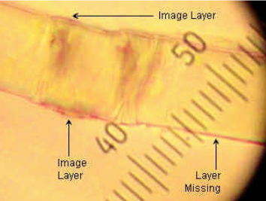
Superficial
The Image Is On The Uppermost Fibers That Make Up The Threads
It Is Only One Fiber Deep
The Image Chromophore Is A Thin Layer On The Outside Of The Fiber 200-600 nm Thick
possible impurity layer or primary cell wall
The Image Is Uniform In Color
Adler & Heller Say It Is Oxidized Cellulose

Slide 9
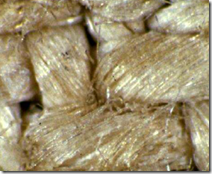
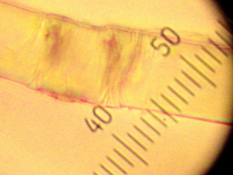
Image Fibers
The superficial nature of the image
does not penetrate the surface fibers of the thread
exists only on the surface of the fibers themselves extending only a few hundred nanometers into the fibers
image color exhibits sudden termination yet follows fibers
Phase contrast microscopic view of image-bearing fiber from the Shroud of Turin. The carbohydrate layer is visible along top edge. The lower-right edge shows that coating is missing. The coating can be scraped off or removed with adhesive or reduced with diimide
http://en.wikipedia.org/wiki/Shroud_of_Turin
https://shroudofturin.files.wordpress.com/2013/11/mark-evans.pdf

Slide 10
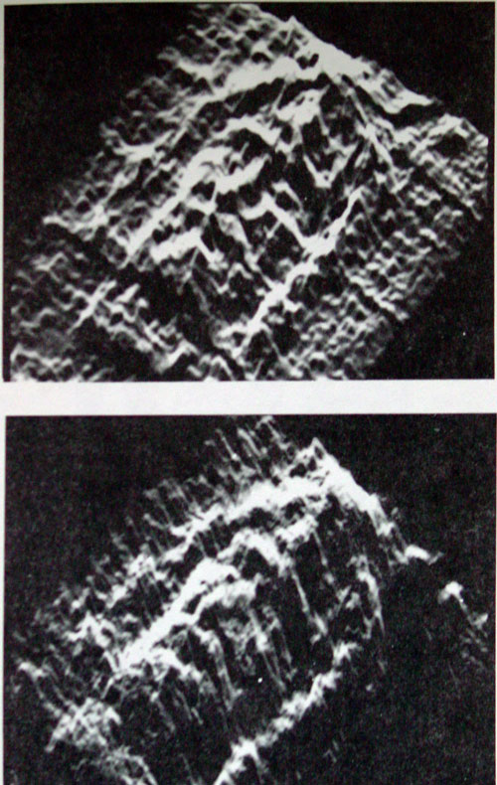
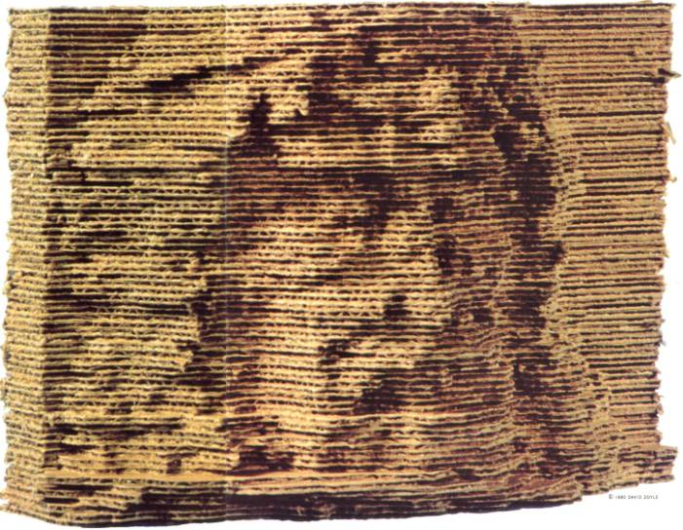
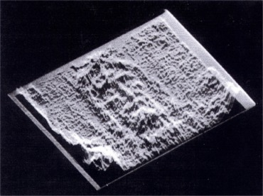
Three Dimensional
Encodes Cloth To Body Distance
Exponential Decay In Intensity
Extinction at 4-5 cm

Slide 11
Exploring The 3D Information
Cleaning Up The 3D Information To Make A Clearer Image
Petrus Soons

Slide 12
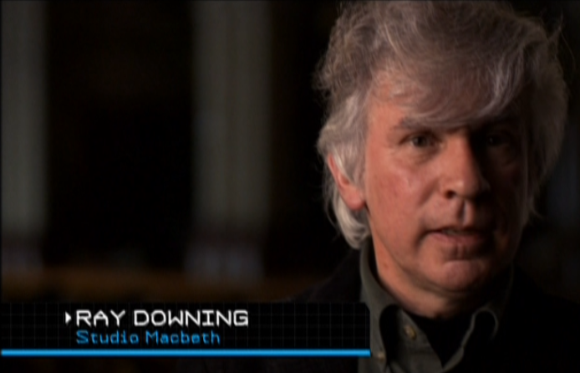
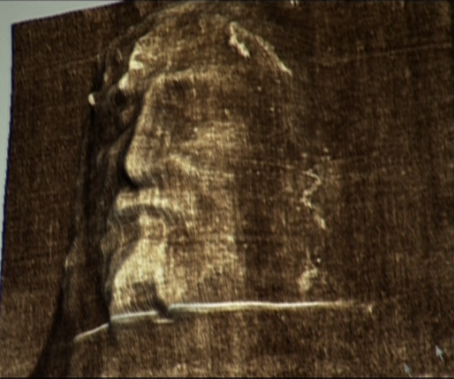
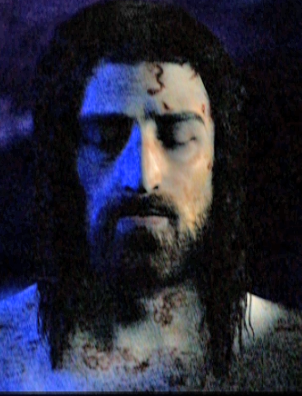
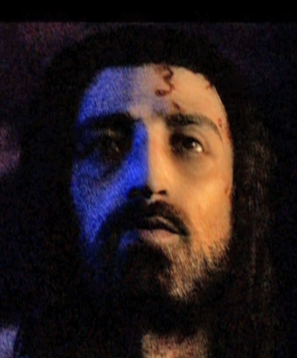
A Fascinating Development of the 3D information on the shroud using computer technology
http://www.history.com/shows/the-real-face-of-jesus/articles/the-shroud-of-turin

Slide 13
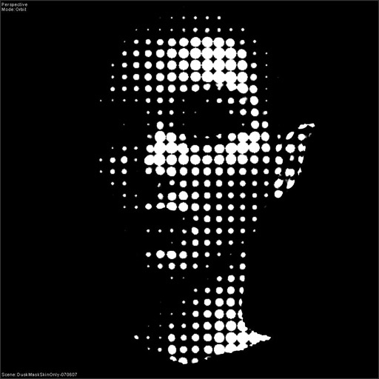
Areal Density
The elements that make up the shroud image are all the same color. Like a halftone image all the "dots" are the same color, more where its darker and less where its lighter
In the case of the shroud the fibers are a uniform yellow of oxidized cellulose

Slide 14
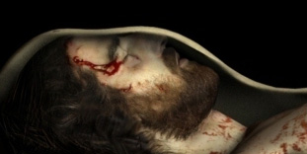
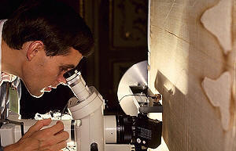
Resolution
d
D
John Jackson pointed out the problem of the resolution of the shroud features that any image process must achieve. Using the example of the lips he estimated the required resolution at D/d where D_{lips} ≈ 0.4 cm and d_{cloth} ≈ 1.1 cm so D/d ≈ 1/3
Any suitable image process must achieve this level of resolution

Slide 15
How Do You Do All Of That?
Negative & STAR
How are these characteristics compatible with one another?

Slide 16
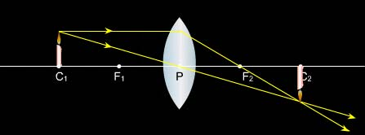
Resolution Requires Collimation and Focus
Normally To Get A Focused Image Requires A Lens Or Some Kind Of Focusing Process
How Can It Be That We Have A Focused Image On The Shroud?

Slide 17
Mechanism? Collimation In The Tomb
Gravity ?
Laminar Air Flow ?
Earth's Static Electric Field ?
Some Combination ?
We Just Don't Know

Slide 18
Collimation Is Not Enough
BUT
The image mechanism encodes cloth to body distance so something about the process "knows" how far the cloth is from the body
How Does That Happen?
The 'agency' degrades with distance extinguishing after about 4-5 cm.
What happens between body and cloth?

Slide 19
Chromophore
A chromophore is the part of a molecule responsible for its color. The color arises when a molecule absorbs certain wavelengths of visible light and transmits or reflects others.
The Chromophore of the shroud appears to be oxidized cellulose which can be reduced with diimide.
A “catalytic compound" (stimulus) promoted the oxidation of the cellulose of the linen/impurity layer to produce a thin (200-600 nm) image

Slide 20
Extinction
No Image Beyond 4 or 5 cm … WHY?
What's Magic About That Distance?
Some Thoughts
Time frame of extinction distance set by speed of propagation of the image producing agent
speed of light 5 cm in 0.167 nanoseconds
gravity fall 5 cm in 0.96 seconds
electric field charge particle flux ? variable
gas or aerosol draft ? variable
Process may involve a chemically active entity that is consumed as it goes through the intervening distance

Slide 21
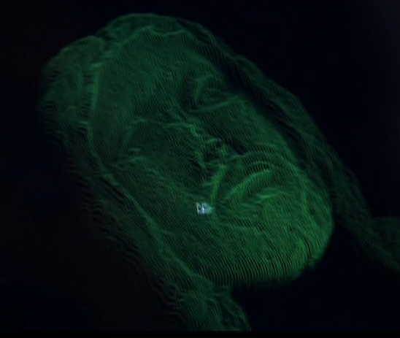
Jackson Tinted Fluid Experiment
By using a bust coated with phosphorescent paint that could be charged to glow
then immersed in water with dye to attenuate the glow from the bust as a function of depth
Jackson was able to duplicate the 3D characteristics of the shroud and explain some distortions
They took the bust, still with the phosphorescent coating, and submerged it, nose up, in a large container of dilute black ink. The nose, which was closest to the top of the inky solution, was brighter; the eye sockets and the hairline, darker. A photograph of the surface of that liquid, when placed in the VP-8, produced an authentic 3-D image of the head.
http://theshroudofturin.blogspot.com/2007_12_01_archive.html

Slide 22
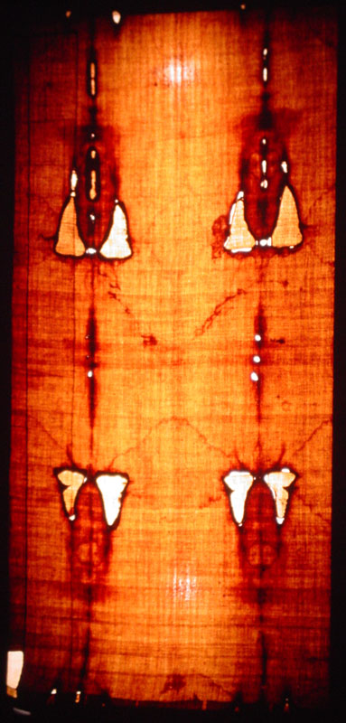
Don't Forget
The Blood Had To Go On Before The Image
And The Whole Thing Had To Retain Forensic Accuracy And Map To A Cloth Wrapped Body

Slide 23
What Plays The Role Of The Ink?
Any Image Mechanism Has To Duplicate The 3D Characteristic, The Resolution, And All The Other Characteristics …
TALL ORDER
Ray Downing's History Channel Documentary Did A Nice Job Of Summarizing The Issue. Without The INK (metaphorically) No Image
Collimated: A Silhouette
Omnidirectional: A Blur
No Solution Was Offered

Slide 24
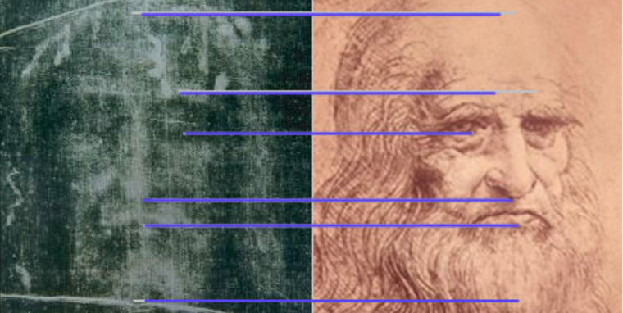
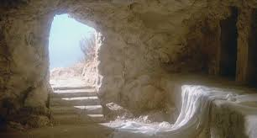
Studio or Tomb
Artist or Natural Phenomenon
What Are Our Options?
A Forger
But How?
Natural
But How?
Supernatural
How Do You Know?

Slide 25
Some Theories People Have Suggested
Keep in mind that whatever is true must explain all the details …

Slide 26
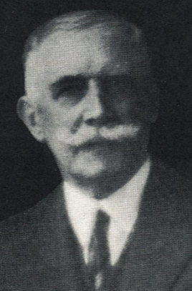
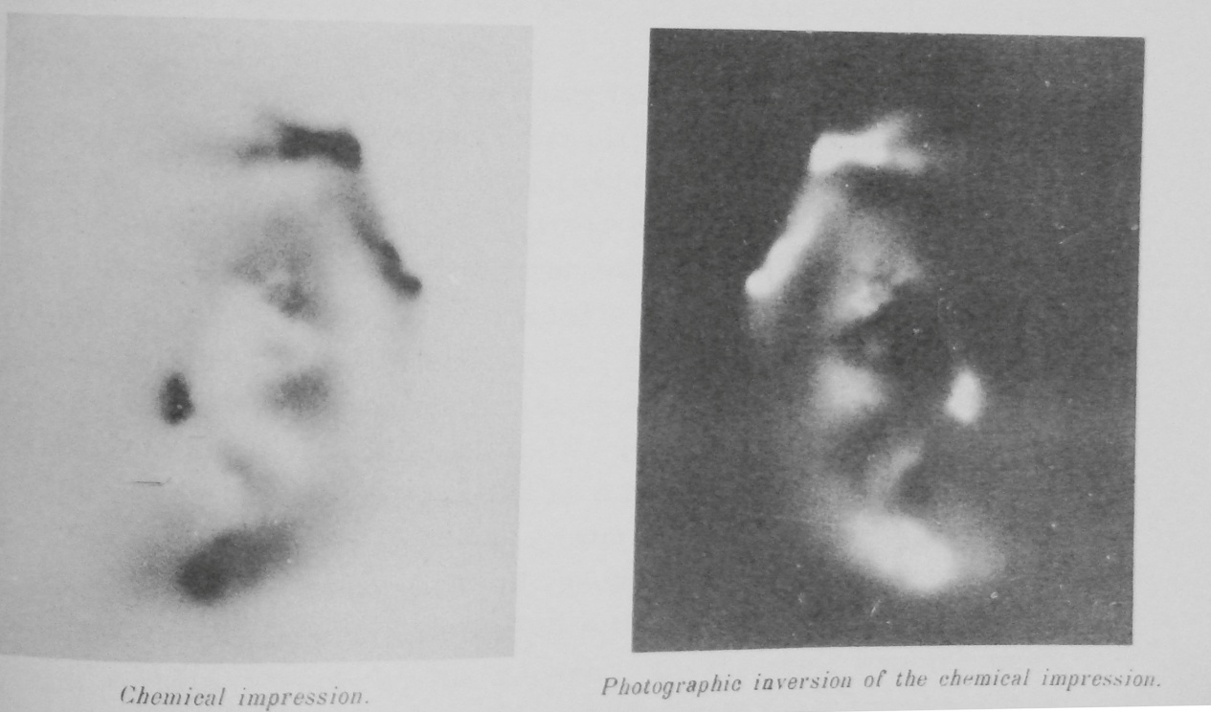
Vaporograph
Paul Vignon's Vaporograph Theory Kicks Of The Question of HOW WAS THE IMAGE FORMED?
Plaster bust impregnated with zinc powder produces an image at a distance on a photographic plate (Simulation)

Slide 27
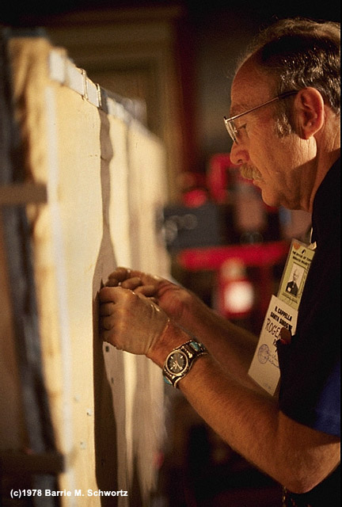
Raymond Rogers
UCLA / Los Alamos Science Fellow
Member of the 1978 STURP team
Cofounder of the Coalition for Excellence in Science Education.
Member of the Department of the Air Force Scientific Advisory Board
Published over 50 peer-reviewed papers in scientific journals.

Slide 28
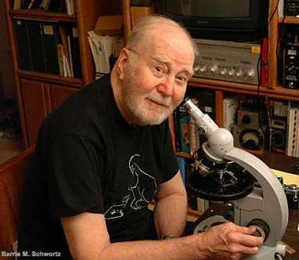
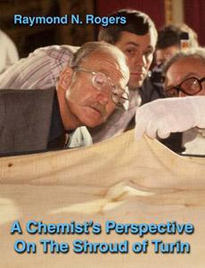
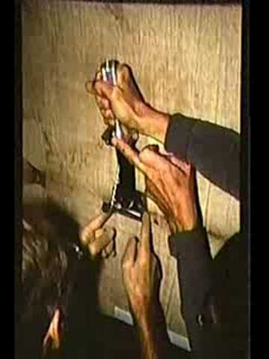
Ray Rogers: Maillard Reactions
Ray Rogers (1927-2005), Los Alamos Chemist, member of the STURP team and author of important ideas about the image formation process
http://www.shroud.com/pdfs/rogers10.pdf

Slide 29
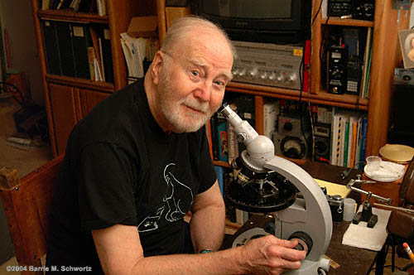
Ray Rogers' Image Hypothesis
Maillard Reactions
in a thin layer of starch impurities
The cloth was produced by technology in use before the advent of large-scale bleaching. Each hank of yarn used in weaving was bleached individually. The warp yarns were protected and lubricated during weaving with an unpurified starch paste. The finished cloth was washed in Saponaria officinalis and laid out to dry. Starch fractions, linen impurities, and Saponaria residues concentrated at the evaporating surface. The cloth was used to wrap a dead body. Ammonia and other volatile early amine decomposition products reacted rapidly with reducing saccharides on the cloth in Maillard reactions. The cloth was removed from the body before liquid decomposition products appeared. The color developed slowly as Maillard compounds decomposed into final colored compounds.
― quoted from Scientific Method Applied to the Shroud of Turin
by Raymond N. Rogers © 2002

Slide 30
The Rogers' Theory
PROS
Explains Superficiality
Explains Banding
Explains uniform color
Explains ghosts
CONS
Doesn’t explain resolution
Doesn’t explain general uniformity of the image
Striation of image fibers?

Slide 31
Can We Make One?
Let's Look At Some Efforts By Those Who Have Tried Mostly Skeptics

Slide 32
Duplicating The Shroud
The C14 Date Was Welcomed By The Skeptics
It Was A Vindication Of Their Position
Nevertheless To Make A Shroud?
AN OVERWHELMING CHALLENGE
The Skeptics
Paintings, Rubbings, Powderings, Photographs And More
TRYING TO FIGURE IT OUT

Slide 33
Intermission
Let's take 10 minutes to stretch

Slide 34
Before Going On Any Questions or Discussion?
Does Anything Need To Be Addressed Before We Explore The World Of The Skeptics?

Slide 35
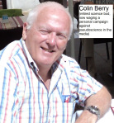
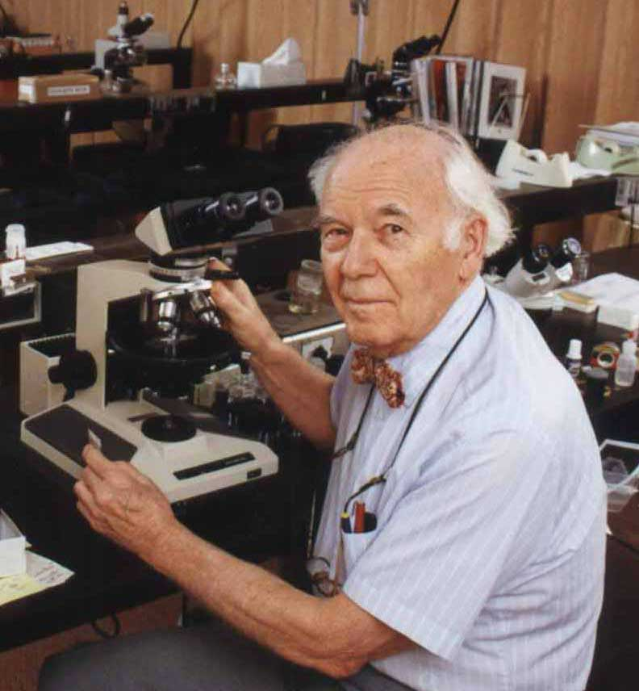
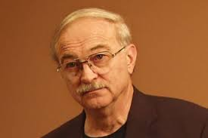
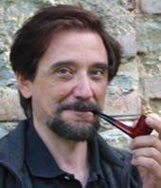
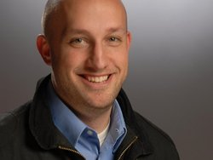
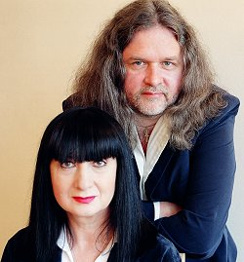
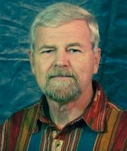
The Skeptics
Colin Berry
Joe Nickell
Walter McCrone
Luigi Garlaschelli
N.D. Wilson
By No Means
A Complete List
Randall R. Bresee
Clive Prince & Lynn Picknett

Slide 36
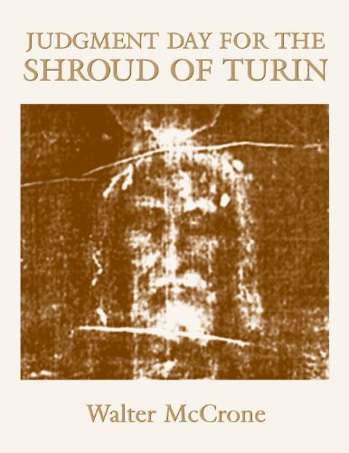
Walter McCrone: Microscopist
Walter McCrone (1916-2002) microscopist worked with STURP tapes, skeptic, believed shroud was some kind of painting
http://www.holyshroudguild.org/drmccrone5.html

Slide 37
Walter McCrone On The Basis Of Microscopy On STURP Tape Samples
I identified the substance of the body-and-blood images as the paint pigment red ochre, in a collagen tempera medium. The blood image areas consist of another pigment, vermilion, in addition to red ochre and tempera. These paints were in common use during the Middle Ages.
The paint on the shroud was dilute (0.01 percent in a 0.01 percent gelatin solution). … Known as grisaille, the style of the painting, with its very faint, monochromatic image, was also common in the 14th century.
http://www.shroud.com/bar.htm#sidebar

Slide 38
Data Trumps Just Looking
McCrone looked at the sticky tape samples through a microscope and didn't really understand the chemistry
Adler & Heller did numerous direct chemical tests with reagents on the samples
established the blood was blood
iron oxide only in water stain areas and blood scorch areas
Burned blood produces iron oxide
retted linen explains presence of iron inside fibers
specks of paint from "sanctifying paintings)
x-ray data invalidates McCrone claims
iron oxide not present in sufficient quantities to be the chromophore
cinnabar in quantities McCrone claimed would have shown up in x-ray data and it didn't
no protein in image areas

Slide 39
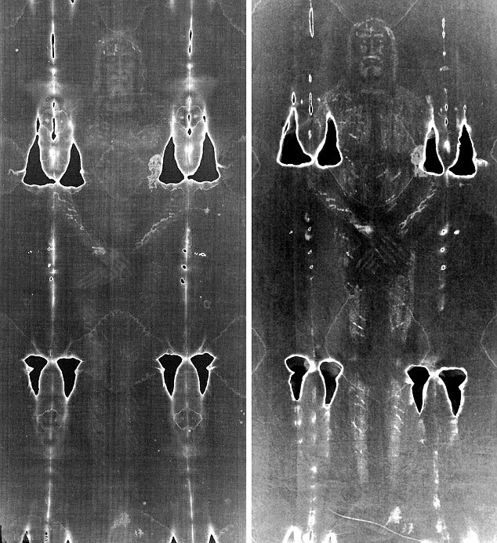
Rubbing With Acid
Luigi Garlaschelli, Researcher in Organic Chemistry, University of Pavia
Made by rubbing a pigment containing dilute acid
The blood was painted on after the image
http://shroudstory.com/2009/10/11/stephen-jones-take-on-the-garlaschelli-fake/

Slide 40
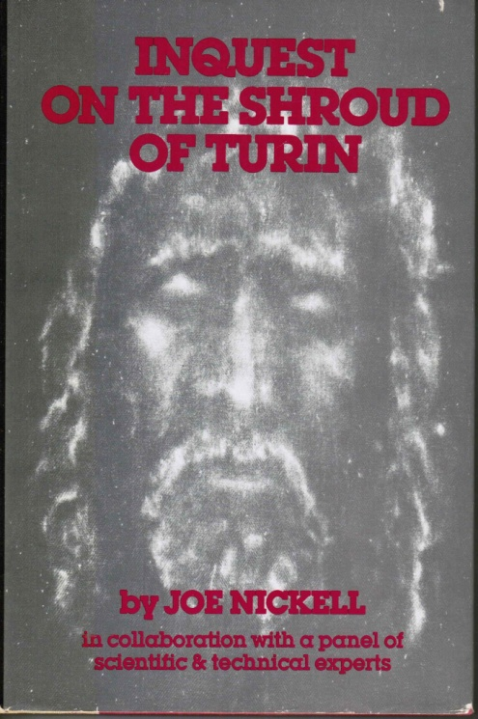
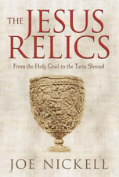
Joe Nickell: Stage Magician and Professional Skeptic
Joe Nickell (1944 - ) prominent shroud skeptic. Has tried to duplicate shroud using bas-reliefs and rubbings with mixed success

Slide 41
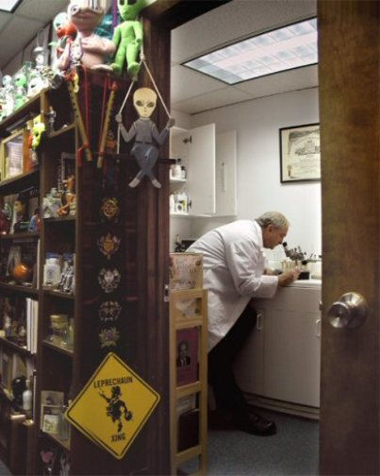
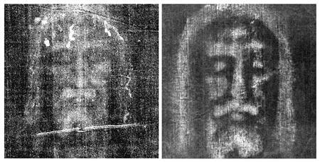
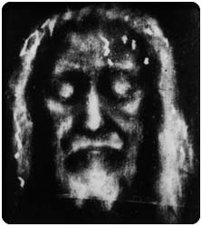
Rubbings
Joe Nickell has a Ph.D. in English
He's a noted shroud skeptic and debunker of all sorts of paranormal things
http://theshroudofturin.blogspot.com/2012/05/you-state-that-there-is-no-paint-dye-or.html

Slide 42
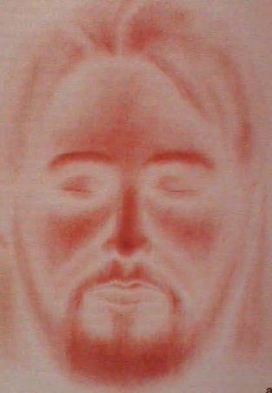
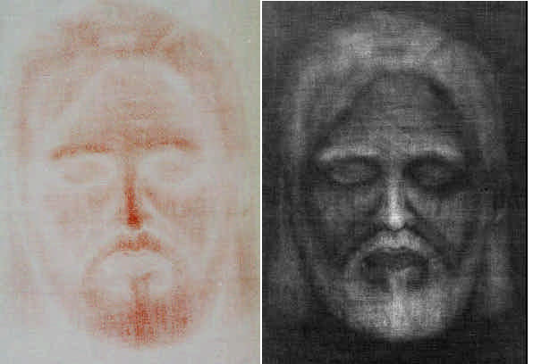
Painting With Powder
Emily A. Craig, Ph.D., and Randall R. Bresee, Ph.D. produced a facial image using red ochre powder dust transfer technique.
https://www.shroud.com/pdfs/craig.pdf

Slide 43
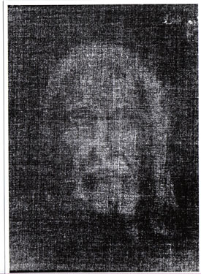
Shadow Shroud
N. D. Wilson produced interesting images using painted glass and sunlight (2005)
http://shroudstory.com/2014/12/12/only-the-shadow-knows/
http://www.shadowshroud.com/index.htm

Slide 44
Scorch Experiment
Done by skeptic Colin Berry with a small brass crucifix
Not clear how well it would scale
Provides some apparent 3D
Problem: Scorches fluoresce and image does not fluoresce
https://shroudofturinwithoutallthehype.wordpress.com/2013/11/14/a-challenging-scorch-assignment-that-i-had-been-putting-off-and-off-and-off/

Slide 45
Leonardo da Vinci Painted It (15 April 1452 – 2 May 1519)
Clive Prince & Lynn Picknett think Leonardo faked the shroud and use his Savior of the World painting to try to prove it.
https://www.youtube.com/watch?v=N382dggI4C0

Slide 46
One Small Problem
Leonardo was not born until almost 100 years after the shroud was being shown in Lirey
A more obvious explanation for the Salvator Mundi of Leonardo is that he modeled it on the shroud

Slide 47
Medieval Photograph
Prof. Nicholas Allen Postulates minimum of two and possibly three exposures over a period of weeks to obtain the images
doesn't address the blood
images not 3D
uses materials not found on shroud
Critique by Barrie Schwortz:
http://www.reviewofreligions.org/385/is-the-shroud-of-turin-a-medieval-photograph-a-critical-examination-of-the-theory/

Slide 48
Dan Porter Checks In
Dan runs shroudstory.com
Rather a humorous example of poking fun at those who come up with theories of shroud fakery.
This was titled: Inspired by Colin Berry’s Experiments with Lemons . . .
So I Couldn't Resist
Photoshopping One Too
http://shroudstory.com/2014/09/30/inspired-by-colin-berrys-experiments-with-lemons/

Slide 49
The Shroud Inspires Artists
The Mysterious And Moving Character Of The Shroud Has Inspired Artists To Produce Shroud Representations
This May Account As We Have Seen For The 6th Century Art Explosion Noted By Vignon
2nd Life
Sunti Pichetchaiyakul Sculpture

Slide 50
Ray Downing's Images
Using Digital Technology and Artistry Downing Recovers "The Real Face of Jesus" From The Shroud of Turin
Ray Downing

Slide 51
Sculptor Luigi Mattei
Shroud sculpture inspired by the Shroud of Turin
http://pegponderingagain.com/2013/01/20/shroud-of-turin/
http://www.stthomasmore.net/STMS_Blog/1519569
Italian sculptor, Luigi Mattei

Slide 52
No Satisfactory Mechanism
for Image Formation
Surface Chemical Reaction STAR
gas diffusion (Vignon, Rogers)
Coronal Discharge STAR
Energy Release at Resurrection STAR*
Scorch from heated bas-relief STAR**
Rubbing with pigments or acids STAR
Painting STAR
(art of 1350’s incapable of creating a shroud-like image)
Early Photograph of Middle Ages STAR
highly implausible
Legend:
gold = NA
bold = Applicable
* the miracle hypothesis is not confirmable or
disconfirmable because it is wholly ad hoc
** scorches fluoresce, but shroud body image does not

Slide 53
Dr. John Heller ( 1921-1995) Dr. Alan Adler (1932-2000)
John Wrote The Best book on the work of the STURP team
Together Demonstrate That The Blood Was Really Blood
Identified The Chromophore As Oxidized Linen
Blood Before Image
John Heller
Al Adler

Slide 54
The Unscientific Hypothesis
Miracles, if they occur, lie outside the realm of science … Well almost? What of side effects?
"I think you should be more explicit here in step two."

Slide 55
Lots Of Miracle Hypotheses
Body Emits Radiation
Neutrons, Protons, UV photons, etc.
Body Dematerializes in a shell of energy
cloth falls through the shell leaving an image
The Flash of the Resurrection
Some sort of Quantum Mechanical Event
PURELY SPECULATIVE HYPOTHESIES ALTHOUGH SOME CAN BE SIMULATED

Slide 56
Two Kinds Of Miracles
Miracles of the First Kind
Supernatural intervention transcending nature
Genesis 1:3 ³ Then God said, “Let there be light”; and there was light.
Miracles of the Second Kind
A "miraculous result" occurs due to a combination of a large number of individually improbable events which produce an unlikely but spiritually meaningful result

Slide 57
The Flash of Resurrection?
Kevin Moran and Giulio Fanti Explore A VP-8 Analyzer At The 2008 Columbus Conference
Moran Favors Some Kind Of Resurrection Flash
Fanti Supports Coronal Discharge

Slide 58
Radiation
Dr. August Accetta * had this image taken after being injected with a radioactive material (Tc-99m) used in medical imaging
Technesium-99 metastable methylene diphosphate decays with a 6 hour half-life yielding a single 140 Kev gamma ray
Problem: Collimation
* Work done with Kenneth Llyons M.D. and John Jackson, Ph.D.
https://www.shroud.com/pdfs/accett2.pdf

Slide 59
Coronal Discharge
Professor Giulio Fanti believes that coronal discharge could explain the shroud image
Giulio has done a lot of good science
Coronal Discharge requires very high voltages

Slide 60
Bodily Dematerialization
In a 1990 paper in Shroud Spectrum International #34 John Jackson proposed a controversial theory
In the process of Resurrection the body became a shell of energy and dematerialized (became mechanically transparent)
The cloth falling through the space volume caused the energy (UV or soft x-ray) absorbed by surface fibers imprint image
http://www.shroud.com/pdfs/ssi34part3.pdf
https://www.academia.edu/9063899/The_Turin_Shroud_Was_Not_Flattened_Before_the_Images_Formed_and_no_Major_Image_Distortions_Necessarily_Occur_from_a_Real_Body

Slide 61
Is There A Way To Go Forward?
Can We Identify The Man of the Shroud?

Slide 62
The Christ Relics
Is This All The Evidence There Is?
If the Sudarium of Oviedo corroborates the shroud, what of other relics?
Perhaps a question for the future

Slide 63
STURP Peer Reviewed Papers
1. Accetta, J.S. and J.S. Baumgart, "Infrared Reflectance Spectroscopy and Thermographic Investigations of the Shroud of Turin," Applied Optics, Vol. 19, No. 12, pp. 1921-1929.
2. Avis, C., D. Lynn, J. Lorre, S. Lavoie, J. Clark, E. Armstrong, and J. Addington, "Image Processing of the Shroud of Turin," IEEE 1982 Proceedings of the International Conference on Cybernetics and Society, October 1982, pp. 554-558.
3. Devan, D. and V. Miller, "Quantitative Photography of the Shroud of Turin," IEEE 1982 Proceedings of the International Conference on Cybernetics and Society, October 1982, pp. 548-553.
4. Ercoline, W.R., R.C. Downs, Jr. and J.P. Jackson, "Examination of the Turin Shroud for Image Distorions," IEEE 1982 Proceedings of the International Conference on Cybernetics and Society, October 1982, pp. 576-579.
5. Gilbert, R., Jr. and M.M. Gilbert, "Ultraviolet-Visible Reflectance and Fluorescence Spectra of the Shroud of Turin," Applied Optics, Vol. 19, No. 12, pp. 1930-1936.
6. Heller, J.H. and A.D. Adler, "Blood on the Shroud of Turin," Applied Optics, Vol. 19, No. 16, 1980, pp. 2742-2744.
7. Heller, J.H. and A.D. Adler, "A Chemical Investigation of the Shroud of Turin," Canadian Society of Forensic Sciences Journal, Vol. 14, No. 3, 1981, pp. 81-103.
8. Jackson, J.P., E.J. Jumper and W.R. Ercoline, "Three Dimensional Characteristic of the Shroud Image," IEEE 1982 Proceedings of the International Conference on Cybernetics and Society, October 1982, pp. 559-575.
9. Jackson, J.P., E.J. Jumper, and W.R. Ercoline, "Correlation of Image Intensity on the Turin Shroud with the 3-D Structure of a Human Body Shape," Applied Optics, Vol. 23, No. 14, 1984, pp. 2244-2270.
10. Jumper, E.J. and R.W. Mottern, "Scientific Investigation of the Shroud of Turin," Applied Optics, Vol. 19, No. 12, 1980, pp. 1909-1912.
11. Jumper, E.J., "An Overview of the Testing Performed by the Shroud of Turin Research Project with a Summary of Results," IEEE 1982 Proceedings of the International Conference on Cybernetics and Society, October 1982, pp. 535-537.
12. Jumper, E.J., A.D. Adler, J.P. Jackson, S.F. Pellicori, J.H. Heller and J.R. Druzik. "A Comprehensive Examination of the Various Stains and Images on the Shroud of Turin," Archaeological Chemistry III, ACS Advances in Chemistry No. 205, J.B. Lambert, Editor, Chapter 22, American Chemical Society, Washington D.C., 1984, pp. 447-476.
13. Miller, V.D. and S.F. Pellicori, "Ultraviolet Fluorescence Photography of the Shroud of Turin," Journal of Biological Photography, Vol. 49, No. 3, 1981, pp. 71-85.
14. Morris, R.A., L.A. Schwalbe and J.R. London, "X-Ray Fluorescence Investigation of the Shroud of Turin," X-Ray Spectrometry, Vol. 9, No. 2, 1980, pp. 40-47.

Slide 64
STURP Papers (Continued)
15. Mottern, R.W., R.J. London and R.A. Morris, "Radiographic Examination of the Shroud of Turin - A Preliminary Report," Materials Evaluation, Vol. 38, No. 12 pp. 39-44.
16. Pellicori, S.F., "Spectral Properties of the Shroud of Turin," Applied Optics, Vol. 19, No. 12, pp. 1913-1920.
17. Pellicori, S. and M.S. Evans, "The Shroud of Turin Through the Microscope," Archaeology, January/February 1981, pp. 34-43.
18. Pellicori, S.F. and R.A. Chandos, "Portable Unit Permits UV/vis Study of 'Shroud'," Industrial Research and Development, February 1981, pp. 186-189.
19. Schwalbe, L.A. and R.N. Rogers, "Physics and Chemistry of the Shroud of Turin, A Summary of the 1978 Investigation," Analytica Chimica Acta, Vol. 135, 1982, pp. 3-49.
20. Schwortz, B.M., "Mapping of Research Test-Point Areas on the Shroud of Turin," IEEE 1982 Proceedings of the International Conference on Cybernetics and Society, October 1982, pp. 538-547.
21. Bucklin, Robert, "The Shroud of Turin: a Pathologist's Viewpoint," Legal Medicine Annual, 1982. (No page numbers available)
22. Dinegar, Robert Hudson. "The Shroud of Turin - A Look at the Overall Picture," The Living Church, May 17, 1981, pp. 9-11.
23. Jumper, E.J., K. Stevenson, Jr., and J.P. Jackson. "Images of Coins on a Burial Cloth?," The Numismatist, July 1978, pp. 1349-1357.
24. Miller, V., and D. Lynn, "De Lijwade Van Turjin," Natuur en Techniek, February 1981, pp. 102-125.
25. John P. Jackson, Eugene Arthurs, Larry A. Schwalbe, Ronald M. Sega, David E. Windisch, William H. Long, and Eddy A. Stappaerts, "A New Tool for Cellulose Degradation Studies," Materials Issues in Art and Archaeology: Symposium held April 6-8, 1988, Reno, Nevada, U.S.A., Ed. Edward V. Sayre et al., Materials Research Society 123, pp. 311-316 (1988).
26. John P. Jackson, Eugene Arthurs, Larry A. Schwalbe, Ronald M. Sega, David E. Windisch, William H. Long, and Eddy A. Stappaerts, "Infrared Laser Heating for Studies of Cellulose Degradation," Appled Optics 27(18), 3937-3943 (1988).
27. R. H. Dinegar and L. A. Schwalbe, "Isotope Measurements and Provenance Studies of the Turin Shroud," in Archaeological Chemistry IV, Ed. Ralph O. Allen, Advances in Chemistry Series 220 (American Chemical Society: Washington, DC, 1989) Chapter 23.
28. Raymond N. Rogers, "Studies on the radiocarbon sample from the Shroud of Turin," Thermochimica Acta Vol. 425, Issues 1-2, 20 January 2005, Pages 189-194

Slide 65
Next Time
We've Seen A Lot About The Shroud of Turin
We've Looked At Correspondences With The Passion Accounts In Scripture
We've Looked At Much Of The Science
We Explored The History
We've Looked At Image Characteristics And The Attempts Made To Duplicate The Shroud
NEXT TIME WE'LL WEIGH THE EVIDENCE AND LOOK TOWARDS THE FUTURE

