Slide 1
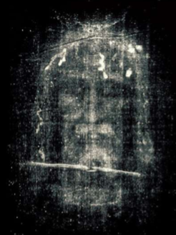
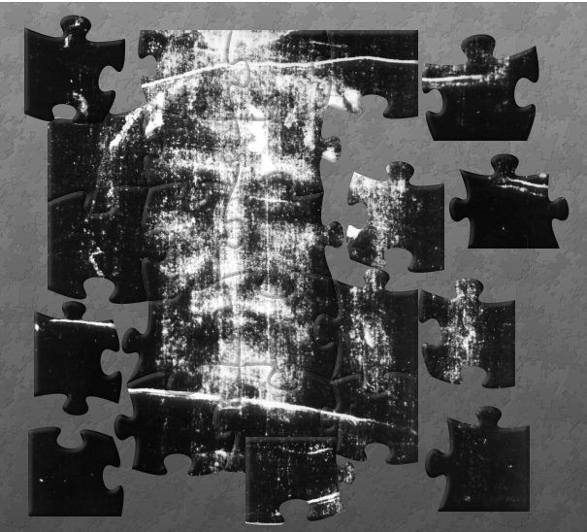
The Shroud of Turin an Enduring Mystery Part 5: Integration & Conclusions
Dr. Ray Schneider, P.E., Ph.D.
Associate Professor Emeritus
Bridgewater College, Virginia

Slide 2
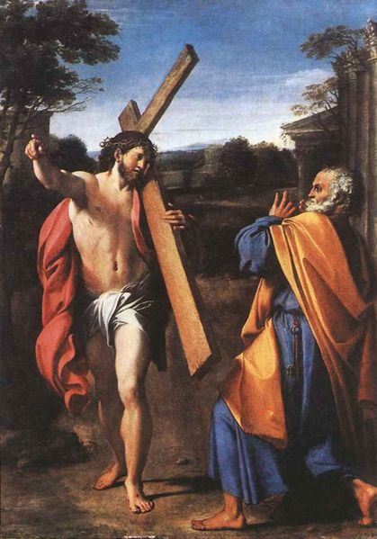
Where Are You Going?
Peter is said to have encountered Jesus carrying his cross towards the city of Rome as Peter fled Nero's persecution.
Peter said "Quo Vadis Domine?" — Where are you going Lord?
This is a question we should contemplate as we sum up our investigations of the Shroud of Turin

Slide 3
The Path We've Traveled
Religion —> Science —> History—>Image
TODAY
Weighing the Evidence
Russ Breaut's Christian Perspective
Thoughts For The Future
New Results
Where Things Might Go
The Final Challenge

Slide 4
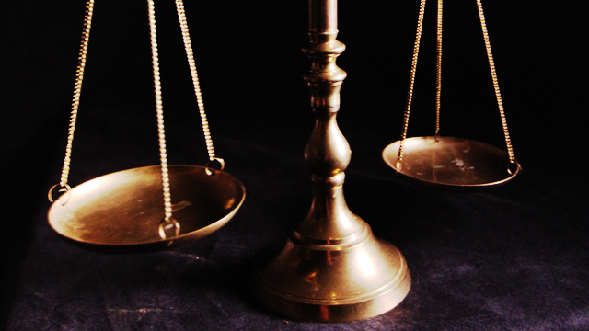
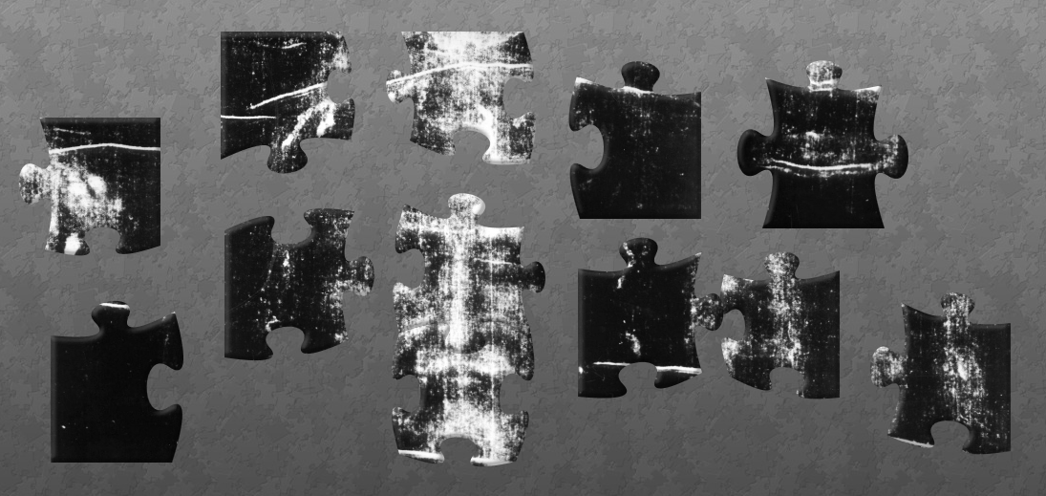
Weighing The Evidence
Direct Observation
Witnesses
Correct Interpretation
Understanding
Correspondences With Other Known Truths
Correlation and Explanatory Principles
Coherence
It All Fits Together
What Is Truth?
— Pilate's Question

Slide 5
Coherence
Jerusalem
- Antioch
Edessa
Constantinople
- Athens
- Othon de la Roche
- Knights Templar
- Besancon
Lirey
Chambery
Turin
Sudarium
Shroud
Pollen
Correspondences
SILENCE
Constantine
Mandylion
- tetradiplon
Shroud
ART
Vignon Markings
UNIQUE FEATURES
Negative
Three Dimensional
Superficial Image
Medical Fidelity
Areal Density Image
Historical/Crucifixion Fidelity
DATING METHODOLOGIES
- Carbon Dating
- Vanillin Extinction
- FTIR
- Raman Spectroscopy
- Breaking Strength

Slide 6
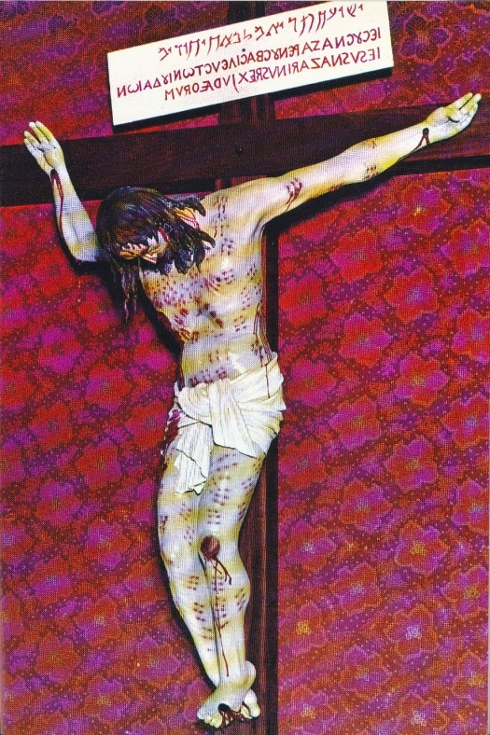
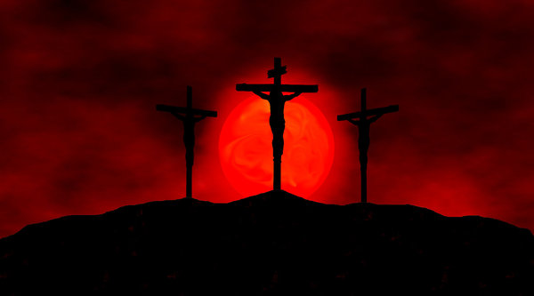
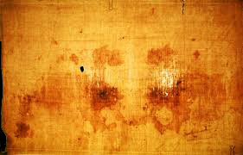
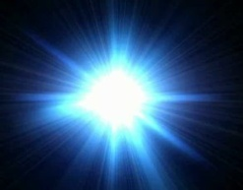
Coherence
Religion
Beaten
Scourged
Crowned with thorns
Carried his cross
falling
Nailed to the cross
through the wrists
Died
Pierced
Buried
RAISED
Authenticity
A Cloth That Wrapped
His Head
A Blood Moon
An Empty Tomb

Slide 7
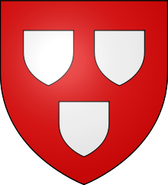
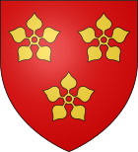
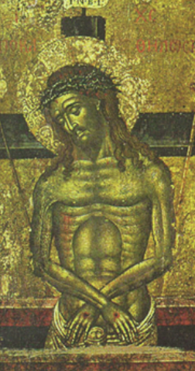
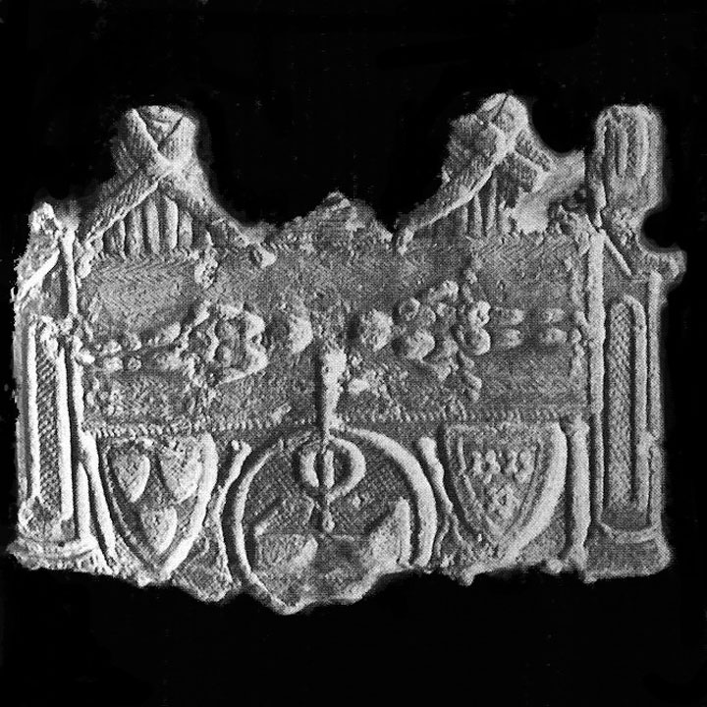
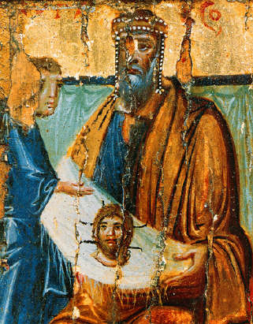
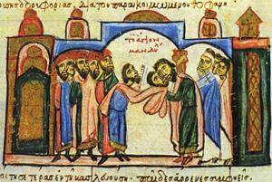
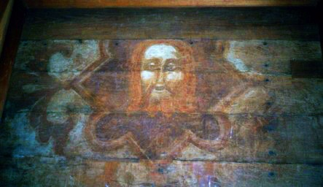
Coherence
History — A Thread of Reality from an Empty Tomb to a Journey from Jerusalem to Europe
The Timeline
70
A Journey
to Edessa
544
944
1204
1355
the Present
?
EDESSA
?
KNOWN HISTORY
30-33 A.D.
CONSTANTINOPLE
A Templar Connection

Slide 8
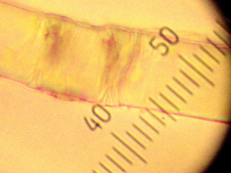
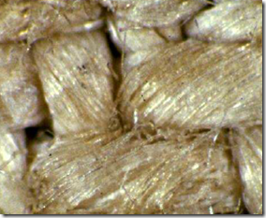
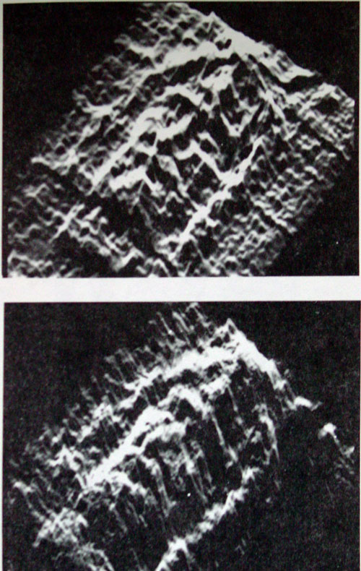
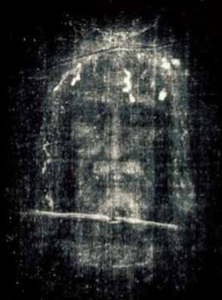
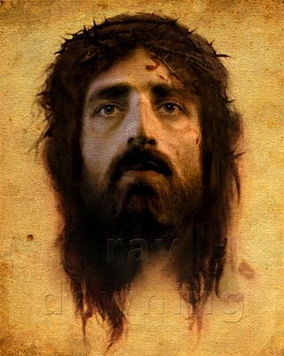
Coherence
The Challenge of the Image
Negative
Superficial
Three Dimensional
Areal Density
Resolution

Slide 9
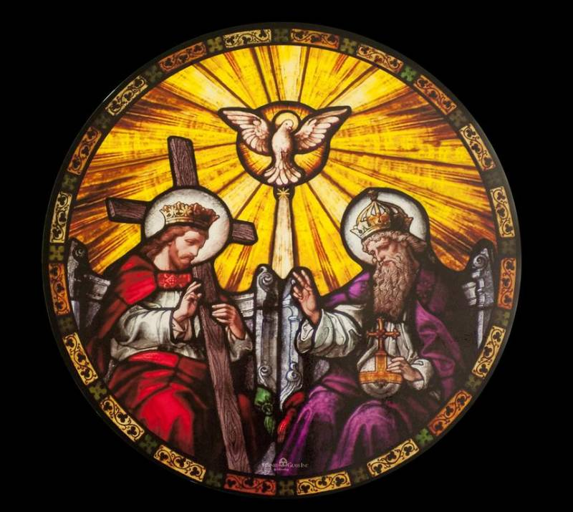
Who Do Men Say That I Am?
Is There A Message We're Missing?
Russ Breault Thinks So

Slide 10
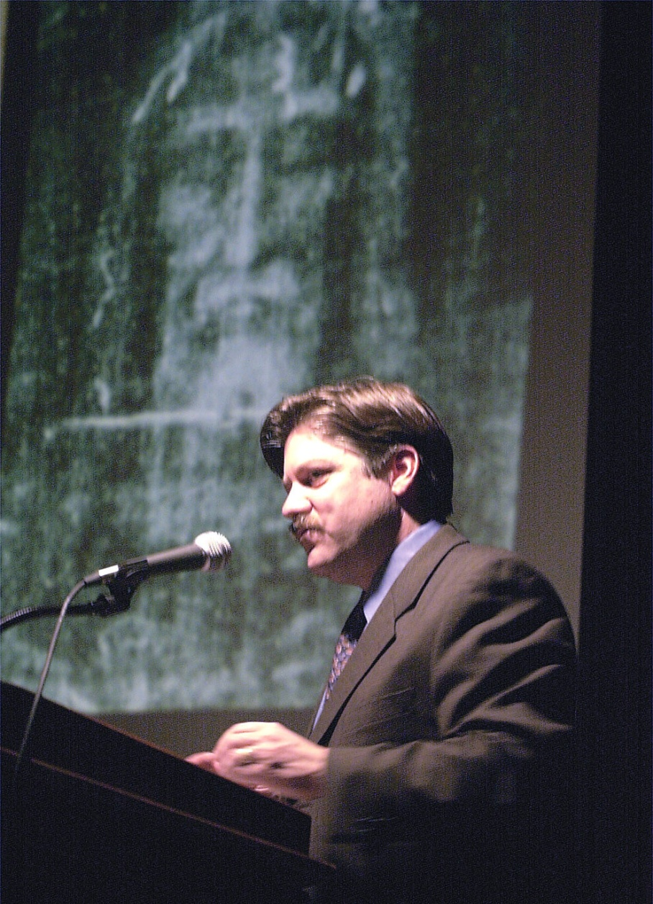
Russ Breault's Seven Secrets
Beyond Science/ Beyond History
Seven Key Concepts
Shroud Reflects The Light Of Scripture
Sooooooo…..
The Seven Concepts Are Derived Directly From Russ Breault's Shroud Encounter: Seven Secrets
I've only condensed his presentation

Slide 11
Concept One
Is There A Message In The Mystery?
The Irony
If the shroud were merely a work of art we'd have figured it out years ago. After thousands of hours of analysis: It Remains A Mystery!
An Argument for Authenticity
All The Deep Things of God are MYSTERIES
Incarnation, Resurrection, Calm a Storm, Feed 5,000 with a few fish and loaves …
Maybe The Mystery Is The Message

Slide 12
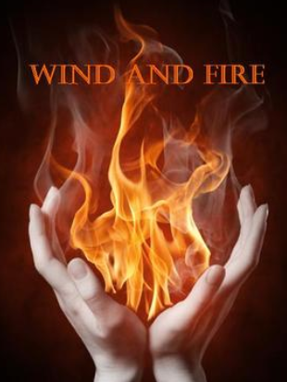
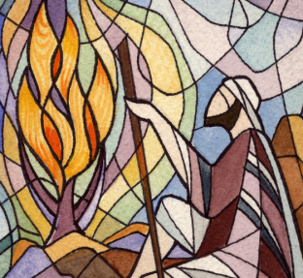
Concept Two
When Is A Scorch NOT A Scorch?
Nature of the Shroud Image
no pigment, superficial, looks like a scorch but image does not fluoresce under UV while scorches do, so image not caused by heat.
Reminds You Of Other Appearances
When Is A Wind Not A Wind? Pentecost As The Spirit Descends
When Is A Fire Not A Fire? Tongues of Fire and Burning Bushes
Moses Came Down From The Mountain, His Face Radiant
Clues to the Shroud Image?
WHEN IT IS LIGHT AND NOT HEAT?
LIGHT THE FIRST ACT OF CREATION
And of course the Transfiguration

Slide 13
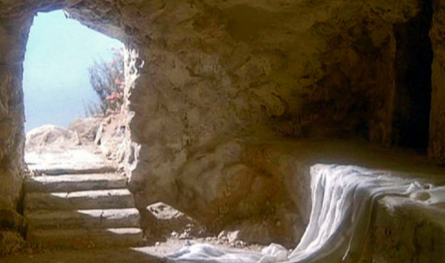
Concept Three
The Witness
Biblical Principle: The Truth of Any Matter is Established by the Testimony of Two or Three Witnesses
The best single reason why the shroud must be authentic.
Every Miracle of Jesus Had Numerous Eye Witnesses
All His Appearances After the Resurrection too!
But NO Eyewitnesses For The Resurrection Itself? What!?
Preposterous! God doesn't violate His own word. The most significant miracle of them all! There must be two or three witnesses. We just have to find them.
First Witness: THE EMPTY TOMB
Second Witness: THE VACANT BURIAL SHROUD
Third Witness: THE NAPKIN THAT WAS AROUND HIS HEAD
The Sudarium of Oviedo
ALL THREE GIVE WITNESS STILL TODAY
A Witness For All Generations

Slide 14
Concept Four
Proof Of Purchase (Four Words)
Bought "You are not your own; you were bought at a price." 1 Cor 6: 19-20
Purchased "Therefore take heed to yourselves and to all the flock … which he purchased with His own blood." Acts 20:28
Redeemed "Knowing that you were not redeemed with corruptible things, like silver or gold … but with the precious blood of Christ … " 1 Peter 1: 18-19
Ransom "For even the Son of Man did not come to be served but to serve, and to give his life as a ransom for many." Mark 10:45
A Transaction Has Occurred. A Payment Has Been Made On Our Behalf. So Where Is The Receipt?
Shows the price that was paid and after than proof of purchase
The Shroud of Turin is not only a receipt, it is an itemized receipt.
Crown of Thorns, Wound in Side, Severe Scourging, Nail Wounds in Hands and Feet
Proof of Purchase: We Have Been Purchased, We Belong To Christ, and We Have A Receipt to Prove it! PAID IN FULL

Slide 15
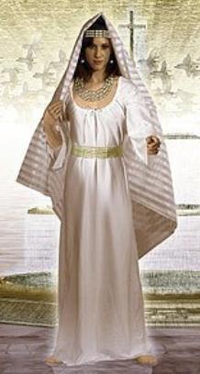
Concept Five
The Theology of Linen
Significant Meaning From Genesis to Revelation
Jesus' Life Beging in Swaddling Clothes and Ends in a Burial Shroud
Fine Twisted Linen mandated for the tabernacle (Ex 26:1) required for priestly tunics (Ex 39:27) David clothed in fine linen (1 Chron 15:27) Seven angels clothed in spotless white linen (Rev 15:5-6) Wedding of the Lamb, the bride wears fine linen bright and clean (Rev 19: 7-8)
The Shroud is Fine Twisted Linen (expensive and rare)
The Answer Wrapped Up In Joseph of Arimathea
A Pharisee, Connected with Temple, Access to the Temple Store, Did He Purchase a Cloth of "fine twisted linen" to Send a Message?

Slide 16
… we have a great high priest
who has ascended into heaven,
Jesus the Son of God, … (Heb 4:14)

Slide 17
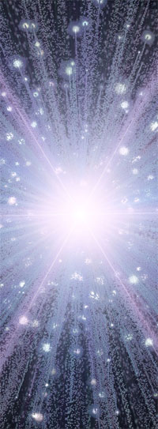
Concept Six
Transformation
Is the Shroud a Sign? For What Purpose?
Thoughts on the First Miracle: Water to Wine
A sign of Transformation: the effect of the ministry — The Message of Transformation
First of the Signs Through Which He Revealed His Glory … John 2:11
… these are written that you may believe … the purpose of the Word and the Shroud are the same. … believing you may have life in His name … John 20:30-31
A Sign of Transformation
Water, Blood, Spirit

Slide 18
Transformation

Slide 19
Concept Seven
The Face
Old Testament: No one ever saw the Face of God
Moses said: "Now show me Your GLORY." and God replied "You cannot see My FACE for no one may see me and live … you may see My back, but My FACE must not be seen." Exodus 33:18-23
New Testament:

Slide 20
Everything Changes

Slide 21
The Blessing of the Lord

Slide 22
I Will Set My Face Against You

Slide 23
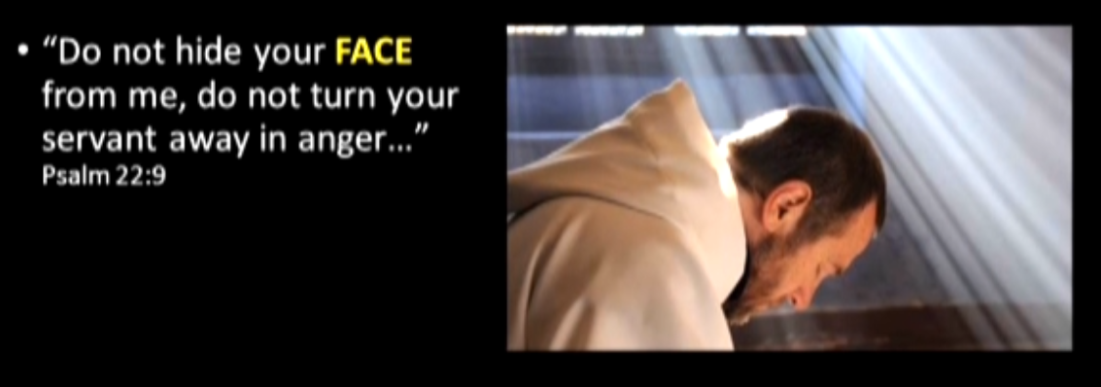
When God Hides His Face: Destruction
David Pleads With God:

Slide 24
Our Rebellion Turns God's Face Away
What We Must Do

Slide 25
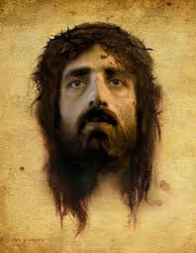
The FACE of Christ

Slide 26
"Show Us The Father"

Slide 27
It Is Finished!

Slide 28
Unconditional Love With Conditional Acceptance

Slide 29
Opening The Door

Slide 30
Seven Powerful Theological Proofs
It Remains A Mystery
When Is A Scorch NOT A Scorch?
The Witness — There Must Be Three Witnesses
The Shroud Is A RECEIPT — A Proof Of Purchase
It Is Fine Linen Suitable For A High Priest About To Enter The Holy of Holies
Transformation!
The Face — We Are Totally Accepted In Christ

Slide 31
Time For A Short Intermission
Come Back In Ten Minutes

Slide 32
Death & Resurrection
The Shroud Clearly Shows Death
BUT
Does It Also Show Resurrection?

Slide 33
Remember Two Kinds Of Miracles?
Miracles of the First Kind
Supernatural intervention transcending nature
Genesis 1:3 ³ Then God said, “Let there be light”; and there was light. (RESURRECTION?)
Miracles of the Second Kind
A "miraculous result" occurs due to a combination of a large number of individually improbable events which produce an unlikely but spiritually meaningful result (IMAGE?)

Slide 34
Two Presentations
From The October 2014 St. Lewis Conference
Robert A. Rucker's Paper, "MCNP Analysis of Neutrons Released from Jesus' Body in the Resurrection" and (Miracle of the First Kind?)
D.S. Spicer and E .T. Toton's Paper, "Electric Charge Separation as the Mechanism for Image Formation on the Shroud of Turin: A Natural Mechanism" (Miracle of the Second Kind?)
Images from the two papers at the St. Louis Shroud Conference of October 2014 have been 'liberated' and in some cases color inverted for display purposes to give you a summary of the papers. You can find links to the papers at http://www.shroud.com/stlouis.htm

Slide 35
A Miracle of the First Kind? Neutron Flux Causes C¹⁴ Enrichment
Slides from Robert A. Rucker's Paper "MCNP Analysis of Neutrons Released from Jesus' Body in the Resurrection"

Slide 36
How Do We Resolve These?

Slide 37
One Hypothesis To Solve Them All

Slide 38
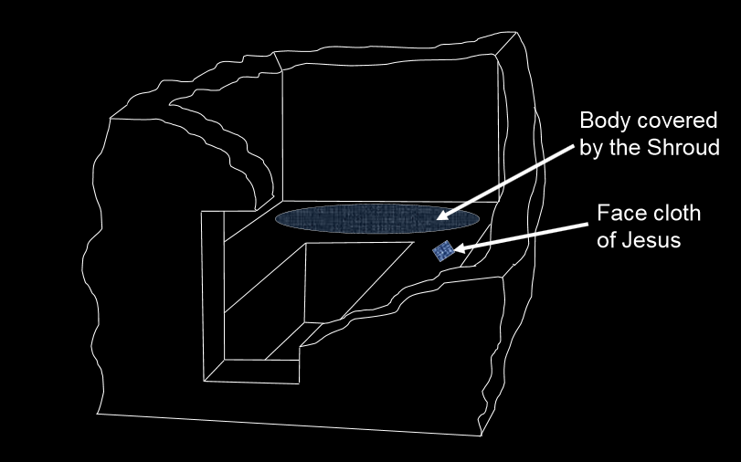
A 3D Model of the Tomb
Sudarium of Oviedo

Slide 39
Simple Volumetric Model of Body
SIDE VIEW
TOP VIEW

Slide 40
Predicted Dates By Location

Slide 41
Fit To C¹⁴ Results

Slide 42
Summary

Slide 43
A Better Protocol for C¹⁴ Sampling
In the Future This Is Testable With A Better Carbon Fourteen Sampling Protocol
But This Doesn't Explain The Image
D.S. Spicer and E .T. Toton's Electric Field Entraining Polar Molecules Offers to Do That
Beyond Vignon and Rogers
An Electric Vaporograph Theory
Explaining the Image with Electric Fields And Polar Molecules

Slide 44
A Miracle of the Second Kind? A Natural Explanation for the Image
Six Features to Explain
Images on the cloth exist only of the dorsal and ventral surfaces of body and these images lie only on the fibers found at the extremities of the cloth
2. No image or discoloration exists between the two surfaces of cloth, i.e., within the cloth
3. There is no image of the top of the head or sides of the body enclosed by the cloth
4. The image density on the cloth appears to embody information on the vertical distance between the cloth and the portion of the ventral body imaged, as if the cloth were held flat and horizontal slightly above the body or, in the case of the dorsal image, between the cloth on either the floor or shelf on which the body lied and the back of the body. In essence, the closer the cloth was to the body the darker the image, and the farther away the fainter the image
5. A body image is visible in areas where there was no contact between the body and the cloth
6. The coloration does not appear under the threads where they cross in the weave of the cloth

Slide 45
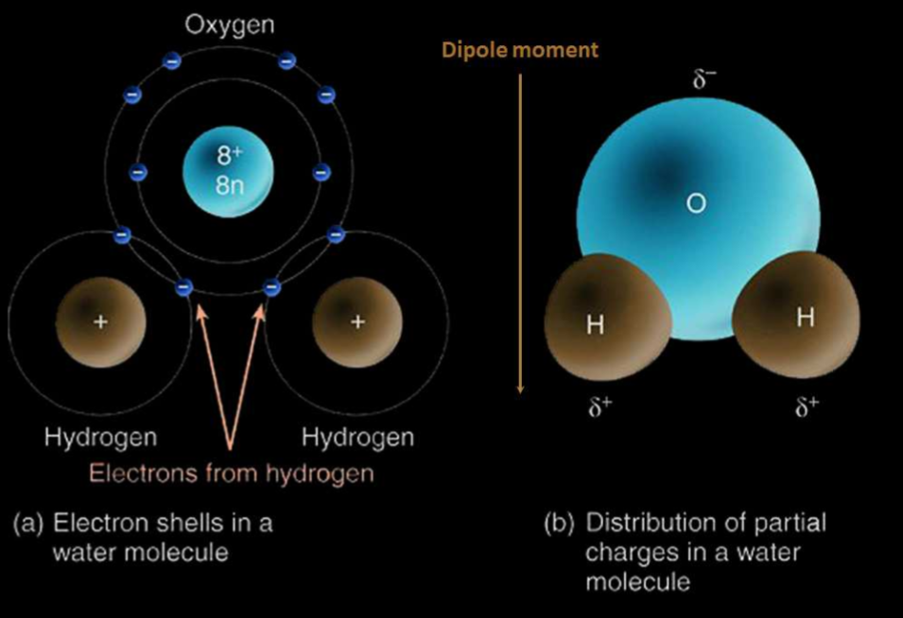
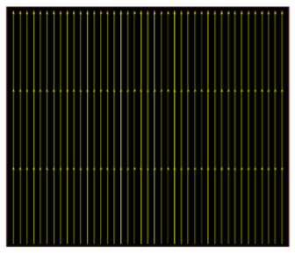
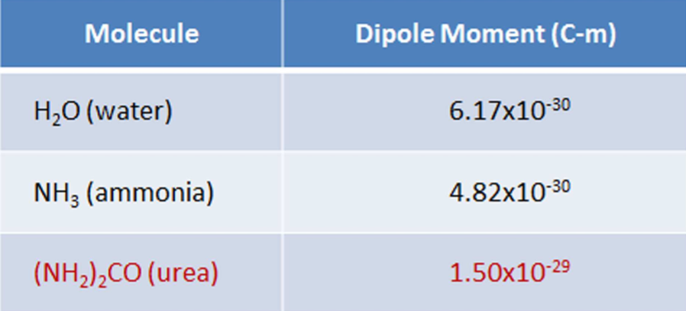
Collimation: A Quasi-static Electric Field
An Electric Field and Polar Molecules
…the urea molecule has a large polar moment, when it diffuses from the body the end of the molecule with a complementary charge preferentially attaches to the molecular charge exposed on the outer surfaces of the dielectric cloth.

Slide 46
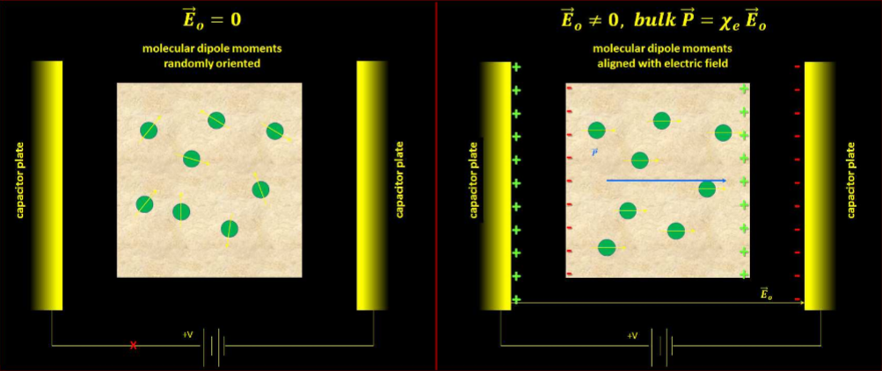
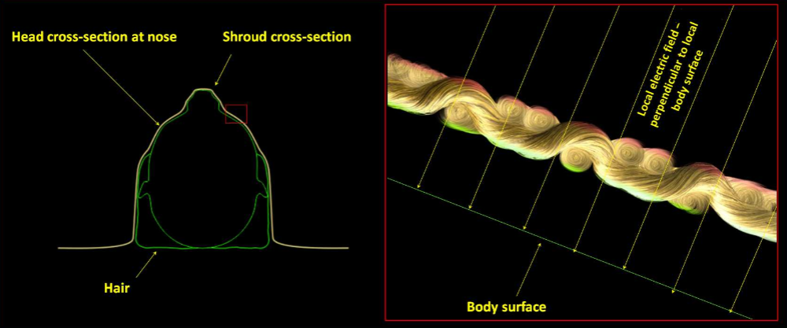
Entrained Polar Molecules Selectively Attach to Surface of Cloth
Resolution

Slide 47
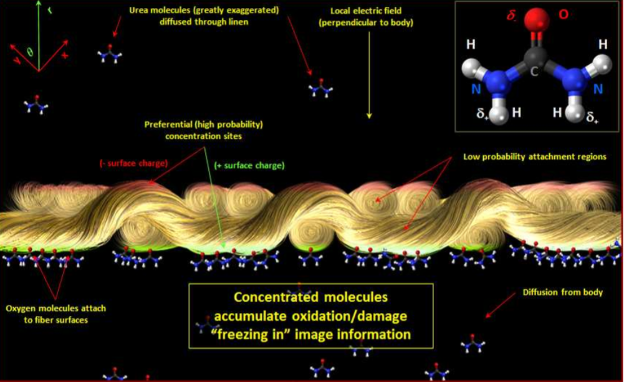
Interaction Selectively Oxidizes the Linen Freezing In the Image
Polar molecule entrainment and surface response

Slide 48
Testing the Hypothesis
Given the theory the whole process could be numerically simulated using a large computer code
It might be easier however to actually test the hypothesis experimentally with a model, urea, and a cloth
This is an example of a Miracle of the Second Kind, multiple relatively rare factors combining to produce an unexpected and religiously significant result

Slide 49
Moving On
We'll Look At Two More Interesting Things
Better Images With Meaningful Data
What if we had a complete high resolution image of the shroud at the resolution of the Mark Evans micrographs? Suppose it was a high resolution multispectral image. What could we do?
What If We Could Actually Identify The Man?
DNA? But we don't have a reference sample of Jesus's DNA … How Would That Work?

Slide 50
HAL 9000 Images
The most recent image of the shroud is that taken by HAL 9000, a company specializing in art photography that obtained permission to take an extraordinarily high definition composite image of the shroud on 22 January 2008. This image is composited from over 1600 credit card sized images for a total image of 12.8 billion pixels. It amounts to about 72 gigabytes of image data.

Slide 51
HAL 9000 Images
Contrast HAL 9000 image with Durante 2002 from Shroud Scope, second HAL 9000 image equalized version of first

Slide 52
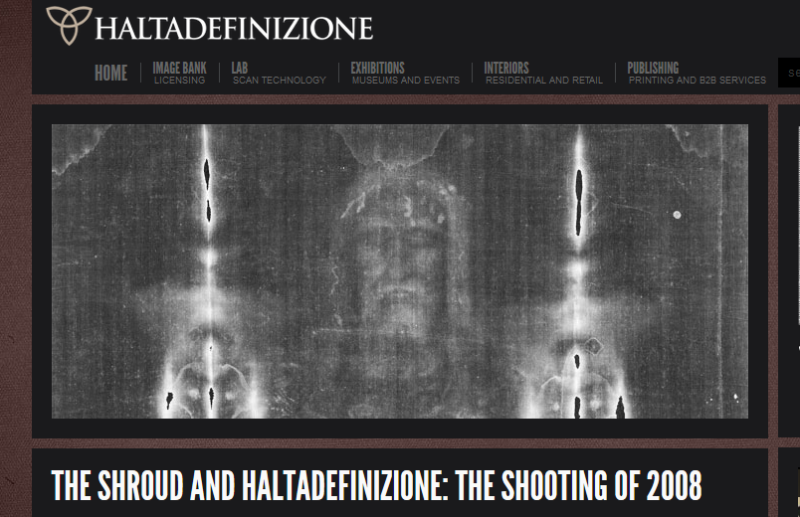
http://www.haltadefinizione.com/en/the-shroud.html

Slide 53
Unfortunately
The HAL 9000 images have not been released to researchers and they are not multispectral
Still they are the best available until better images come along
An iPad app has been introduced called Shroud 2.0 but images are heavily watermarked and not very useful to researchers.

Slide 54
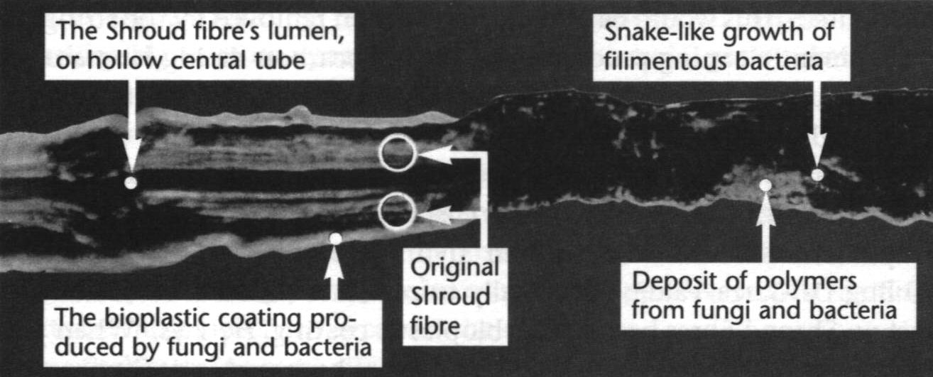
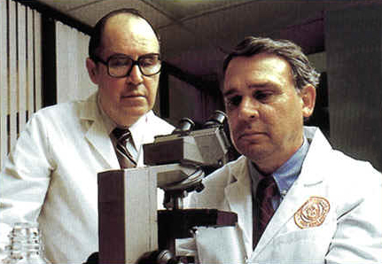
Dr. Leoncio A. Garza-Valdes (1939-2010)
Suggested that bacterial deposits very resistant to chemical cleaning produced impurities on the C14 samples which could substantially skew the carbon dates.

Slide 55
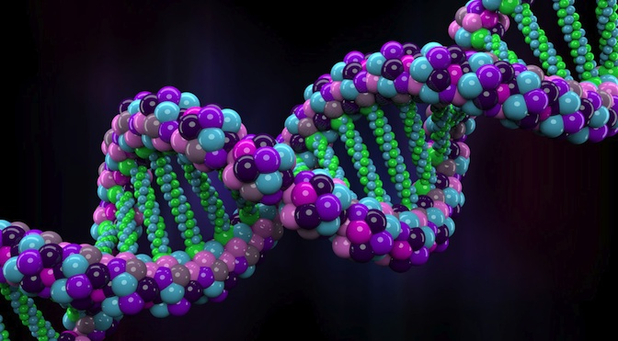
What About DNA?
There is undoubtedly a lot of DNA on the shroud from a lot of different individuals
What can we know for sure?

Slide 56
The Blood On The Shroud
"A Critical (Re)evaluation of the Shroud of Turin Blood Data:Strength of Evidence in the Characterization of the Bloodstains"
Presented by Kelly P. Kearse, Ph.D.
He reviewed a lot about the fact that the blood is human blood and that it is type AB
Then he talked about DNA

Slide 57
No DNA In Red Blood Cells
DNA in White Blood Cells, about 1% of Blood

Slide 58
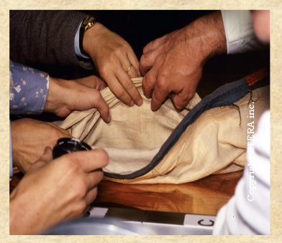
Can't Tell Where It Came From
Comparing from multiple sites would help
Contamination Is Impossible
To Rule Out

Slide 59
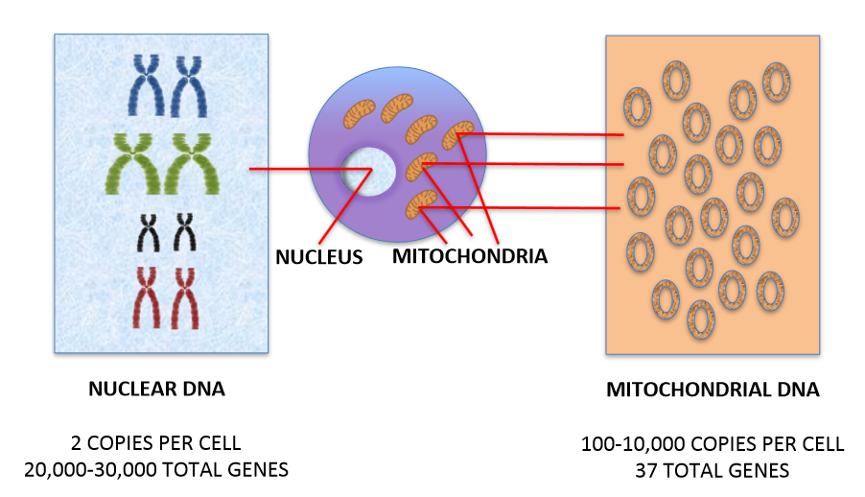
Two Kinds Of DNA

Slide 60
Connecting The Dots
Multiple Samples From Same Artifact
Multiple Samples From Different Related Artifacts
The Connecting Link: Common DNA From The Same Individual
Nuclear DNA Inherited from Both Parents
Mitochondrial DNA Inherited from Mother
Comparing DNA from the Shroud and the Sudarium as well as other possible relics could demonstrate that a single individual was common to multiple relics (validating the relic and isolating the individual)

Slide 61
Bruno Barberis President of the International Center of Sindonology Turin
Barberis recently said: "We need new data if we want to continue in the search", and proposes "to organize a real laboratory around the Shroud"

Slide 62
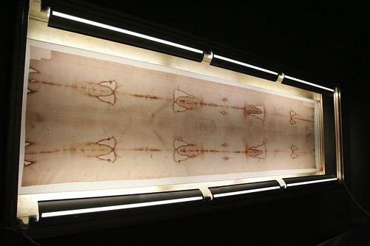
The Future Awaits
There Are Still Many Avenues Of Exploration
Further Clarification of the History and Science Can Only Increase Our Understanding Casting Light On This Enduring Mystery

Slide 63
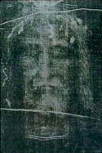
Who Do You Say That "I Am"?
Perhaps I've Only Served To Increase Your Mystification
What Is The Shroud of Turin?
RELIC or ICON
What Does It Mean?
Finally,
You Must Decide

Slide 64
A Plug for STERA

